Slide 1
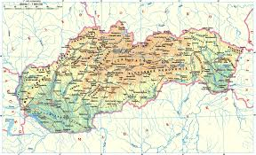
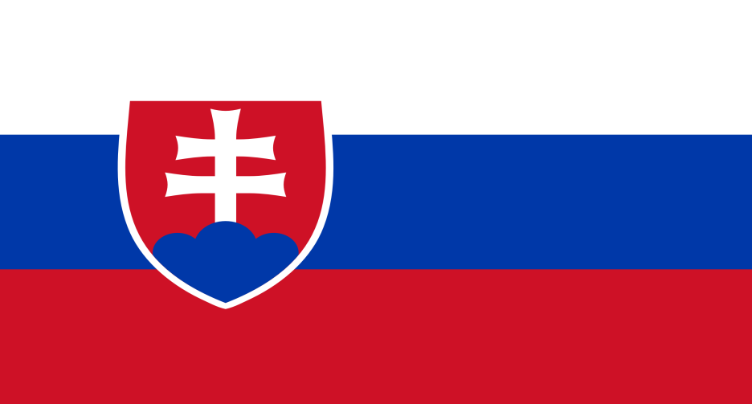
Tour the slovakia
Lenka Púšová, Lucia Grznárová

Slide 2
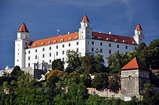
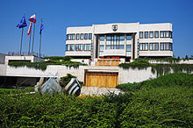
Bratislava
Capital city
Largest city
Bratislava castle
Grassalkovich palace
National council

Slide 3
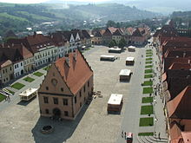
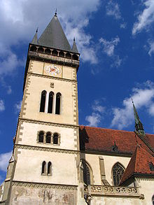
Bardejov
UNESCO
Town square
Church St. Edígia

Slide 4
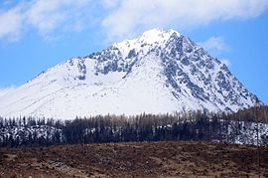
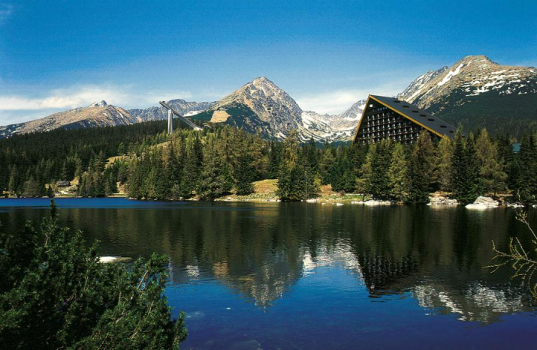
High TAtras
North Slovakia
Gerlachovský štít
Štrbské pleso

Slide 5
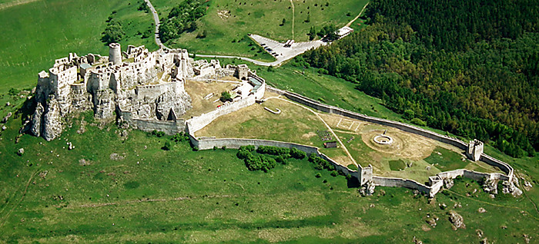
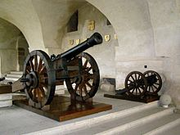
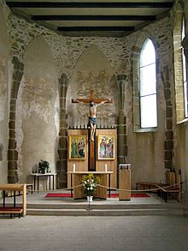
Spišský Castle
Largest
UNESCO
Museum of weapons
Chapel St. Elizabeth

Slide 6
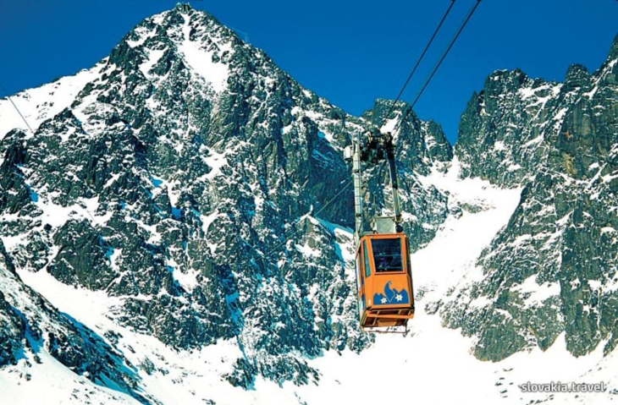
Lomnický peak
2. largest
Acess with cable car
Beautiful scenery
Near is luxurious hotel

Slide 7
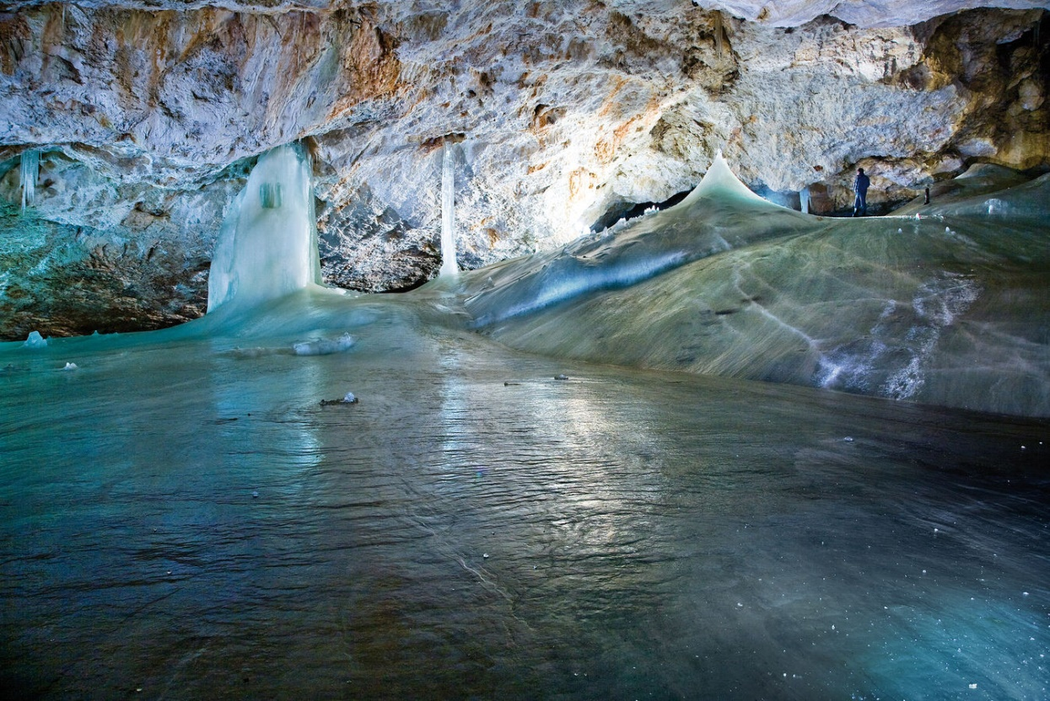
Dobšinská ice cave
Largest ice cave
UNESCO
Big iced hall

Slide 8
Thanks for attention

