Slide 2
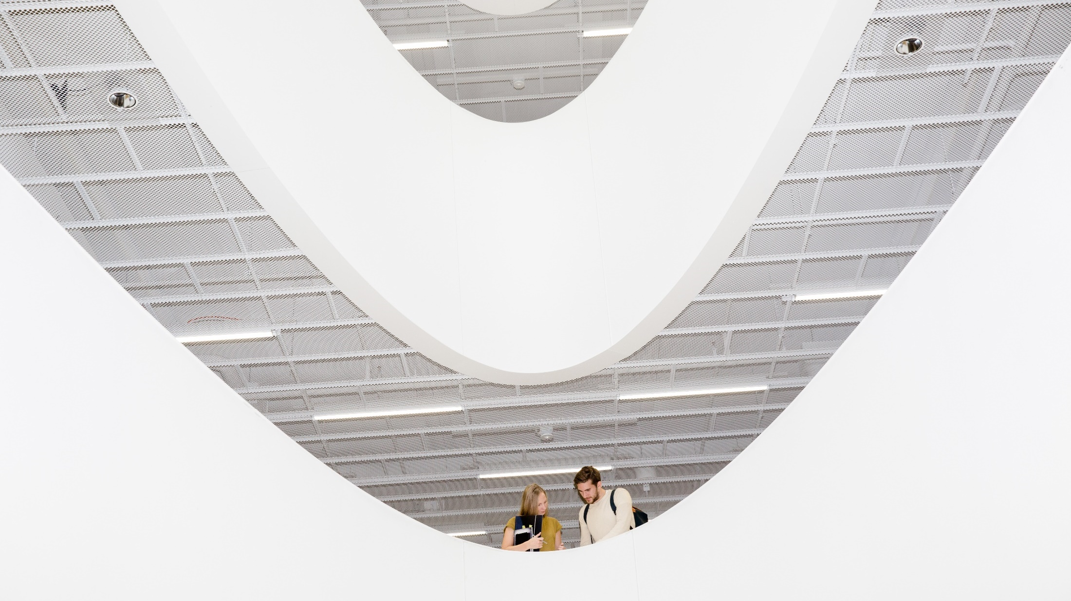
The FINNISH education system &
EDUCATION SERVICES and solutions
Photo: Sakari Piippo
Notes:
Photo: Sakari Piippo

Slide 3
Education is the key to evolve and adapt in the changing world. Education helps us meet the requirements of future jobs and improves our standard of living while mitigating climate change.
The system in one country cannot be copied, but good practices can be adapted to another when co-creation takes place. People, new knowledge, digital technologies, learning philosophies, flexible structures, and processes can cross borders.
Finland has great strengths and proven track record in education, which can be shared with other countries.
Notes:
OECD (2019), “Preparing for the changing nature of work in the digital era”, OECD Going Digital Policy Note, OECD, Paris,
www.oecd.org/going-digital/changing-nature-of-work-in-the-digital-era.pdf

Slide 4
FINLAND HAS ONE OF THE BEST PERFORMING EDUCATION SYSTEMS IN THE WORLD
#1
EDUCATING FOR THE FUTURE INDEX
(Economist 2019)
#1
DIGITAL SKILLS
(WEF Global Competitiveness Report 2020)
#2
TERTIARY EDUCATION SYSTEM DELIVERS NEEDS OF EMPLOYERS
(WEF Global Competi-
tiveness Report 2020)
#1
THE HAPPIEST COUNTRY IN THE WORLD
(World Happiness Report 2021)
Notes:
Sources:
#1 EDUCATING FOR THE FUTURE INDEX: https://educatingforthefuture.economist.com/the-worldwide-educating-for-the-future-index-2019/
#1 IN DIGITAL SKILLS: WEF Global Competitiveness Report 2020: http://www3.weforum.org/docs/WEF_TheGlobalCompetitivenessReport2020.pdf
#2 BEST PLACED TERTIARY EDUCATION SYSTEM TO DELIVER TO THE NEEDS OF EMPLOYERS: WEF Global Competitiveness Report 2020: http://www3.weforum.org/docs/WEF_TheGlobalCompetitivenessReport2020.pdf
#1 THE HAPPIEST COUNTRY IN THE WORLD: World Happiness Report 2021 https://worldhappiness.report/

Slide 5
THE FINNISH EDUCATION SYSTEM IN A NUTSHELL

Slide 6
Education for all
The development of the whole education system takes time. During the first years of the 20th century, only a third of rural children went to school.
The 1921 act on compulsory education started the path towards a modern education system based on the philosophy of education for all.
Today education from pre-primary to higher education is free of charge for Finns and citizens from EU/ETA countries. Early childhood education and care is subsidized.

Slide 7
History
1943
Law on free-of-charge school meals. All pupils have been served free school lunch during each school day since 1948.
1973
Act on Children’s Day Care. Local authorities are obliged to organize public day care, which allows both parents to participate in working life.
1921
Compulsory School Attendance Act. Municipalities are obliged to provide six years of compulsory education to all children aged 7 to 13.
1972
School reform. New comprehensive school system with 9 grades guarantees same opportunities for good quality education in a school nearest to you.

Slide 8
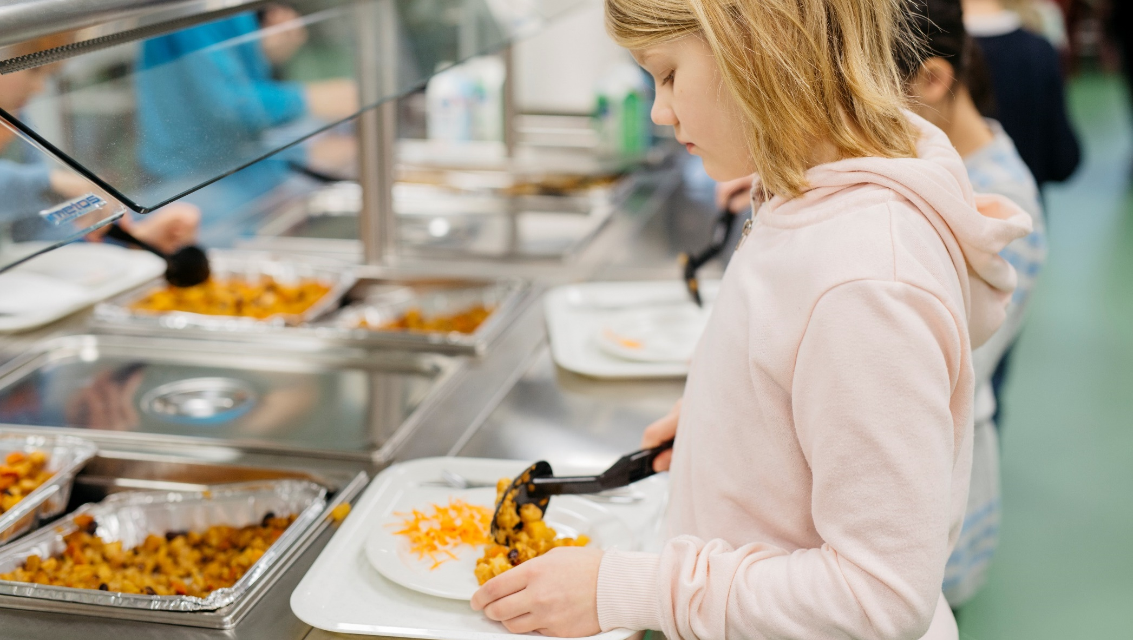
School meals work as an equalizer between children from different backgrounds, strengthen equal opportunity and most importantly, promote learning.
Photo: Elina Manninen/Keksi
Notes:
All pupils in Finland from pre-primary to upper secondary schools get a free-of-charge, nutritious school meal each day. In higher education, students get a meal subsidy.

Slide 9
History
1994, 2004, 2014
The national core curriculum and the education system have been reformed several times
1994
Requirement of master's level education for all basic education teachers
1985
Shift from a unified curriculum to a national core curriculum with local adaptations
1990s
Strong decentralization of education system. Abolishment of School inspectorate system, School books no longer centrally approved.
1996
Introduction of the dual model in higher education: academic universities & universities of applied sciences.

Slide 10
History
2018
Reform of secondary vocational education to introduce competence-based qualifications and a close co-operation with workplaces
2010
Introduction of the principal of inclusion in Finnish schools
1995
First ‘e-Learning strategy’: Education,
Training and Research in the Information Society (1995-2000)
2015
Pre-primary education compulsory for all 6-year-olds
2021
Extension in compulsory education. The minimum school leaving age raised from 16 to 18 years.

Slide 11
The Finnish education system today
Secondary education
16-19-year-olds
Matriculation examination in general upper secondary schools
Tertiary education
Appr. 3+2 years
Bachelor’s and Master’s degrees at Universities
Doctoral degrees and licentiate degrees in Universities
Basic education
0-5-year-olds
Early childhood education and care
6-year-olds
Compulsory pre-primary education
7–16-year-olds
Basic education in comprehensive schools
16-19-year-olds
Vocational qualifications in vocational institutions
Appr. 3+2 years
Bachelor’s and Master’s degrees at Universities of Applied Sciences
Notes:
The Finnish education system today consists of early childhood education and care, one-year pre-primary education, nine-year basic education, upper secondary (general or vocational) and higher education.
Additionally, lifelong/continuous learning is emphasized and adult education is available at all levels of education and in non-formal education. It is no coincidence that in Finland enrolment in adult education ranks among the highest in the world together with other Nordic countries.

Slide 12
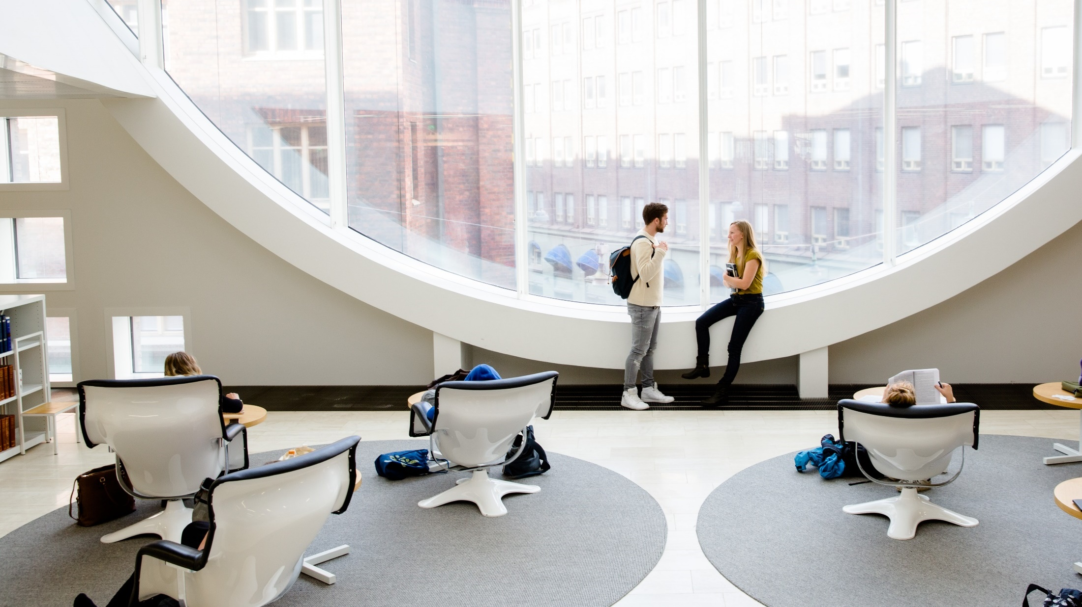
An OECD study ranks Finland as #2 in the world, for highest performing graduates (2019).
Photo: Sakari Piippo
Notes:
Education at a Glance 2019 (OECD): https://www.oecd-ilibrary.org/sites/f8d7880d-en/index.html?itemId=/content/publication/f8d7880d-en

Slide 13
Characteristics of Finnish education
Schools are given a great deal of autonomy. The national core curriculum is localized and there is a high level of trust between the national and local school authorities.
Teachers are professionals of learning. They can for example decide how they teach and what learning materials and resources they use.
All children are entitled to special support. Pupils with minor or medium learning difficulties study in the same schools and classrooms as the others, but the schools are allocated additional resources.
Finnish children begin pre-primary education at the age of six, spend less time in the classroom and have less homework than kids in many other countries, but still have excellent learning outcomes.
Notes:
The average class size is around 20 pupils in primary and lower secondary education. At primary level, the average class in OECD countries has 21 students.

Slide 14
Teachers in Finland
Teachers are valued in Finnish society. Teaching is a popular profession and universities can select the most motivated and talented applicants.
Both class teachers and subject teachers are highly trained, and their research-based training includes pedagogical studies and teaching practice.
As a results, teachers are autonomous professionals with the expertise and ability to develop their own work. They are trusted, enjoy wide autonomy and have flexibility in their work.
Teachers also actively participate in developing education and educational solutions and learning materials.

Slide 15
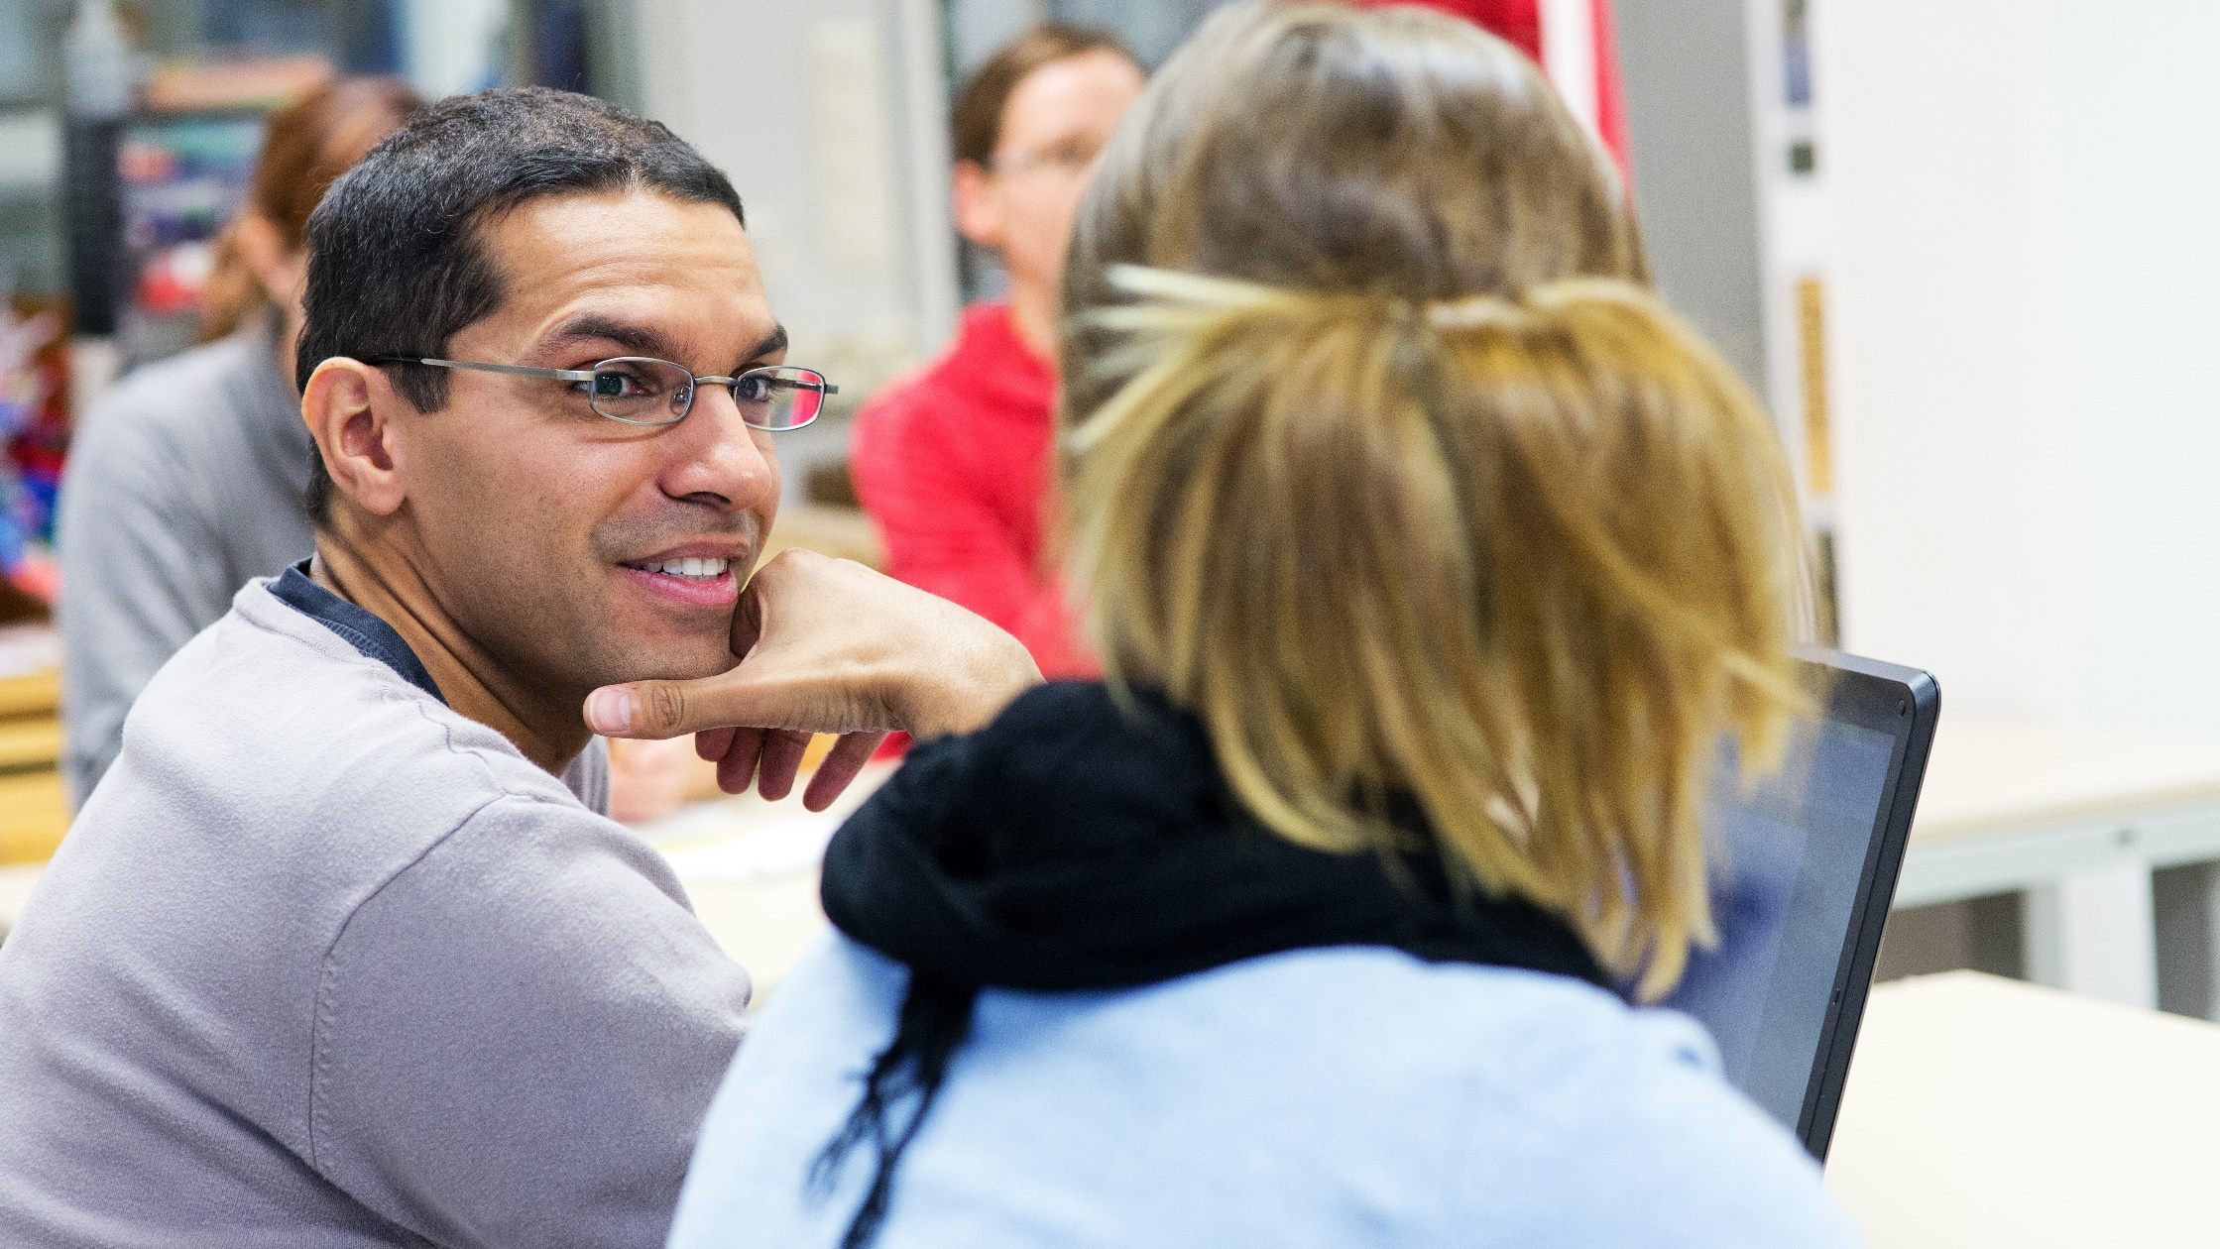
90% of teachers in Finland are satisfied with their work, and 92% say positive aspects of their job outweigh the negative ones.
Source: Ministry of Education and Culture
Photo: Riitta Supperi/Keksi/Finland Promotion Board

Slide 16
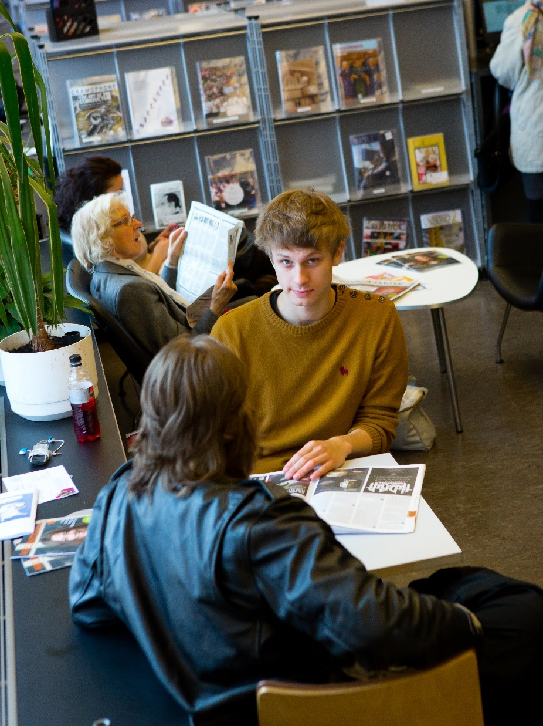
Lifelong learning
Annually 1,1 million citizens take part in courses offered by adult education centres, folk high schools, learning centres, sports training centres and summer universities. Courses are nearly free of charge.
The aim of liberal adult education is to promote social cohesion, equality and active citizenship.
Photo:
Photo:
Photo: Riitta Supperi/Keksi/Team Finland
Notes:
Photo: Riitta Supperi/Keksi/Team Finland
Source: Education lies at the heart of Finnish society: https://toolbox.finland.fi/life-society/education-lies-at-the-heart-of-finnish-society/.

Slide 17
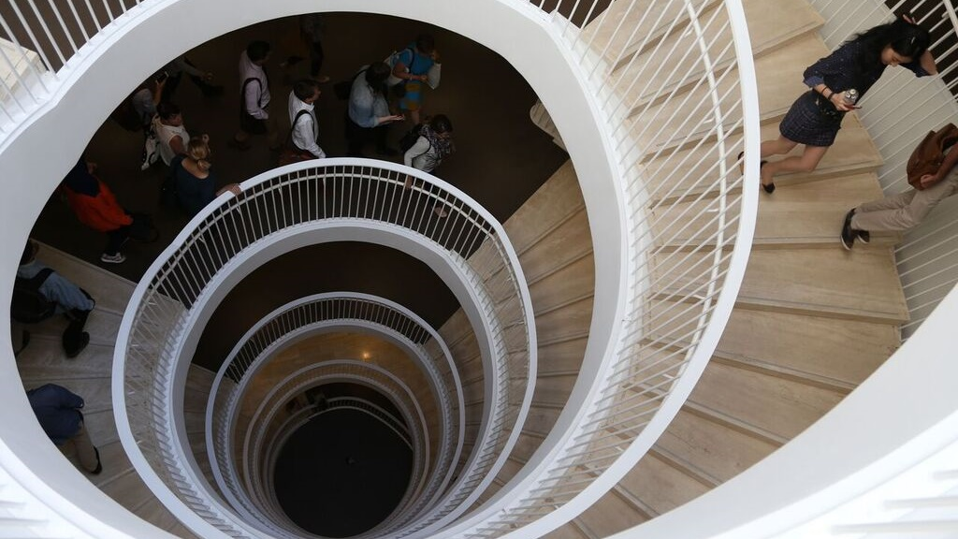
68.7% of adult Finns participated in informal learning during the past year, compared to the EU average of 59.9%.
Source: Eurostat
Photo: Sakari Piippo

Slide 18
Creativity and problem-solving
At the end of the 20th Century Finland’s economy started focusing on technology industries, R&D, information and knowledge.
New partnerships developed between tertiary education and industry, while primary and secondary education also evolved to promote creativity, problem-solving, teamwork and other working life skills.
The national core curricula of 2014 for basic education and 2021 for general upper secondary education emphasized transversal competences and phenomenon-based learning, while still holding on to traditional school subjects.
Notes:
Experts have helped travel companies to develop comprehensive study tours.

Slide 19
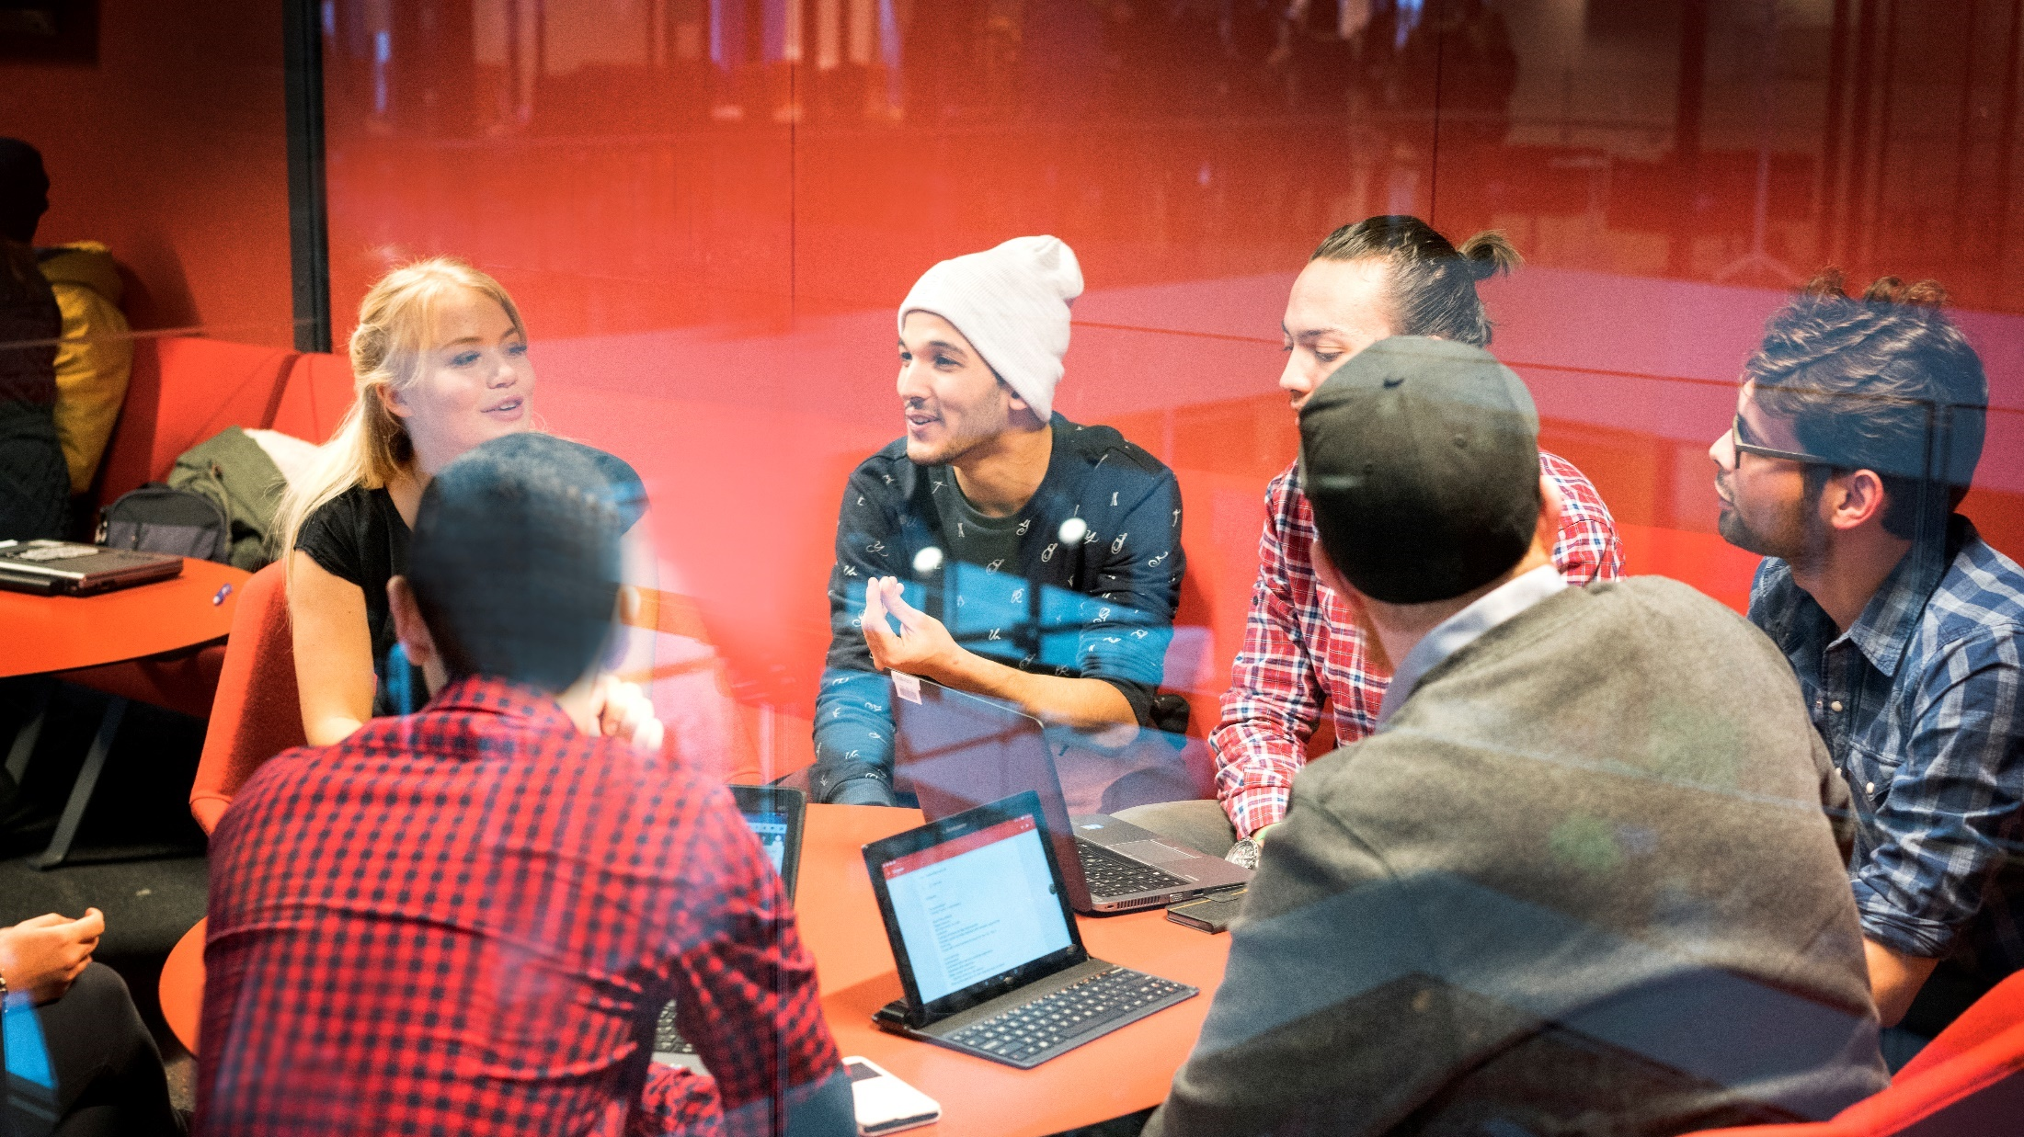
Photo: Velhot Photography Oy/ Riku Isohella

Slide 20
Education Technology
In recent years a thriving Education Technology (EdTech) sector has developed, merging Finnish software and education strengths.
Finland has a strong digital sector and a booming gaming industry. This all has helped to create favorable conditions for developing cutting-edge digital learning solutions, that make learning fun, engaging and personal.
Many of the educational technology solutions have been developed together with Finnish teachers, and tested in Finnish schools.

Slide 21
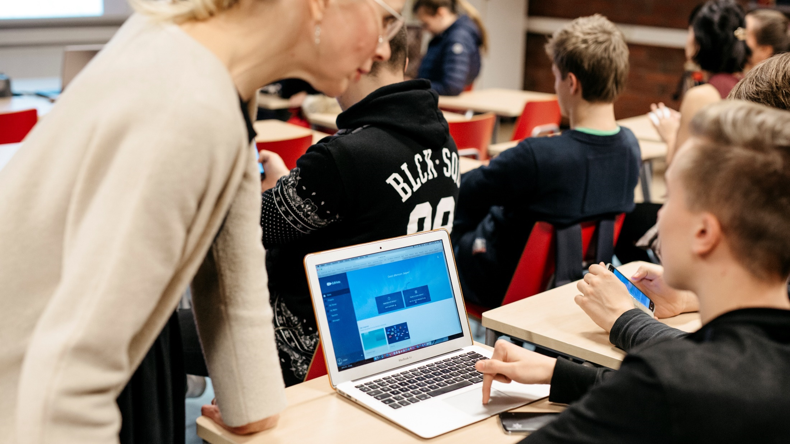
Photo: Velhot Photography Oy/ Riku Isohella

Slide 22
Worldwide recognition
In the 2000s Finland’s education system began to receive worldwide attention thanks to high international rankings in education. Additionally, Finland achieved this result while spending only slightly more money per student than the OECD average.
In the latest PISA rankings, Finland has stood out for success in combining excellent academic results with a high level of student satisfaction. Well-being is a key consideration in Finnish education.

Slide 23
Teaching during the pandemic
COVID-19 demonstrated the resilience and versatility of the Finnish education system. In the spring of 2020 Finland closed almost all schools for two months and begun distance learning with minimal interruption.
  During the school closures teaching and learning took place online. Students were also given tasks to learn independently or together with peers and often hand in homework electronically to teachers.
All Finnish schools have tutor teachers and mentors as well as other peer support mechanisms for using digital tools and services.

Slide 24
THE BEST PRACTICES FROM FINLAND’S EDUCATION SYSTEM CAN BE ADAPTED

Slide 25
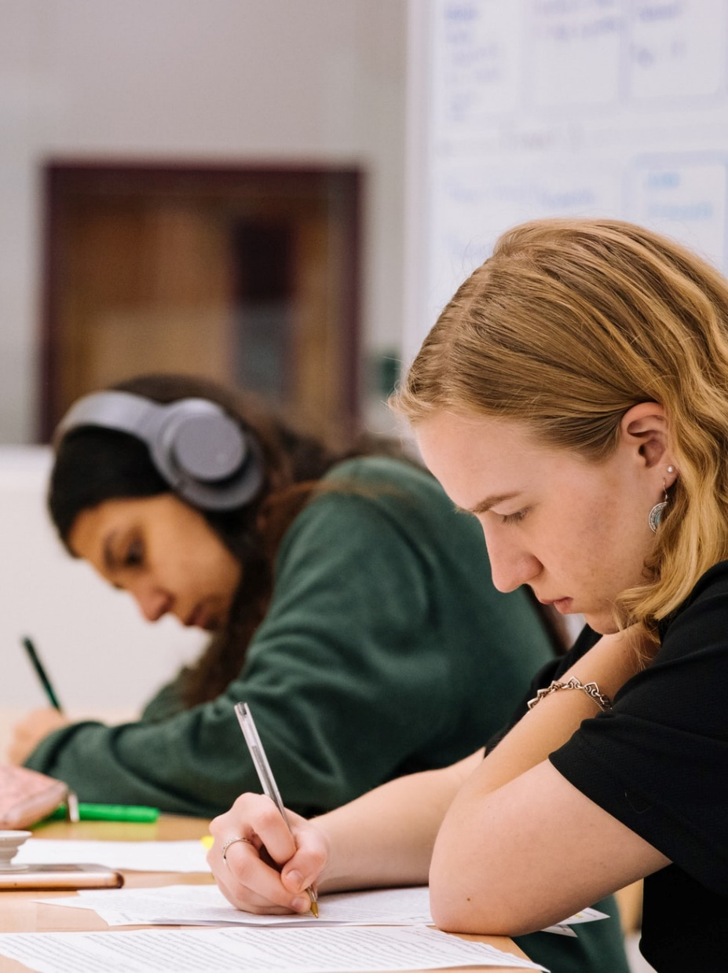
Continuous development
The reforming of the education system in Finland continues even today.
Finnish education institutions and companies are eager to work with international partners in education, share what they know and collaborate for new innovations in learning.
Photo: Jeswin Thomas/Unsplash
Notes:
Photo: Jeswin Thomas/Unsplash

Slide 26
Education Finland
Education Finland is a governmental cluster programme supporting education institutions and companies in their growth on the international market.
Its member companies (130) have a wide variety of services in education, representing some of the most innovative solutions:
  Degree programmes: higher education and VET
  Educational services: teacher training, pedagogical and vocational programs, consultancy services
  Educational and learning products: programs, applications, learning platforms, educational content and materials
  Learning environments.

Slide 27
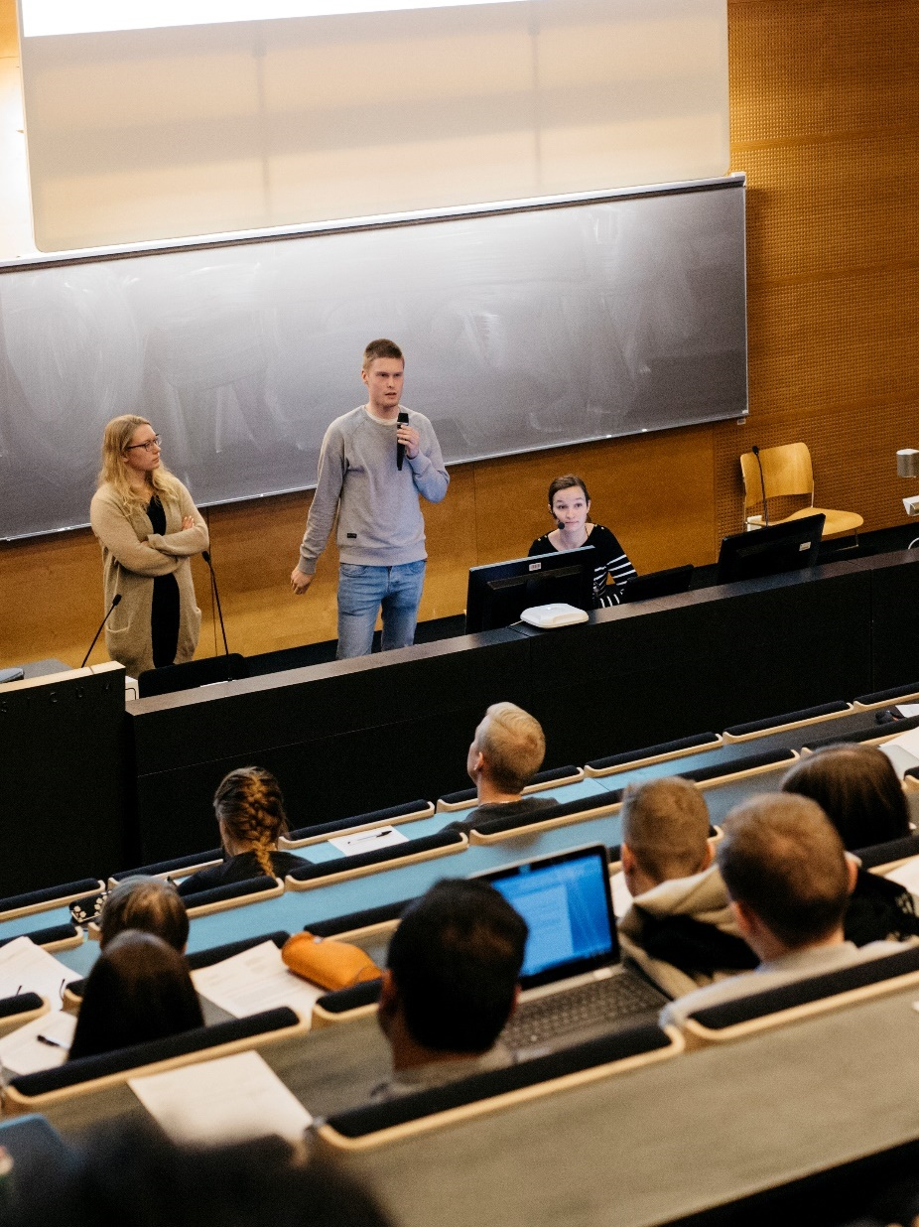
Educational travel
Educational travel to Finland is growing in popularity.
Students often combine educational content with leisure travel, while education professionals learn about the Finnish education system, including the curriculum, management, pupil-centred learning and more.
Photo: Elina Manninen/Kuvatoimisto Keksi
Notes:
Experts have helped travel companies to develop comprehensive study tours.
https://www.businessfinland.fi/4aaf9f/globalassets/julkaisut/visit-finland/tutkimukset/2020/educational_travel_manual_0910_final_pakattu.pdf (Educational Travel best practices 2020)

Slide 28
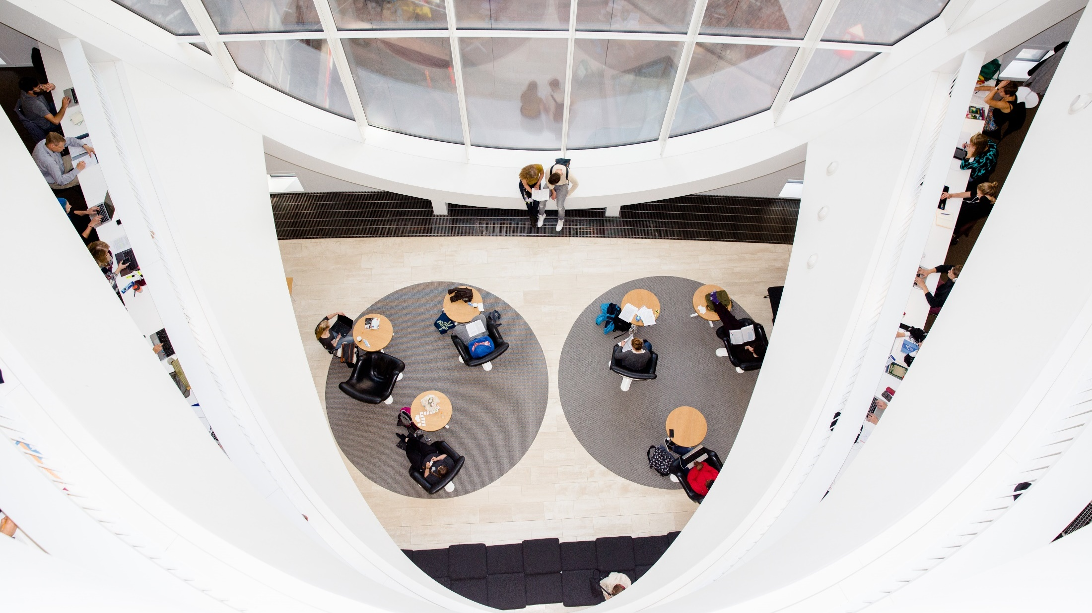
There are more than 400 English-taught degree programs in 13 universities and 22 universities of applied sciences. Source: Studyinfo.fi
Photo: Sakari Piippo
Notes:
https://www.studyinfinland.fi/

Slide 29
Higher Education
Universities and universities of applied sciences have extensive autonomy and freedom of education and research.
  They promote competitiveness, well-being, education and learning as well as sustainable development.
Finnish Higher Education system has been ranked by Universitas21 among the Top 10 in the world.
International students particularly appreciate Finland’s study facilities like well-equipped libraries and campuses, IT services and support services.
  Affordable student housing is offered to international students.

Slide 30

INTERNATIONAL STUDENTS
LOVE TO

Slide 31
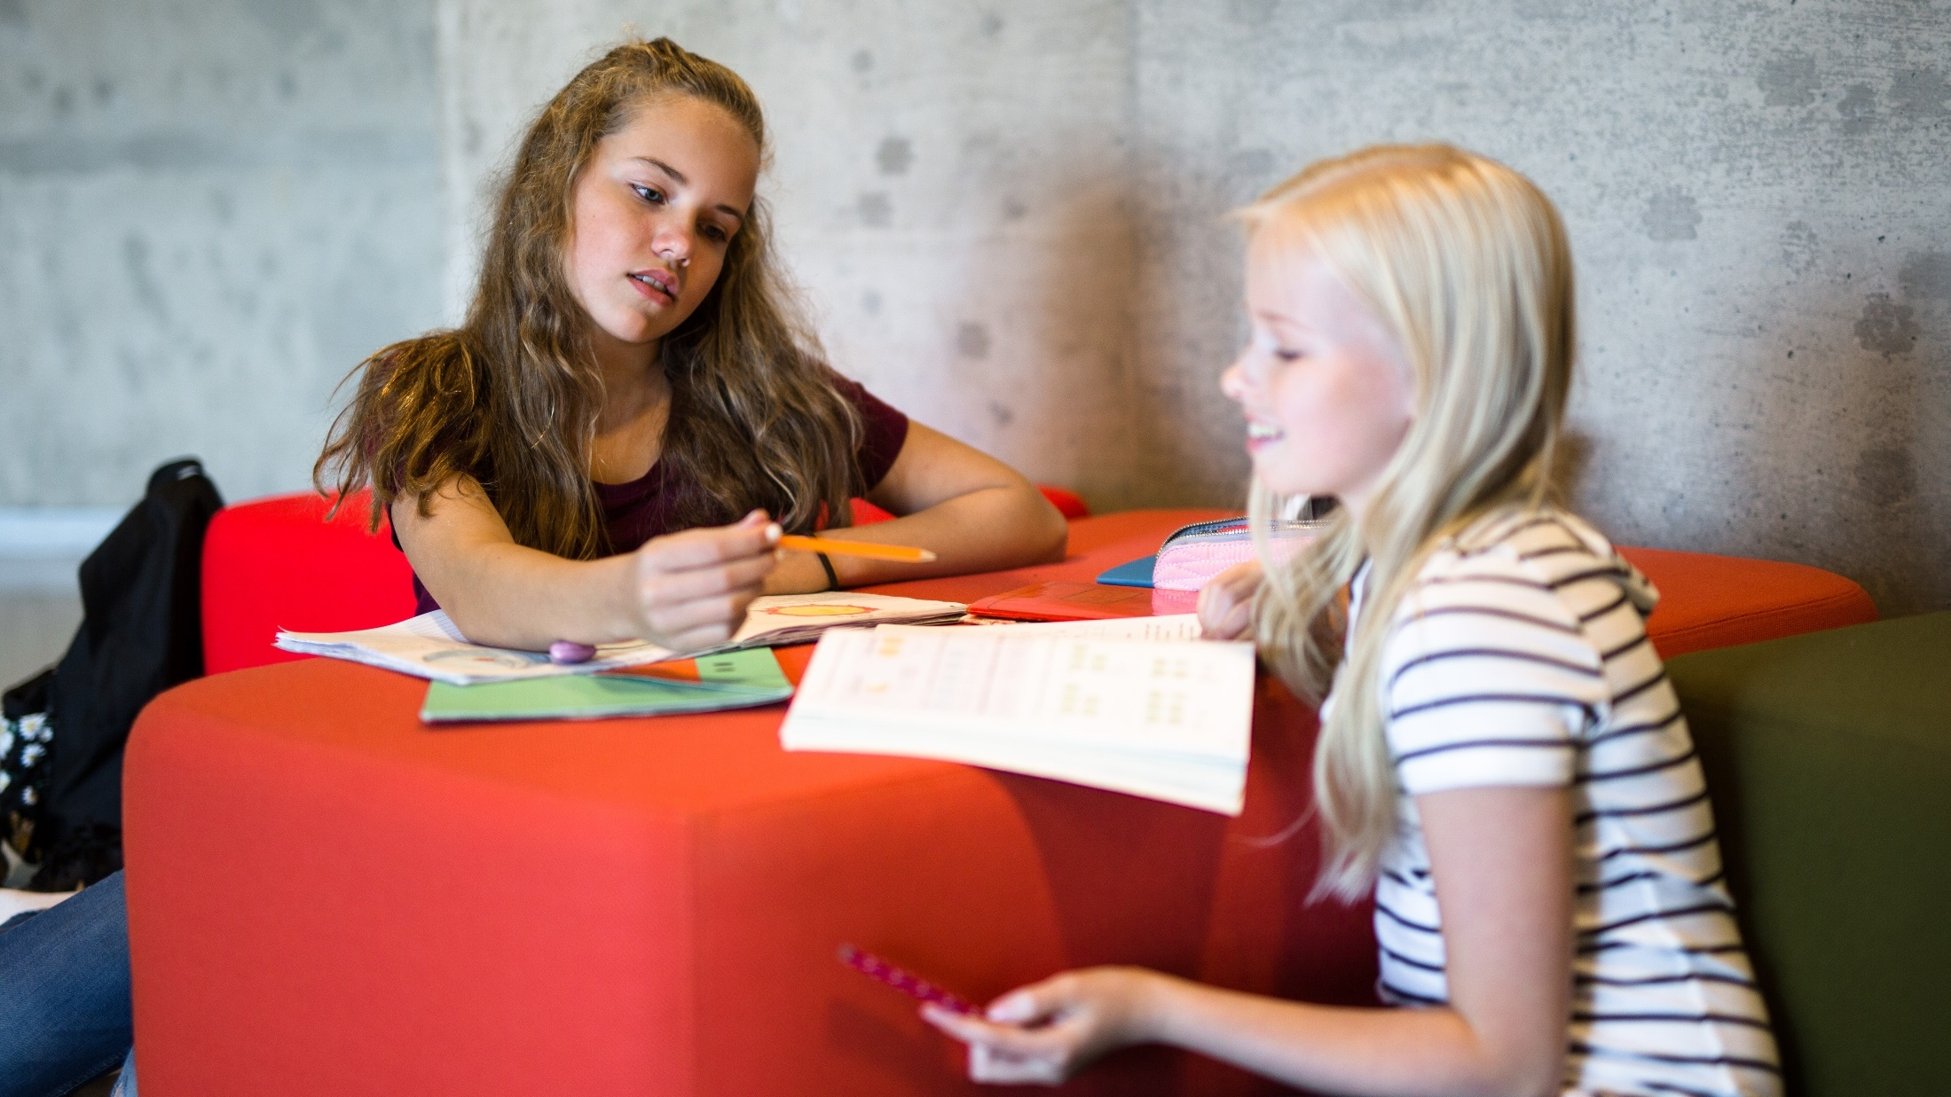
Thank you!
Photo: Sakari Piippo
Notes:
Photo: Sakari Piippo

