Slide 1
RIVALRY BETWEEN SCHOOLS FROM THE SAME AREA
SWEDISH VALUE. WE WANT TO BE GOOD ENOUGH
DEMOCRACY IN TERMS OF DECIDE, SHARE, MANAGE, COMPLAIN
FLEXIBILITY: ONE GOAL, DIFFERENT WAYS TO ACHIEVE IT
EDUCATION SYSTEM
OPENNESS
GOOD MARKS = GOOD REPUTATION
FREE
MARKS OBSESSION = SCHOOLS PRESSURE

Slide 2
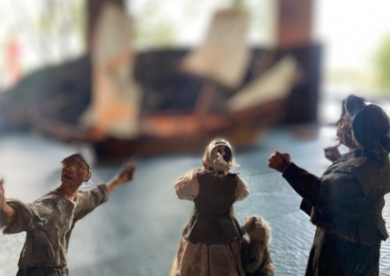
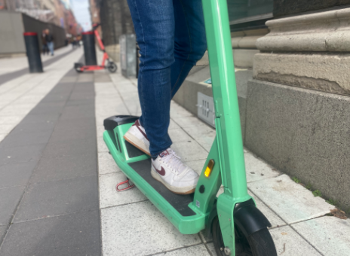
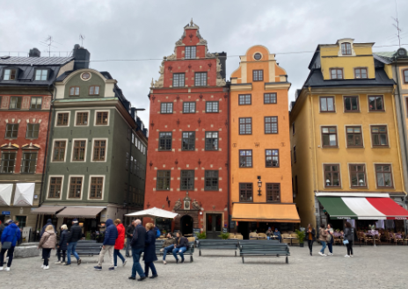
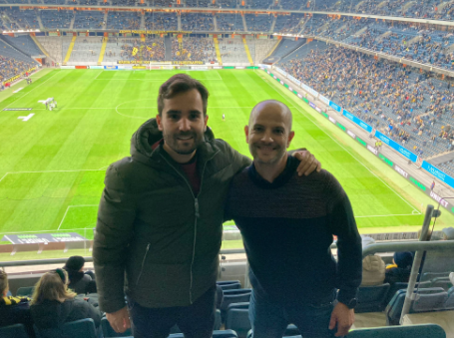
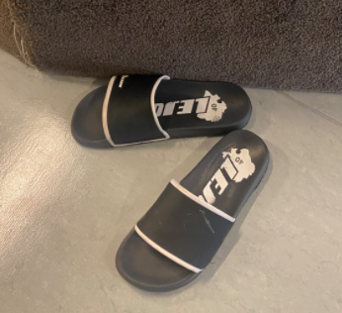
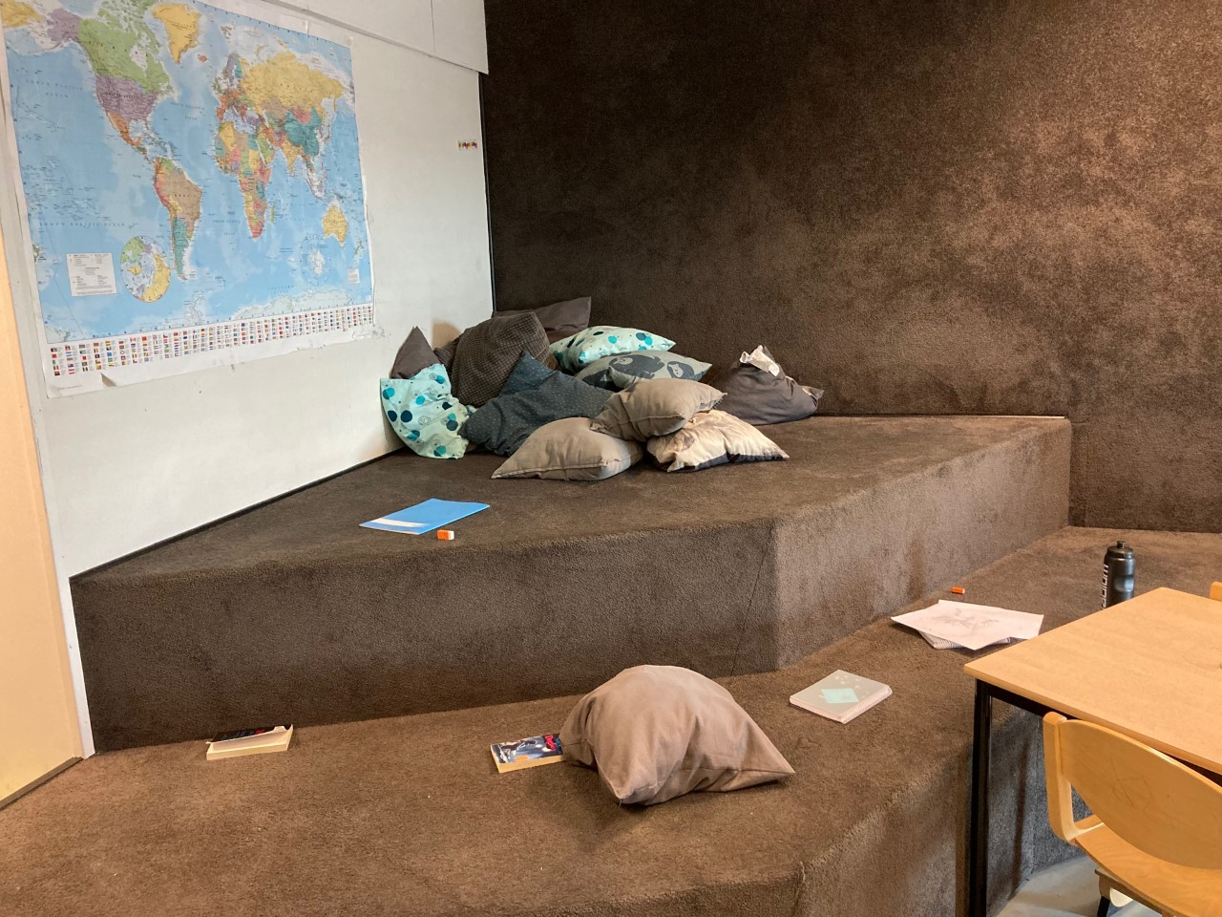
INSPIRING IMAGES
HISTORICAL LEGACY
GREEN TRANSPORTATION
COMMITTED CITIZENS
SWEDISH VALUE
RESPECT
DEMOCRACY
HOME SWEET HOME

Slide 3
European dimension, people and countries:
Germany
Italy
France
Greece
Bulgaria
Spain
Czech Republic
Slovakia

Slide 4
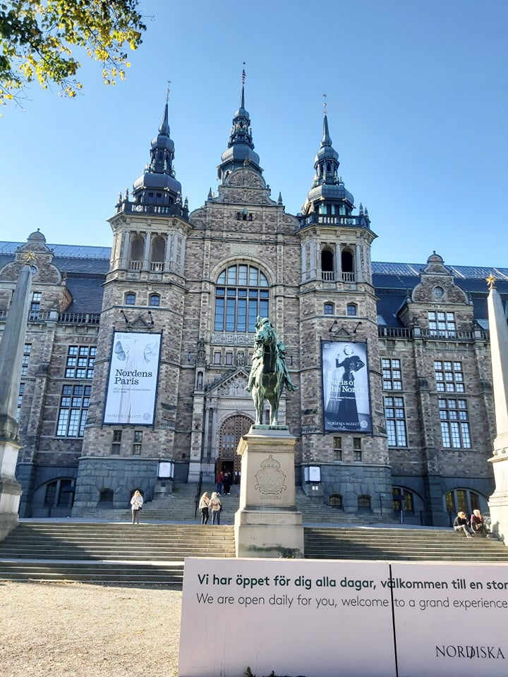
ERASMUS + IN SERVICE EUROPEAN PROGRAMME
Structured course: Structured Educational Visit and Training Seminars in Sweden
Duration: 7 days
Organized by English Matters in Spain, lead by Eduardo Marín Navas

Slide 5
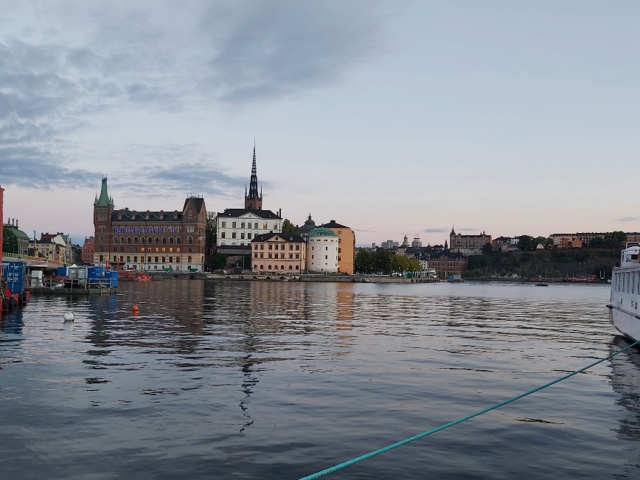
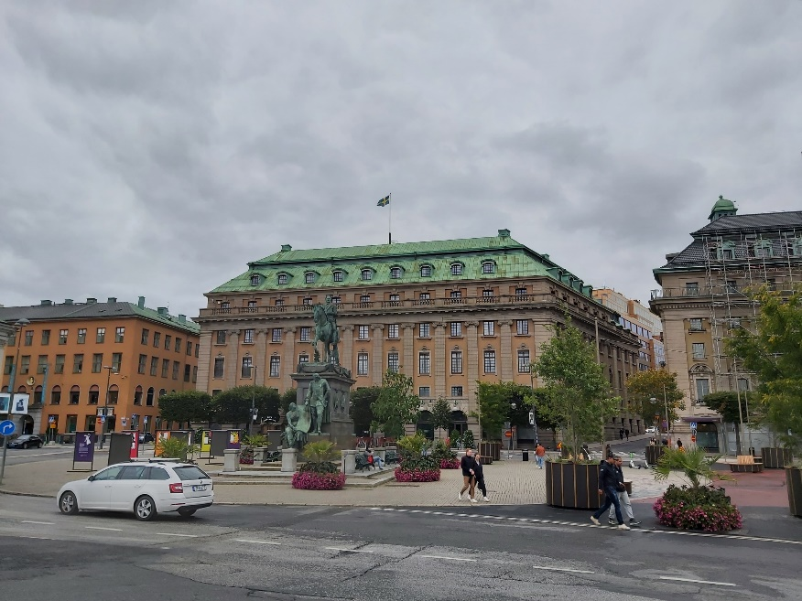
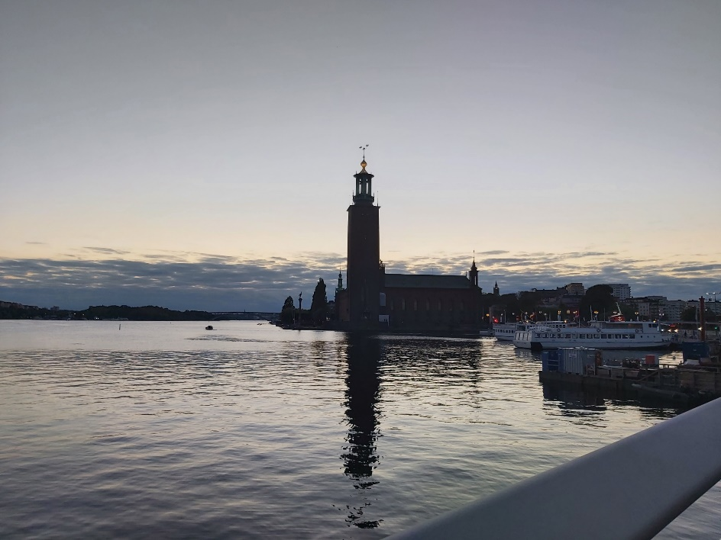
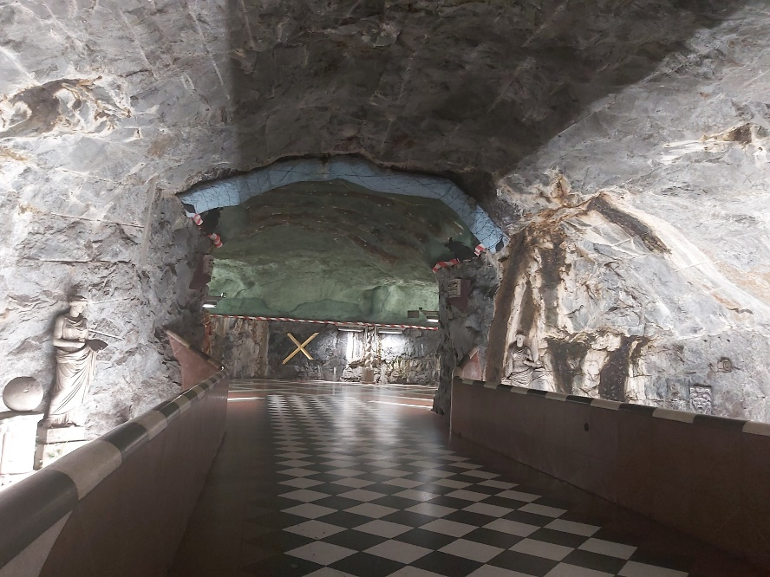
Známi Švédi
Prehliadka starého mesta a najznámejších pamätihodností
Stockholm - “Benátky severu” (12 ostrovov)

Slide 6
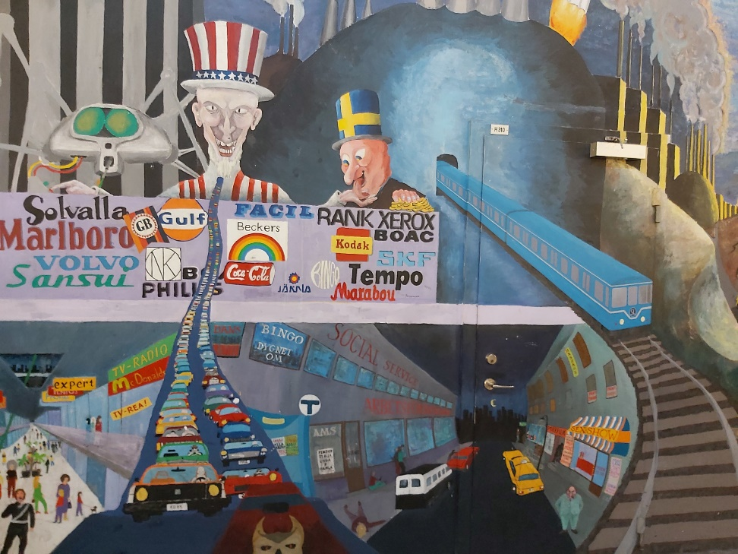
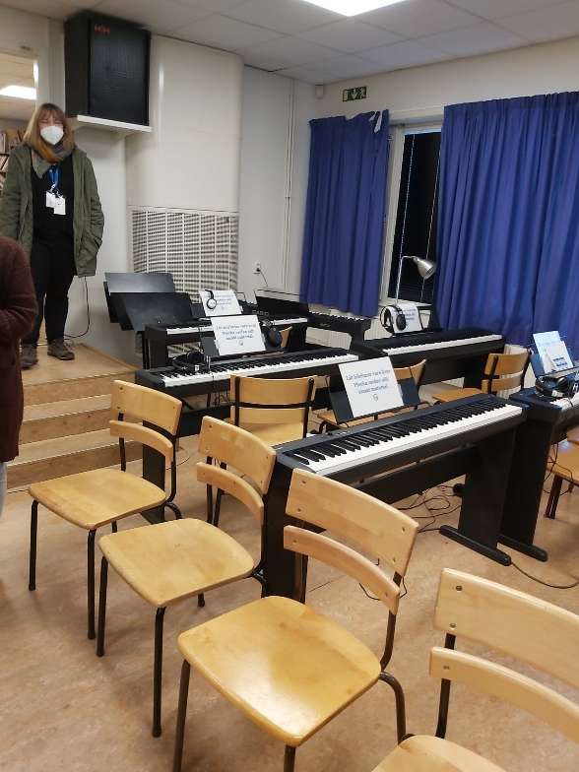
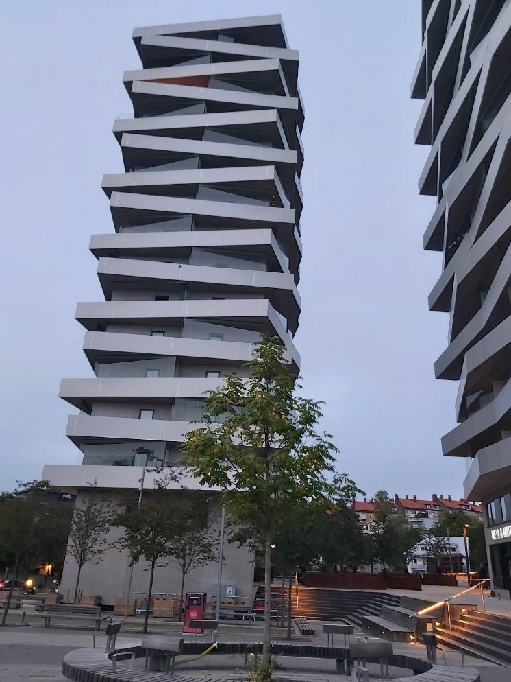
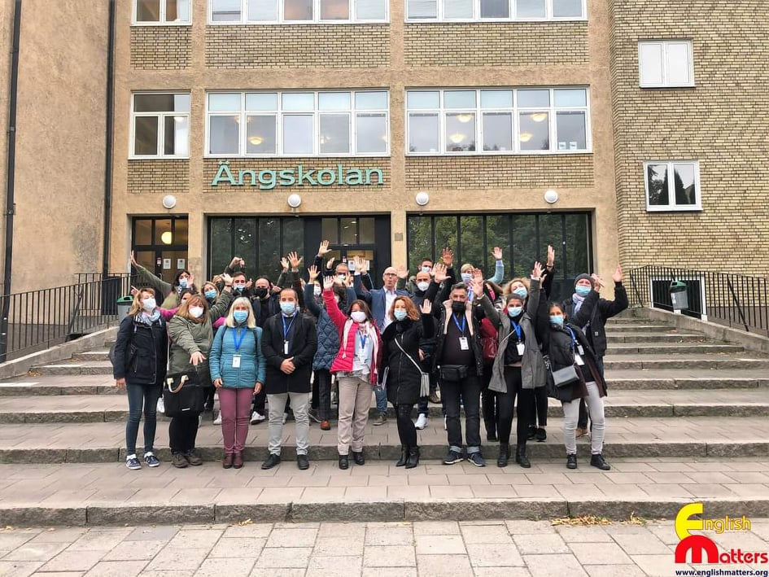
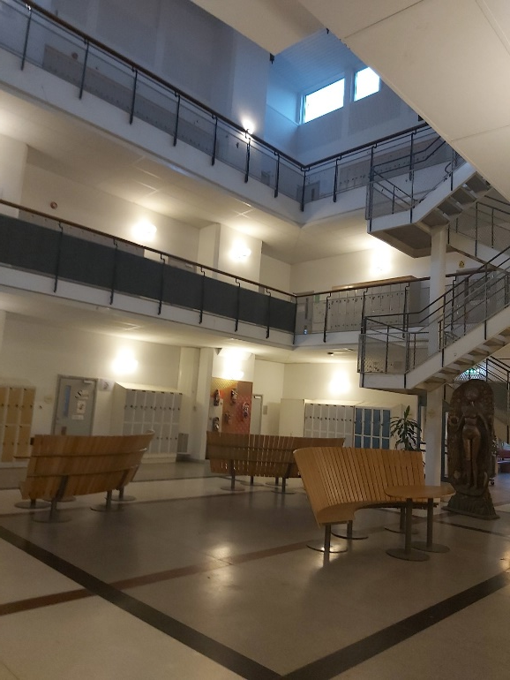
Škola v Sundbyberg – Ӓngskolan (Per Nilsson)

Slide 7
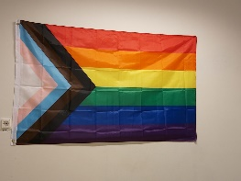
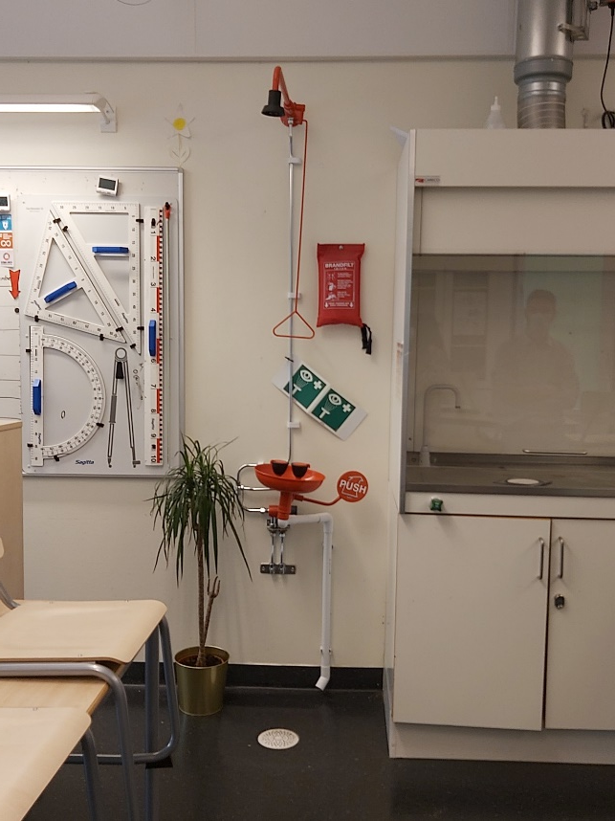
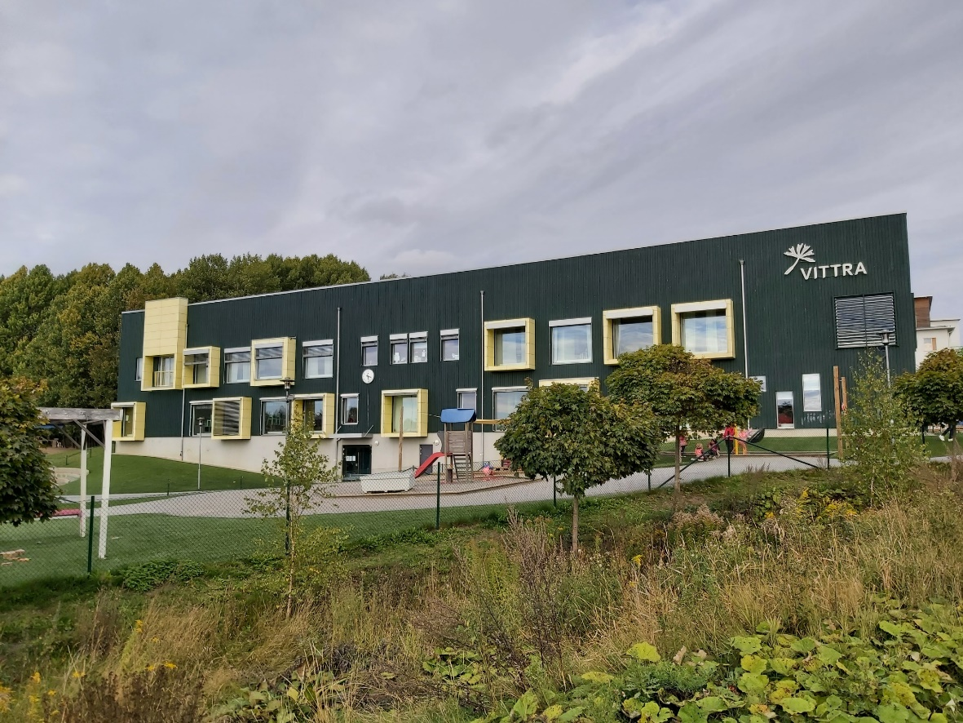
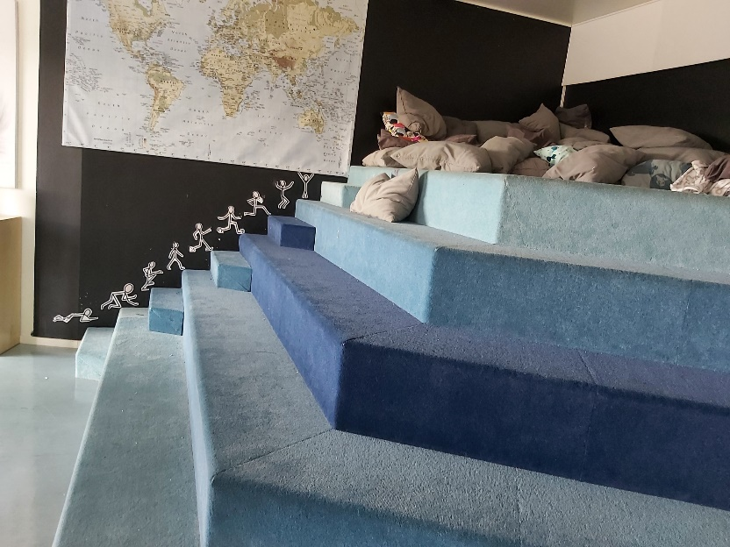
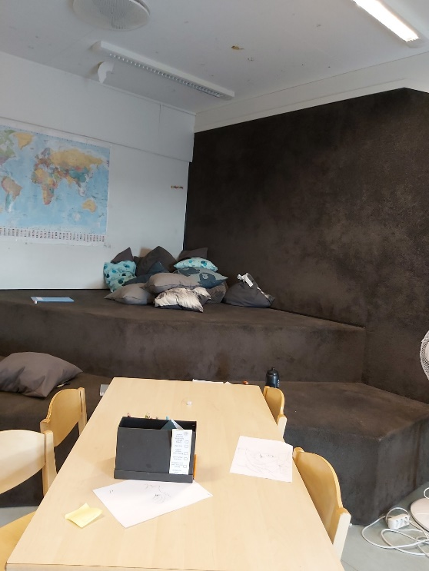
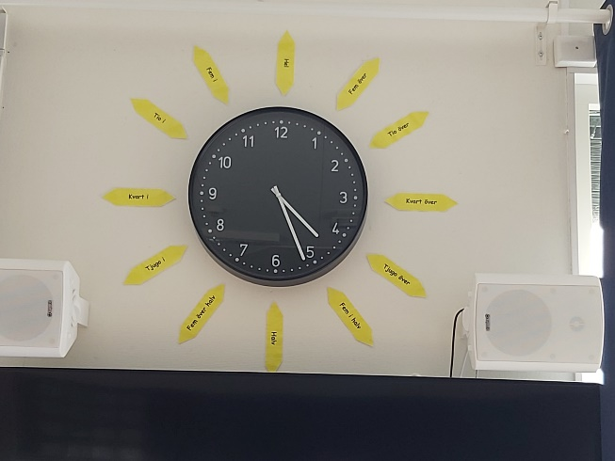
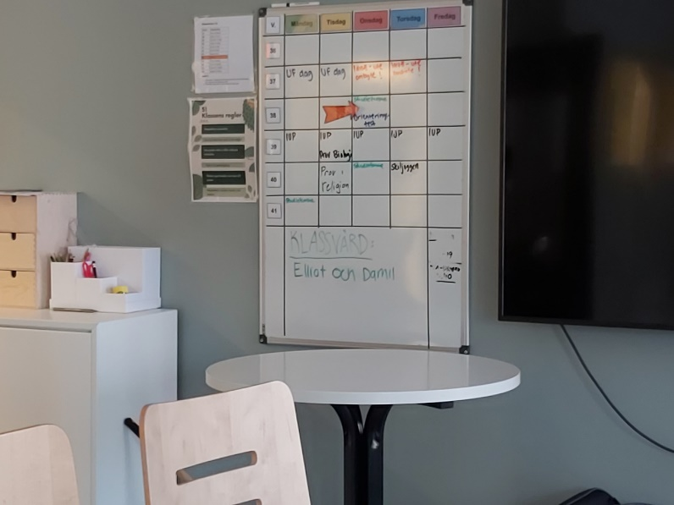
Vittra Brotorp (Norma Aznar)

Slide 8
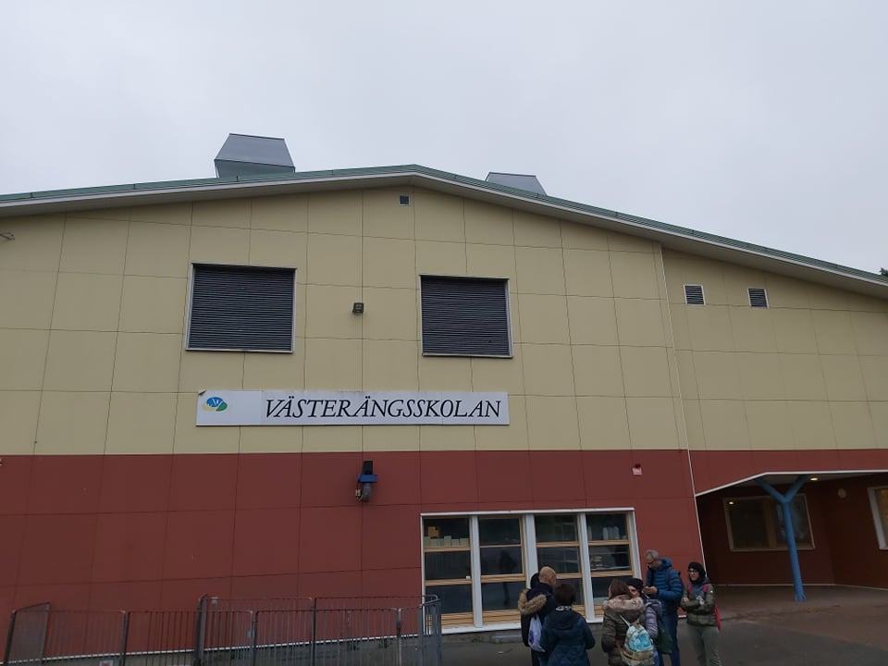
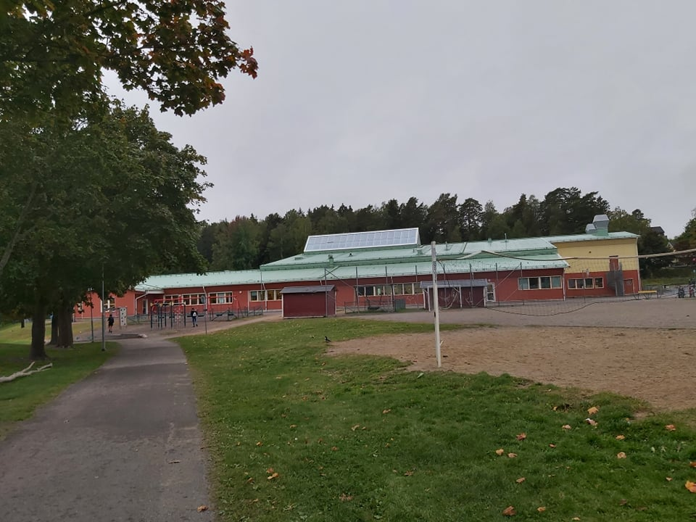
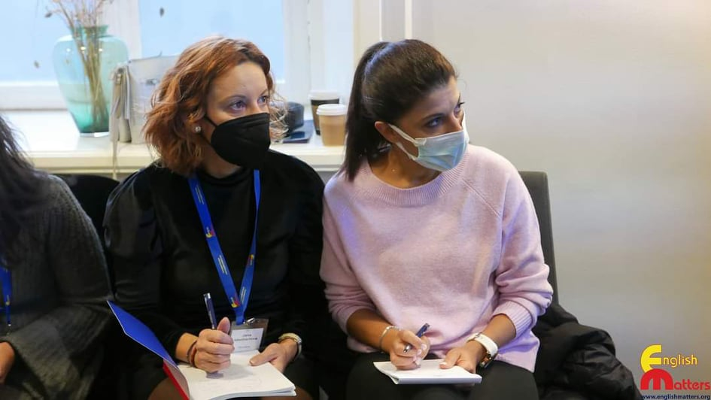
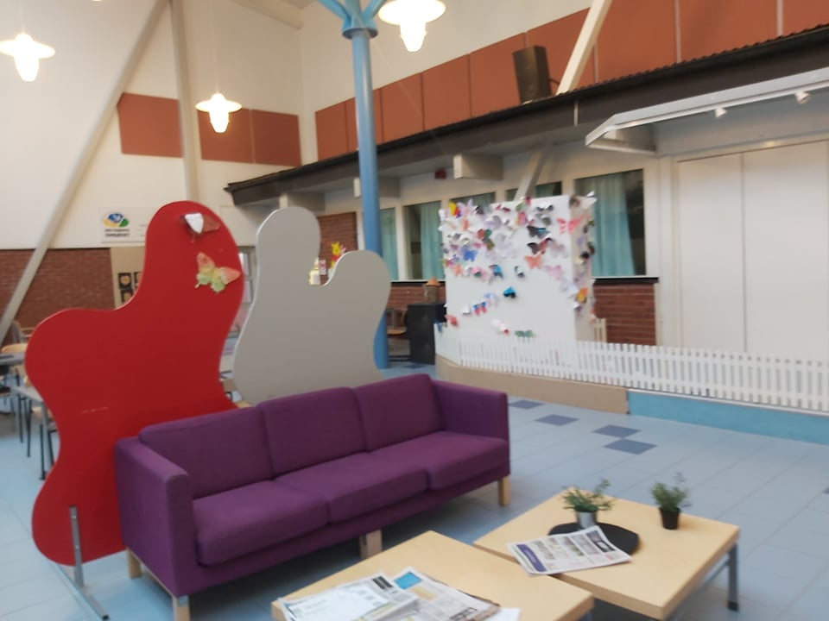
Västerängsskolan (Mette Sandh), Bålsta

Slide 9
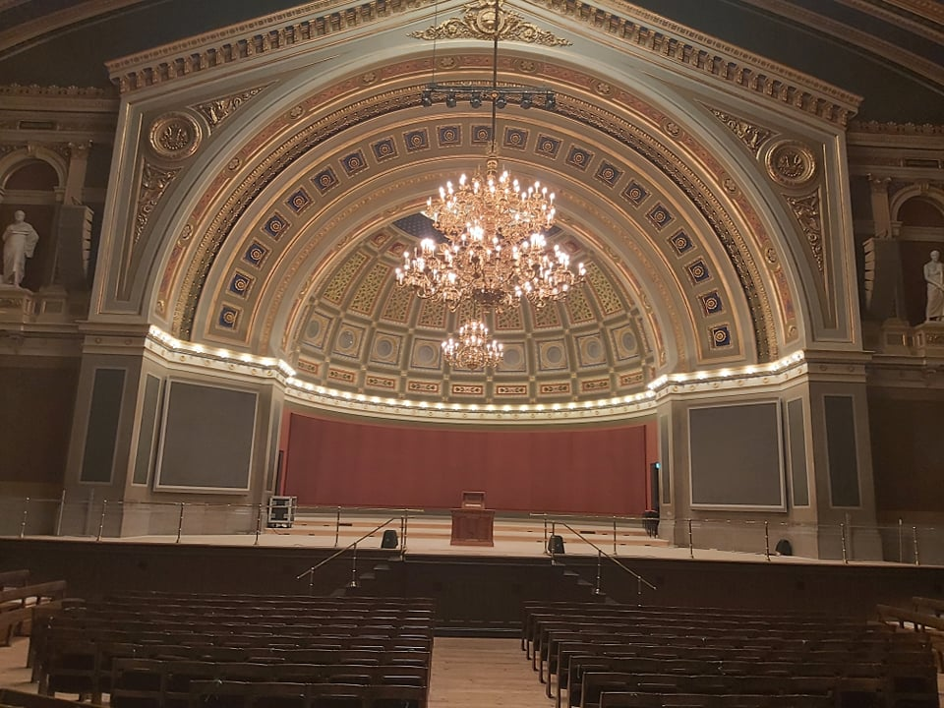
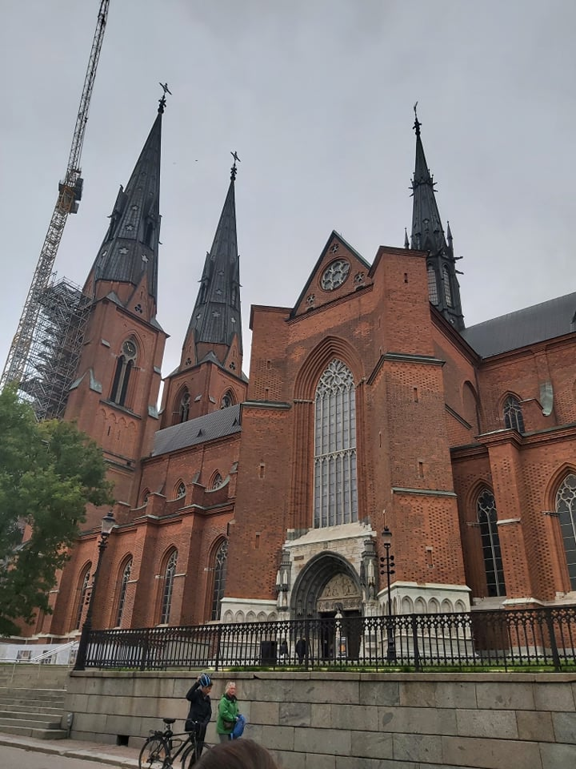
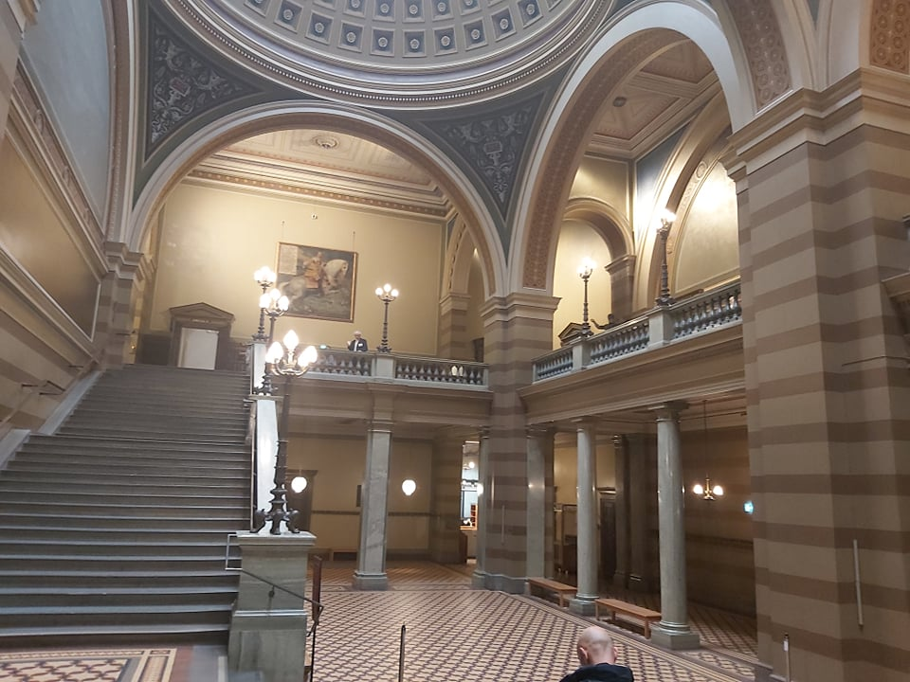
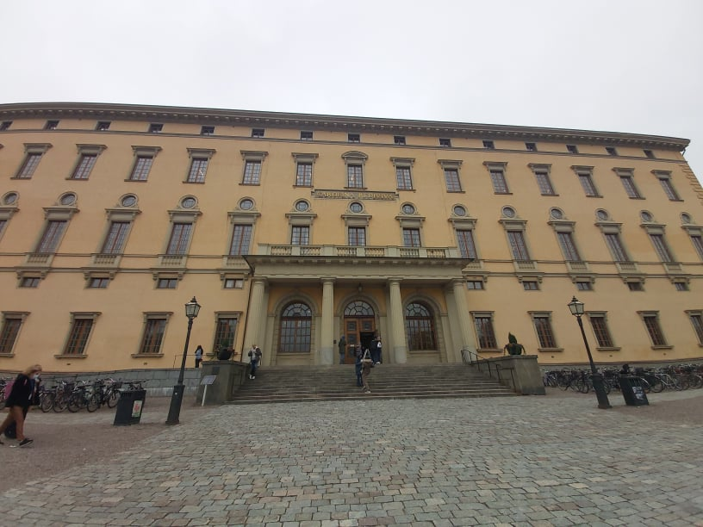
Uppsala- Swedish Cultural and Academic Heritage

Slide 10
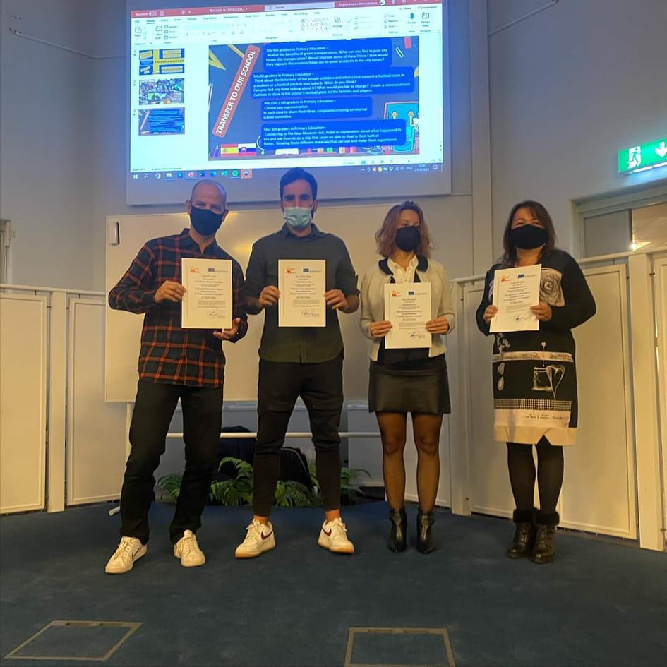
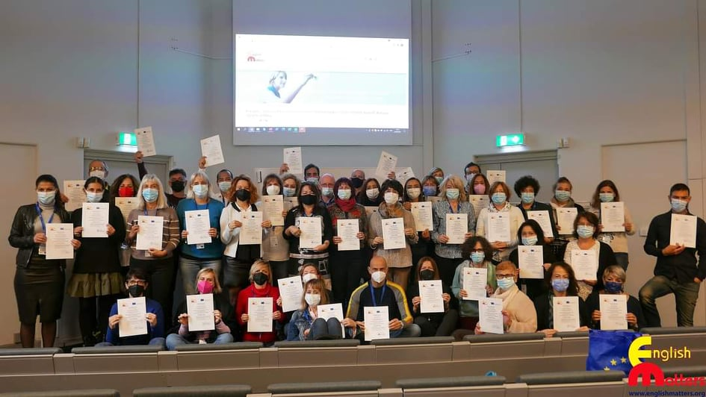
CERTIFICATION:
European dimension. Reflection on Dissemination Strategies.
Presentation of Learning Portfolios.
Final reflection on learning acquired.
Evaluation of the programme.

