Slide 1
STEMAction for the Future
TTC meeting in Alanya, Turkey
31 October – 4 November 2022

Slide 2
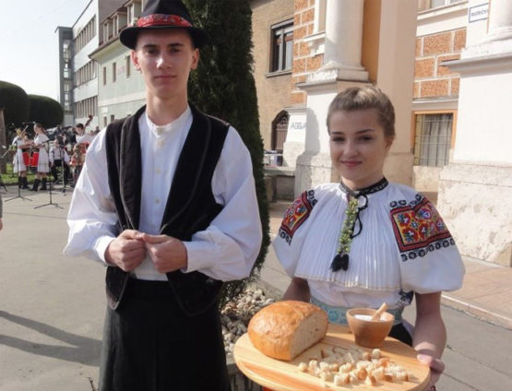
WELCOME TO SLOVAKIA

Slide 3
Problem:
Unhealthy eating and shopping habits
Objective:
Increase consumer awareness and competences

Slide 4
Activity 1:
Divide students into 4 groups
Roles of the students in a group:
ITC expert
Chemistry and Biology expert
Maths and economy expert
Presenter

Slide 5
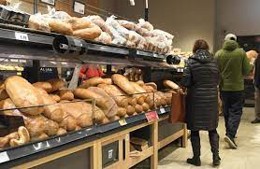
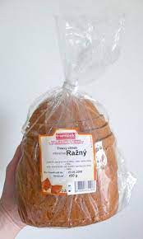
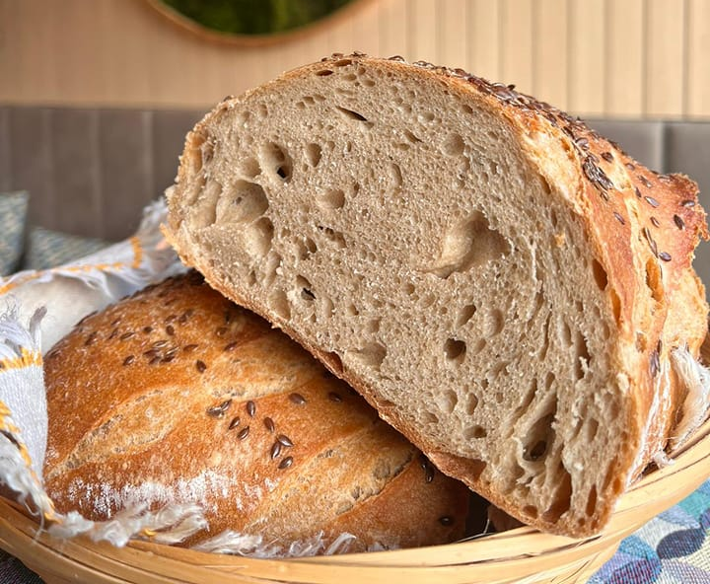
Material
4 types of bread
Laptop
Internet
Worksheet
Pen / pencil

Slide 6
Where is the bread from?
1. Bakery round the corner – in your own bag
2. Slovak food Factory Topec - in a paper sack
3. Packed bread from the supermarket - in a plastic cover from Germany
4. Frozen bread in a plastic box from the USA

Slide 7
Fill in the table
Group / Bread | Country or place of origin | Distance in km from the producer | Food additives (E111, E124, E132, E300) | Cover | Price | Taste and smell * (1 - 4)
1.
2.
3.
4.
ICT expert finds out distance from producer to customer on the Internet.
Chemistry expert finds out food additives and cover.
Economy expert finds out the price.
Presenter will publish the results of their research.

Slide 8
Conclusion
1. Environmental impact - distance and transport, cover – waste
2. Economical impact - support of Slovak economy, price of transport
3. Health impact – quality and additives, ingrediences
4. Final tasting

Slide 9
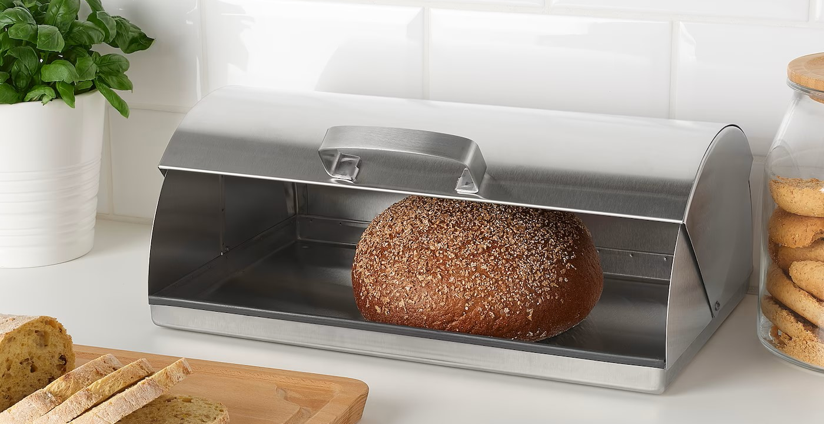
Activity 2:
Design a bread container
Criterias: cheap, keep bread fresh and crispy, environmental friendly,
Blueprint
Material: cotton, linen, paper – soft, hard, scissors, pencils, ruler, etc.

Slide 10
Assessment
Group | Design | Functionality | Price
1.
2.
3.
4.

Slide 11
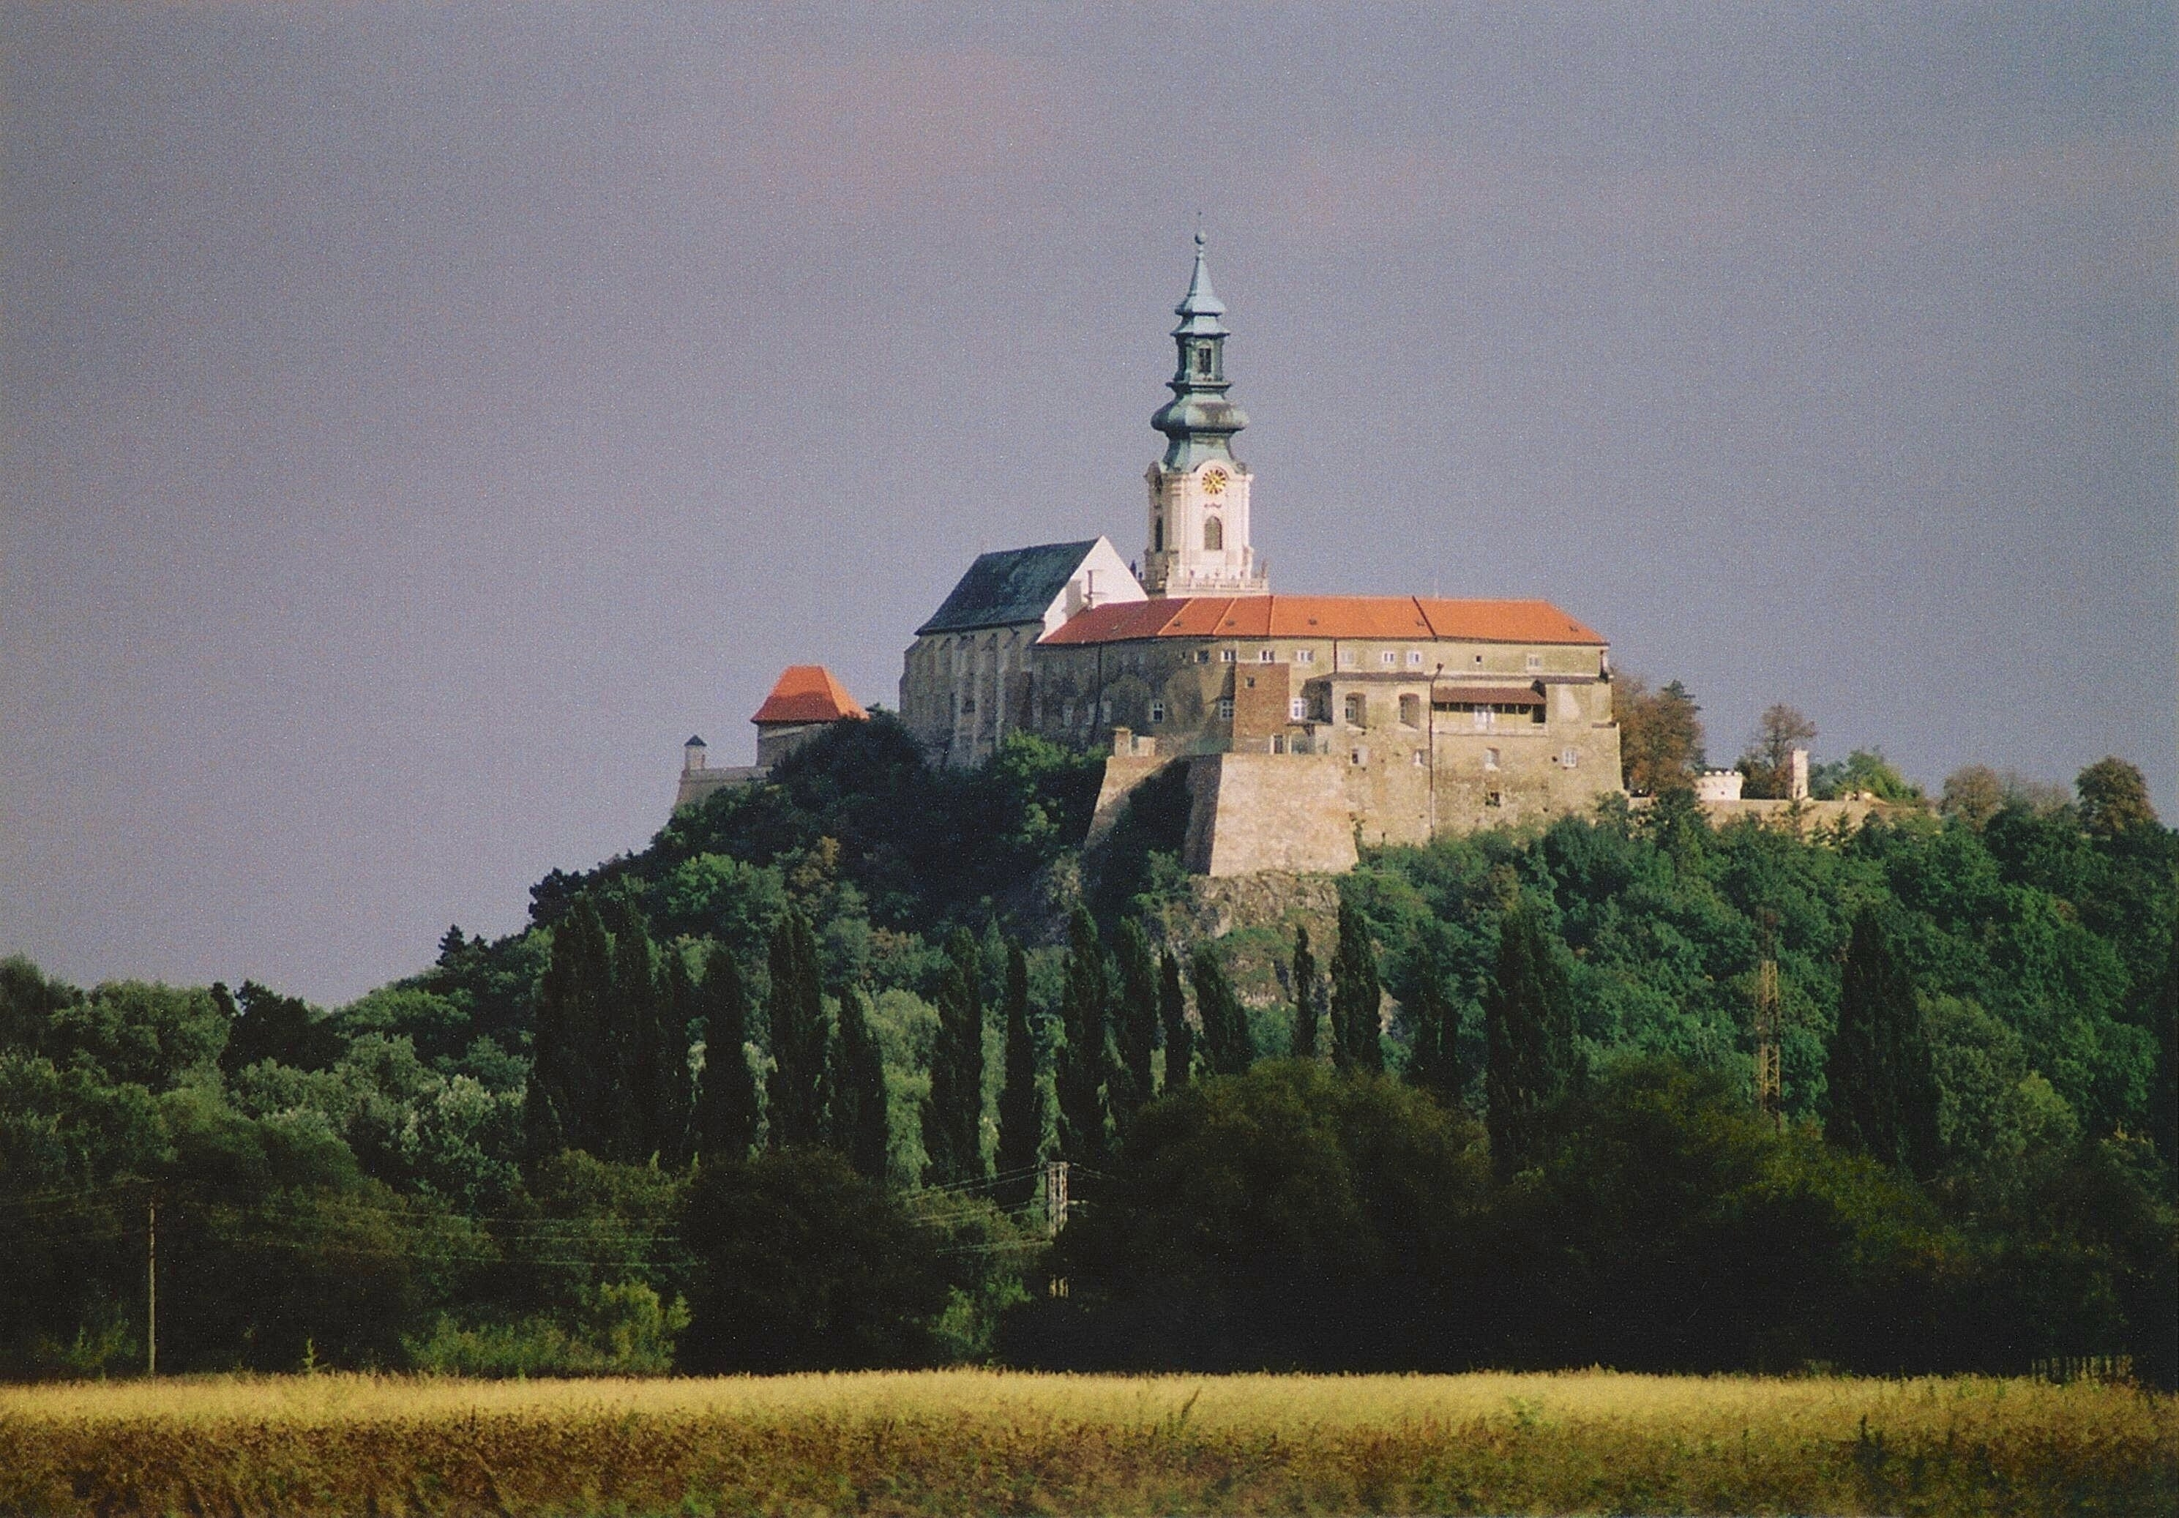
Thank you for your attention

