Slide 1
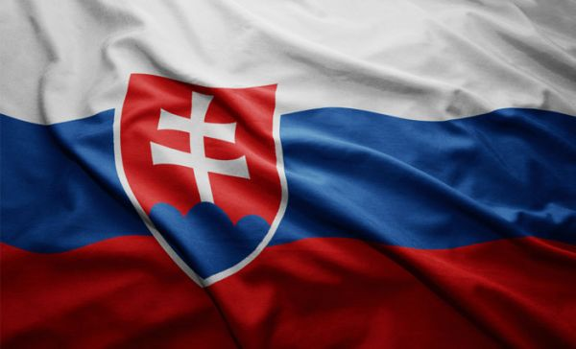
_______
Slovakia
A.Bernáthová
H.Šiková
S.Tonhauserová

Slide 2
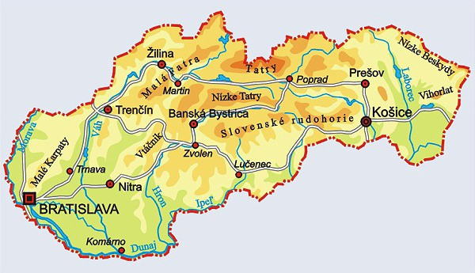

Slide 3
Main informations
Middle Europe
Neighbouring states: Czech Republic, Hungary, Poland, Ukraine, Austria
Capital city: Bratislava
Population: 5,4 mil.

Slide 4
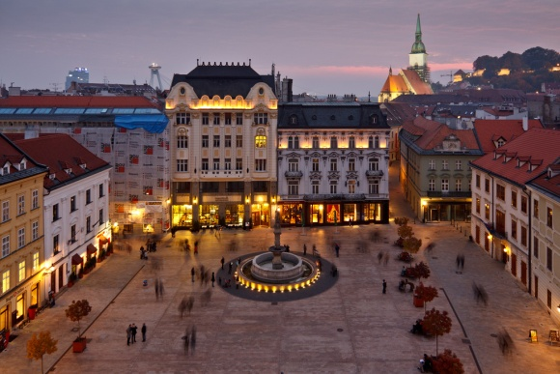
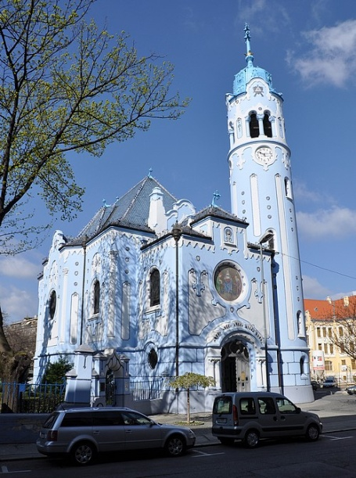
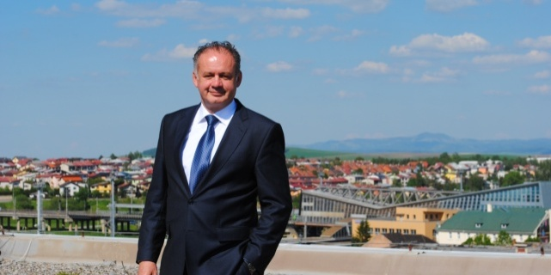
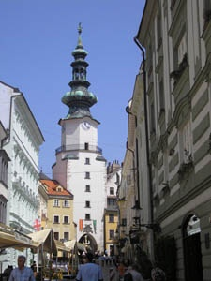
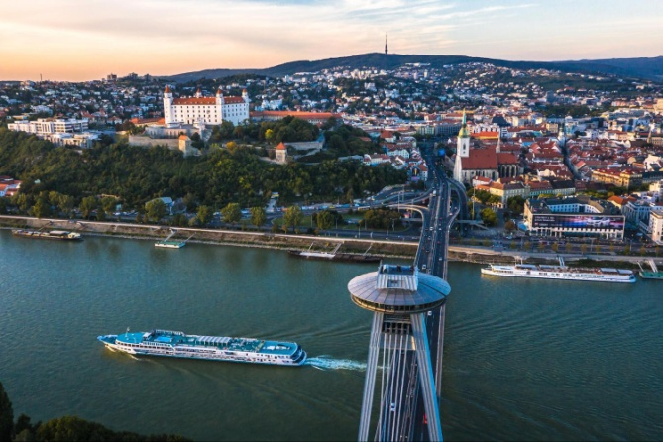
Bratislava
West Slovakia
There is our president Andrej Kiska, our parliament and international airport

Slide 5
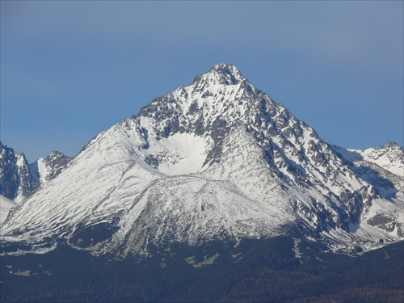
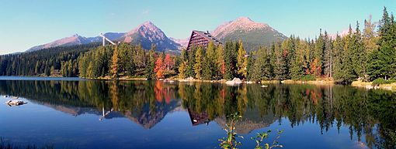
Mountains
Our biggest mountains are the Tatras
Our highest point is Gerlachovský štít
Other mountains : Chopok, Karpaty, Malá Fatra, Veľká Fatra and many more

Slide 6
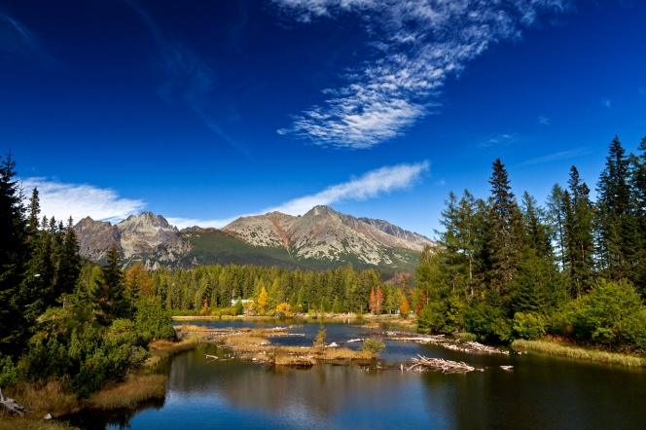
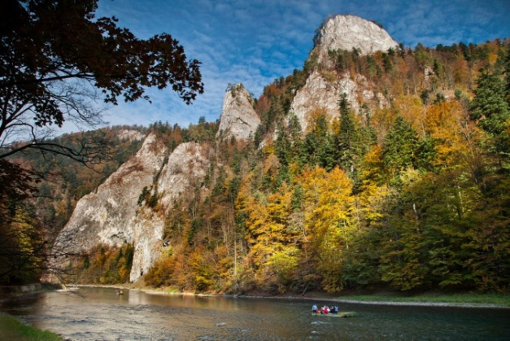
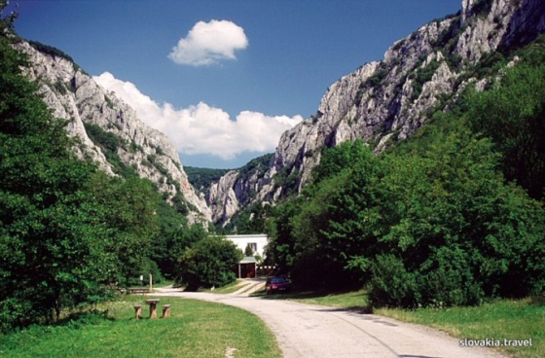
National parks
NP Malá Fatra
NP Veľká Fatra
NP Poloniny
NP Pieniny
NP Nízke Tatry
Tatranský NP
NP Slovenský raj
NP Slovenský kras
NP Muránska planina

Slide 7
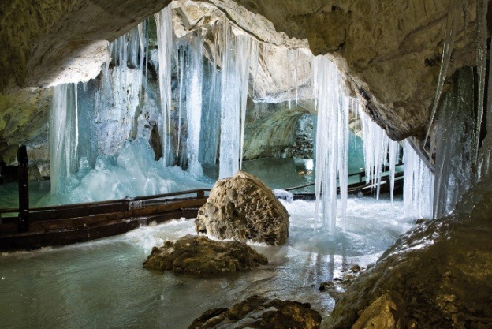
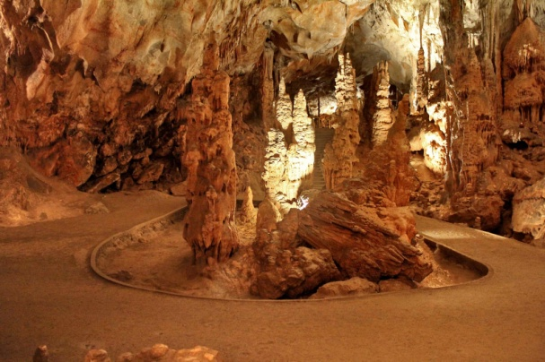
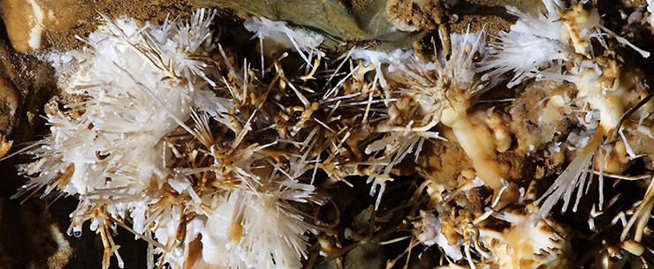
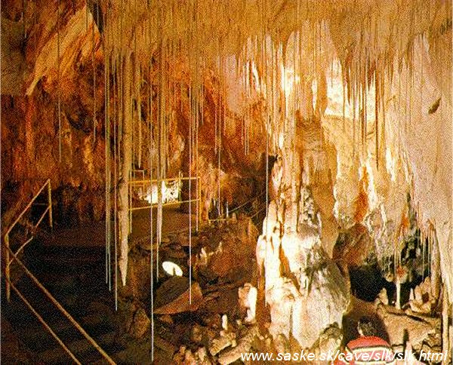
Caves
We have more than 2 400 caves, of which more than 400 have been explored, but here are some of them, which are really interesting
Demänovská ice cave Domica cave
Ochtinská aragonit cave Gombasecká cave

Slide 8
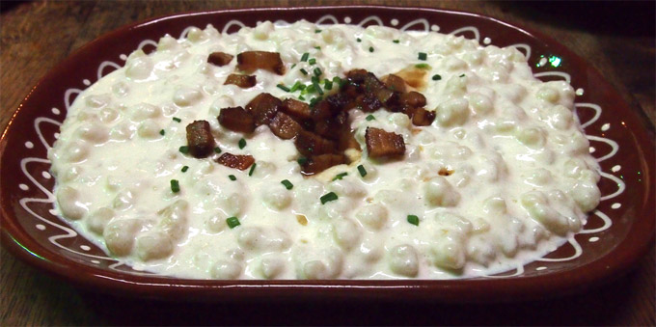
Traditional food
Bryndzové halušky
Dumplings with bryndza (cheese from sheep) and bacon

Slide 9
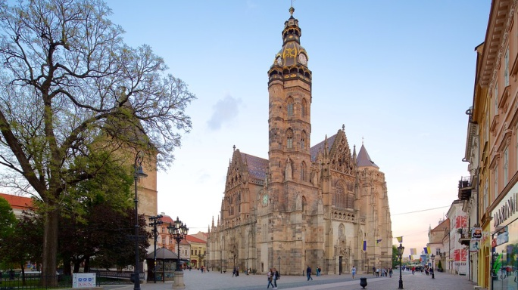
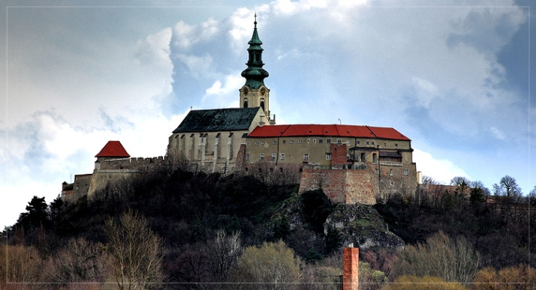
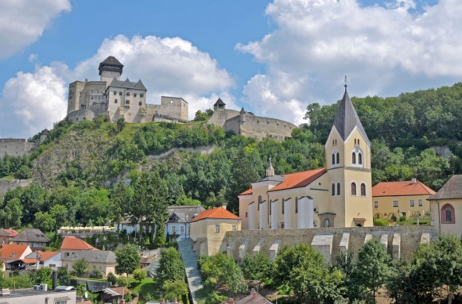
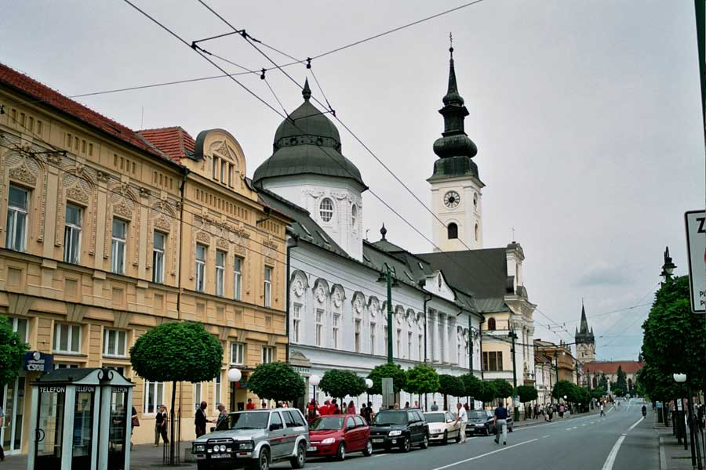
The biggest cities
Bratislava
Košice
Prešov
Žilina
Banská Bystrica
Nitra
Trnava
Trenčín
Martin
Poprad

Slide 10
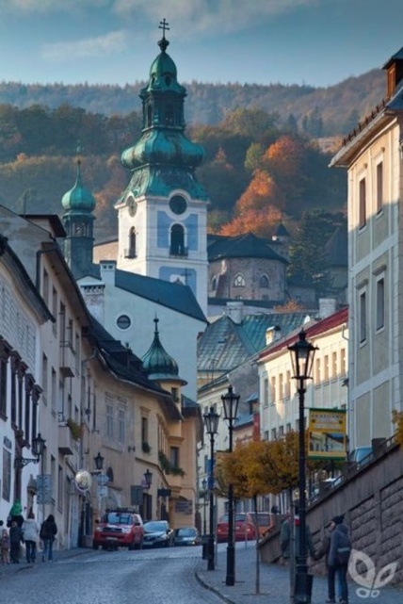
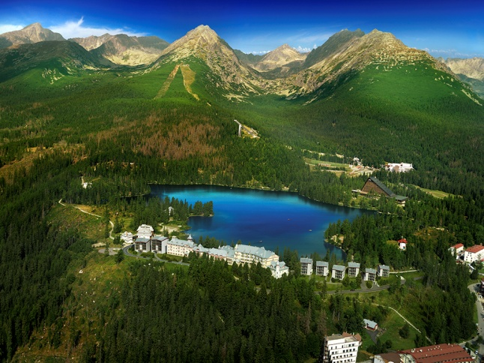
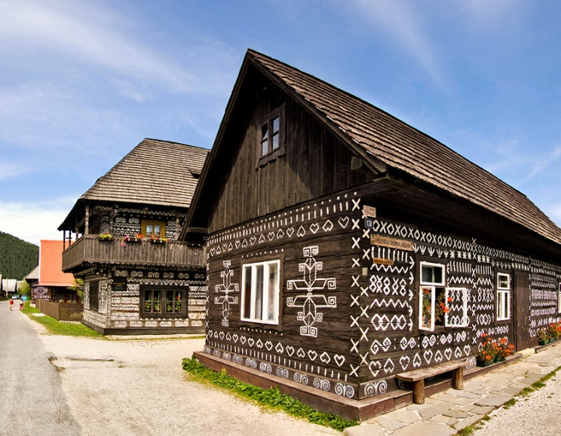
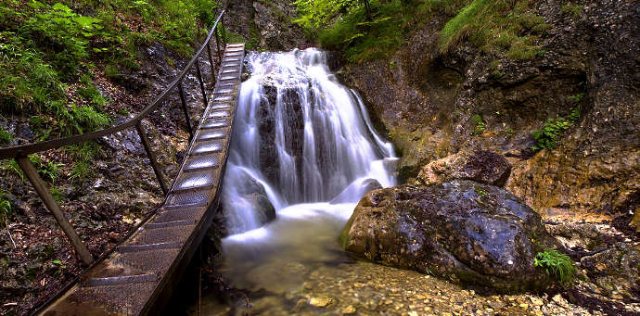
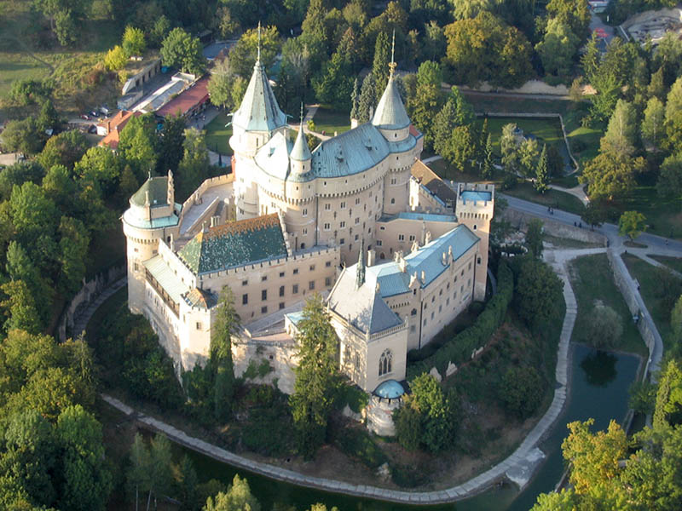

Slide 11
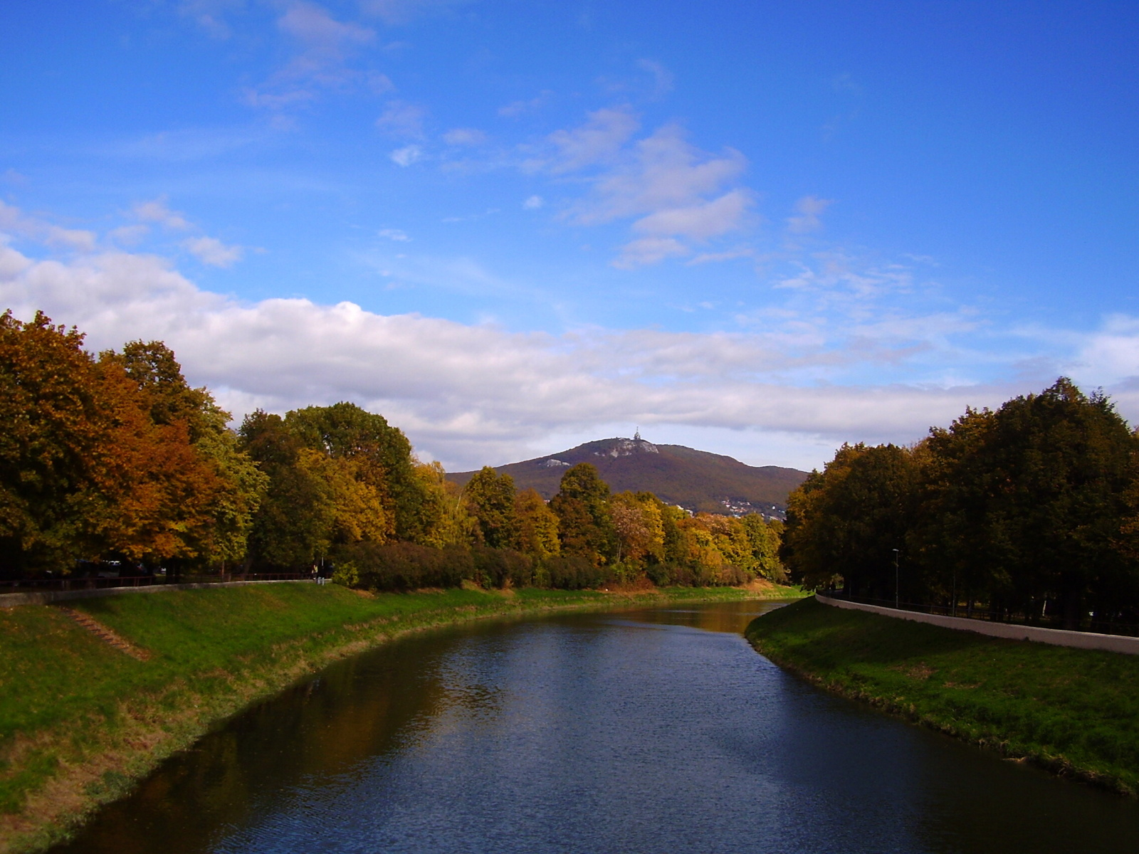
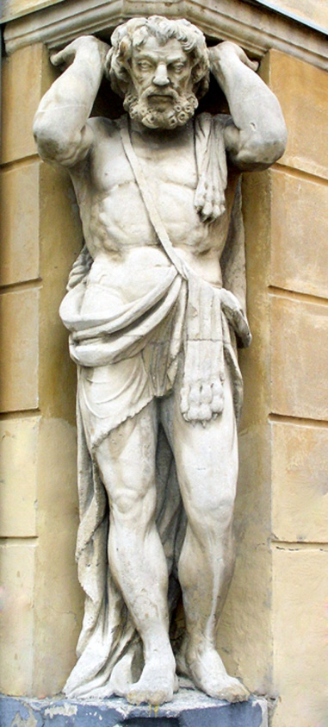
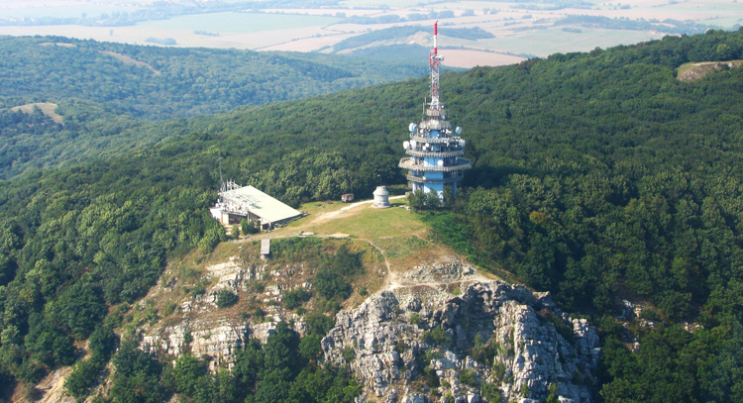
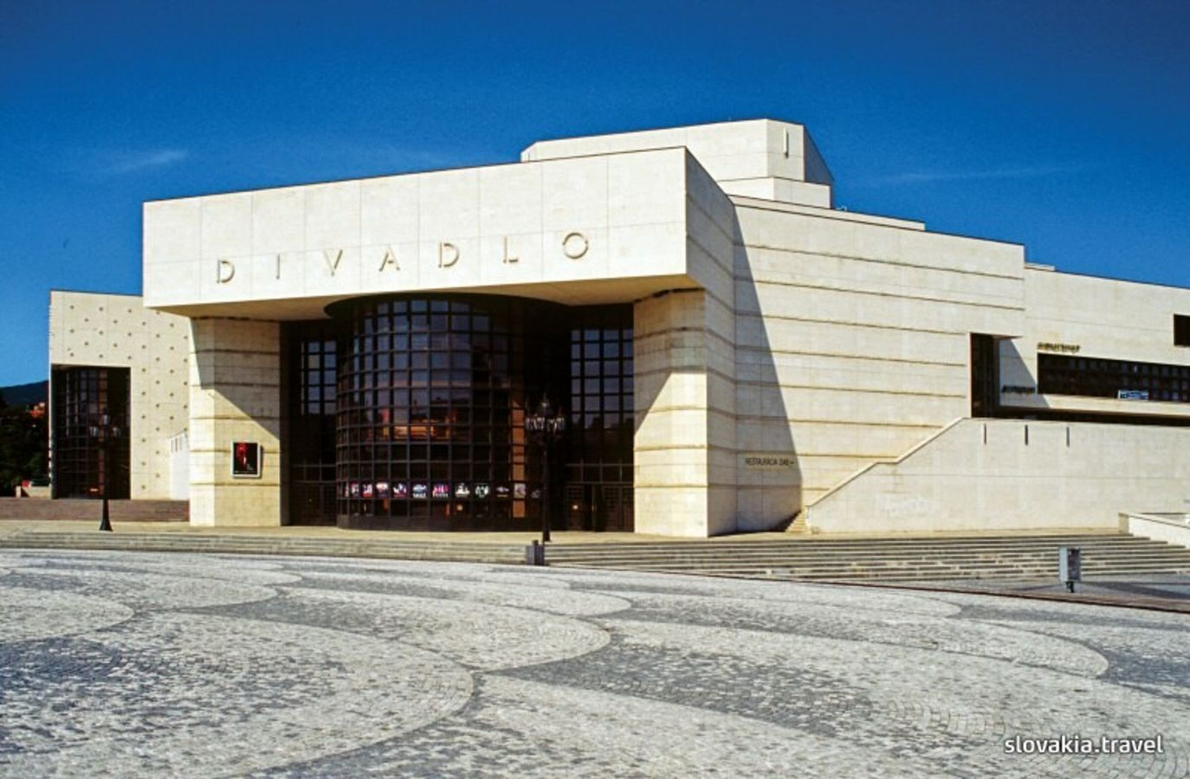
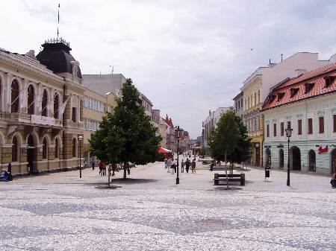
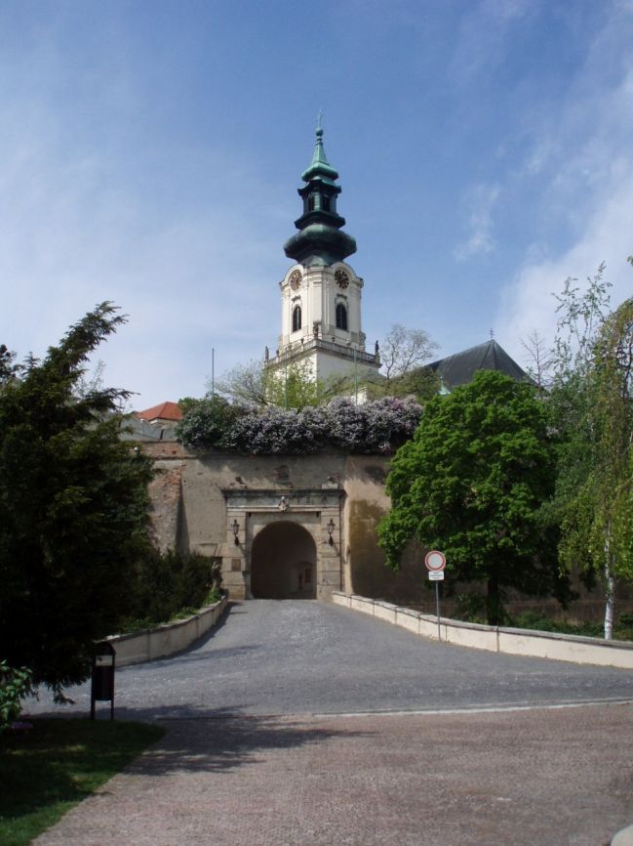
Nitra
West Slovakia

Slide 12
Thank you for your attention

