Slide 1
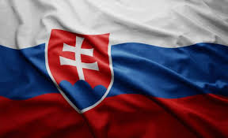
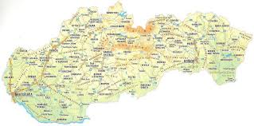
Slovakia
Laurent Molnár
Miroslav Zelenka

Slide 2
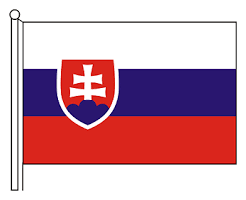
Slovak symbols
Flag
Emblem
Seal

Slide 3
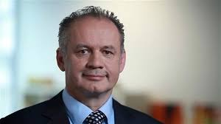
Some facts about Slovakia
Our capital city is Bratislava
President is Andrej Kiska
Neightbor states are Czech republic, Poland, Ukraine, Hungary, Austria
Population is 5 500 000
Our language is Slovak language
Slovakia is in middle Europe
Our anthem is : https://www.youtube.com/watch?v=oBd4HPqMt_w

Slide 4
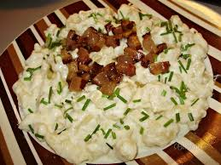
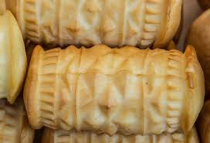
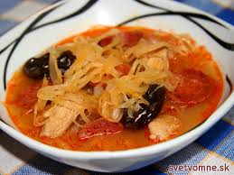
Traditional food
Bryndzové halušky
Oštiepok
Kapustnica

Slide 5
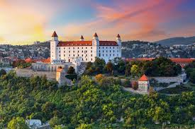
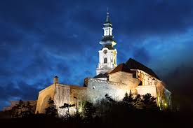
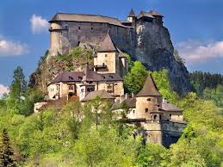
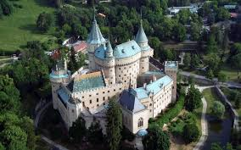
The most beautiful castles
Bratislava castle
Nitra castle
Orava castle
Bojnice castle

Slide 6
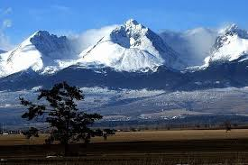
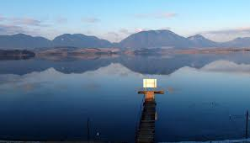
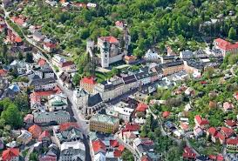
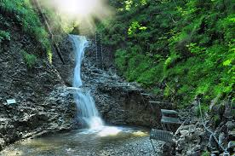
The most beautiful places
Hight Tatras
Liptovská mara
Banská Štiavnica
Slovenský raj

Slide 7
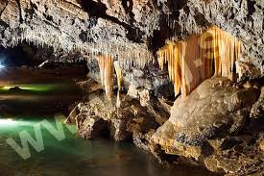
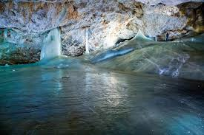
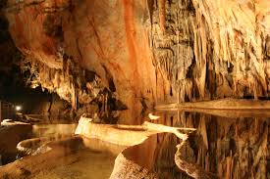
Beauties of our nature
Demänovská cave
Dobšinská ice cave
Ochtinská aragonitová cave

Slide 8
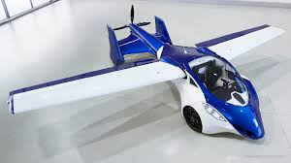
Famous Slovaks
Jozef Banič (inventor of parashute)
Štefan Klein (inventor of AeroMobil)
Peter Sagan (cyclist)
Pavol Demitra (hockey player)
Marián Gáborík (hockey player)

