Slide 1
Slovakia
Timotej Kopáč, Linda Veselá

Slide 2
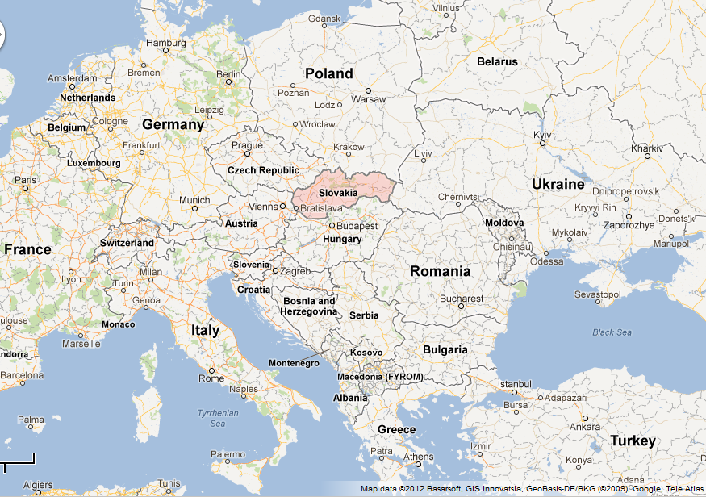
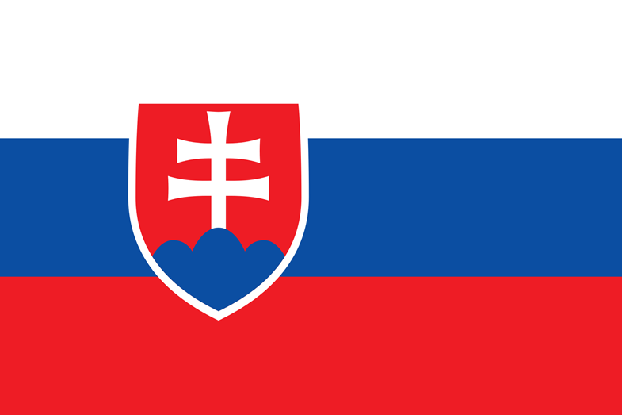
Slovakia
Officially Slovak Republic
Landlocked country in Central Europe
Bordered by Czech Republic, Austria, Poland, Ukraine, Hungary
Territory spans about 49,000km²

Slide 3
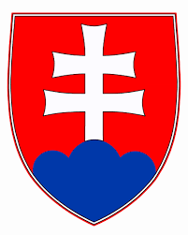
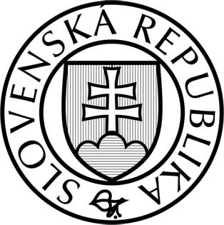
Slovakia
Population over 5 million
Capital and largest city is Bratislava
Language is Slovak
Parliamentary republic
President: Andrej Kiska
Anthem: Nad Tatrou sa blýska

Slide 4
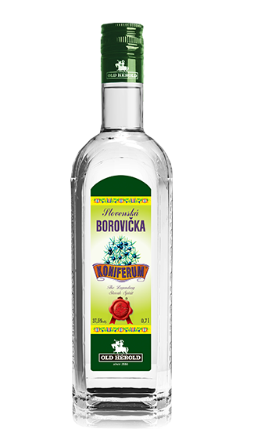
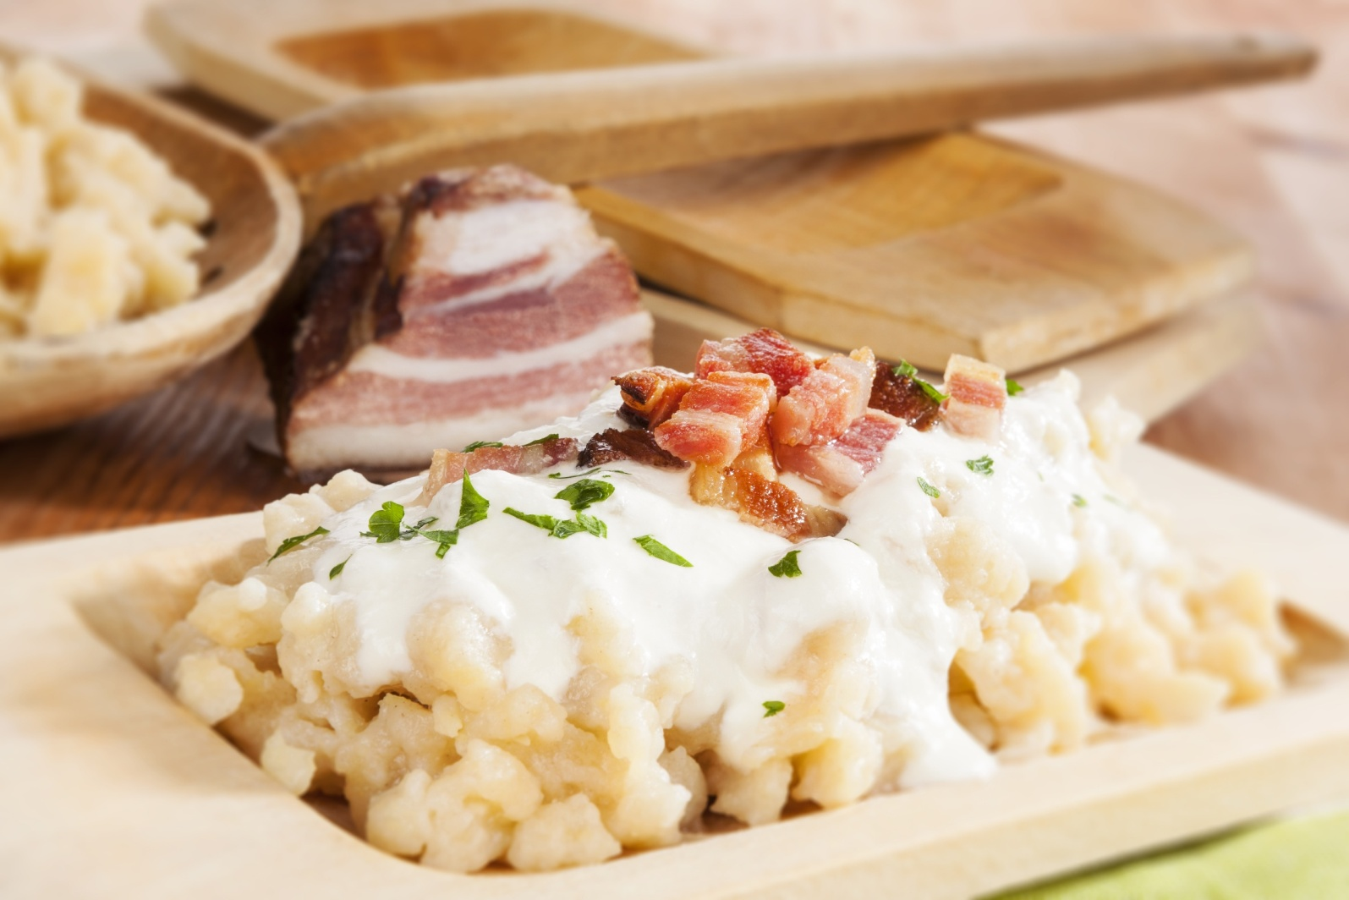
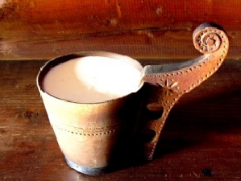
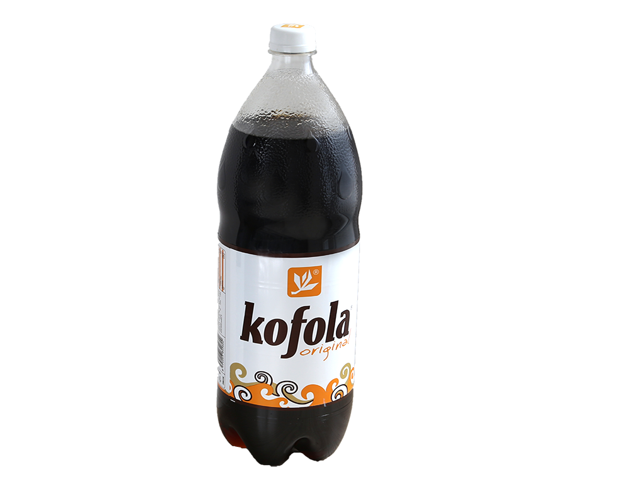
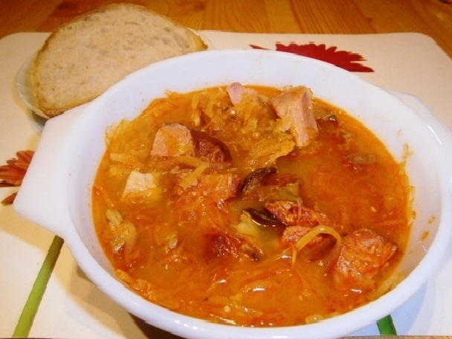
Traditional food and drinks
Bryndzové Halušky
Kapustnica
Žinčica
Kofola
Borovička

Slide 5
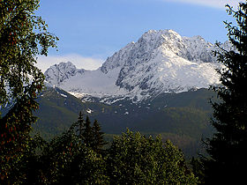
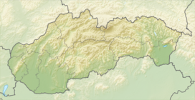
High Tatras
Emblem of Slovak Republic
Highest peak in Slovakia is Gerlachovský štít (2,655 metres)
Second highest is Lomnický štít
(2,634 metres)
Gerlachovský štít

Slide 6
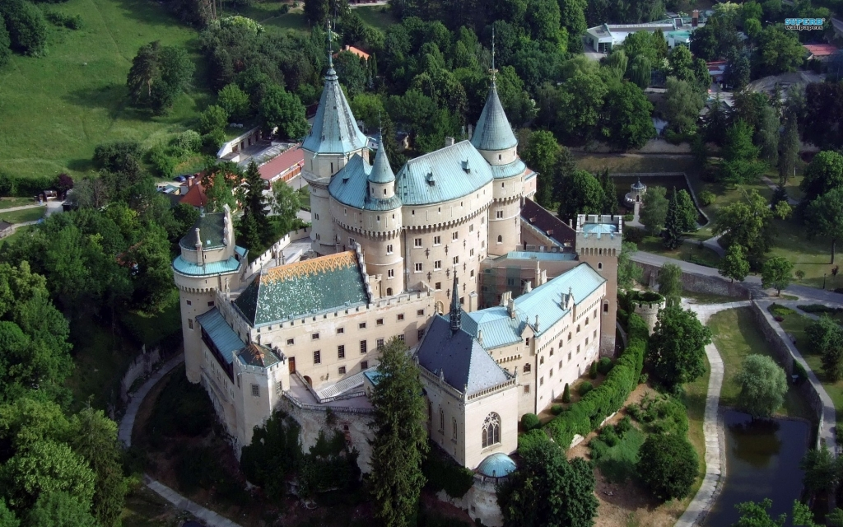
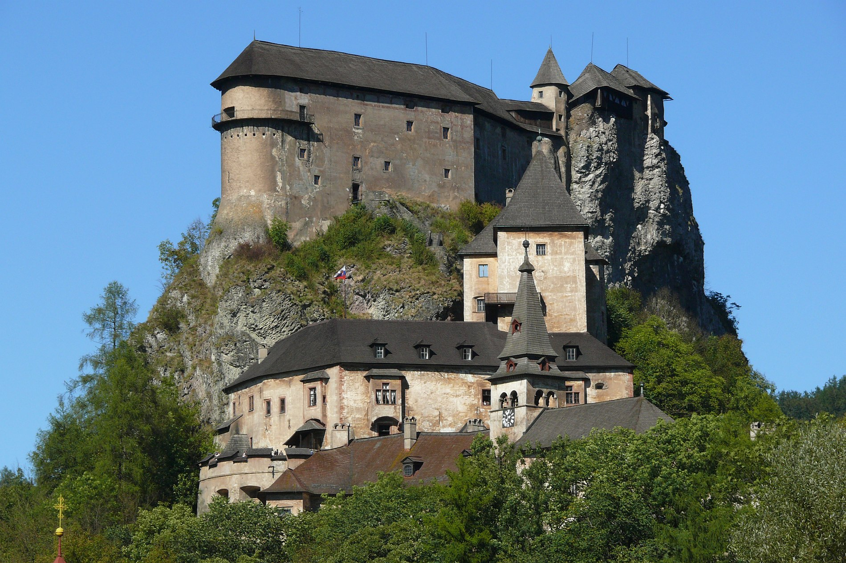
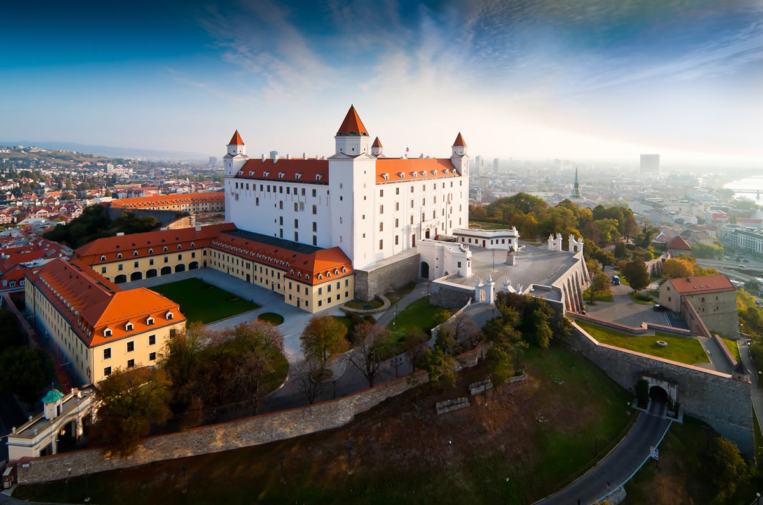
Tourism
Mostly popular are medieval castles, caves, folk architectures, spas and ski resorts
Castle Bojnice
Orava castle
Bratislava castle

Slide 7
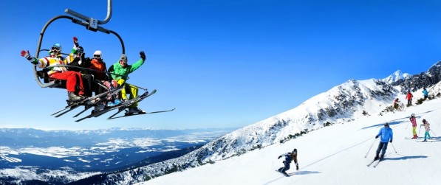
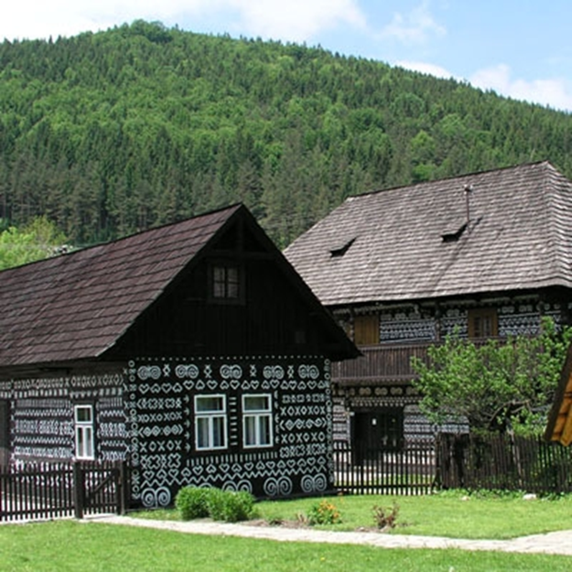
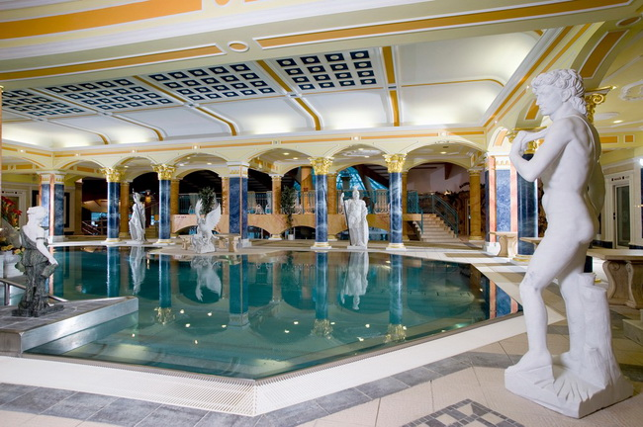
Tatranská Lomnica
Spa Rajecké Teplice
Folk village Čičmany

Slide 8
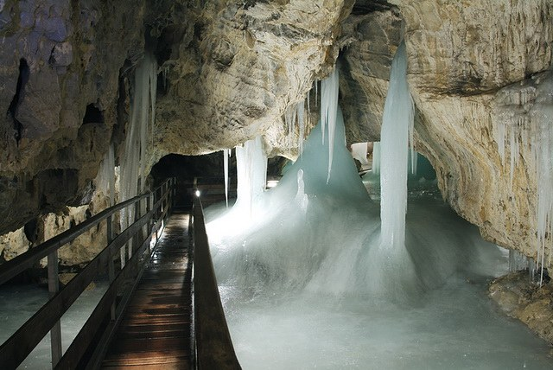
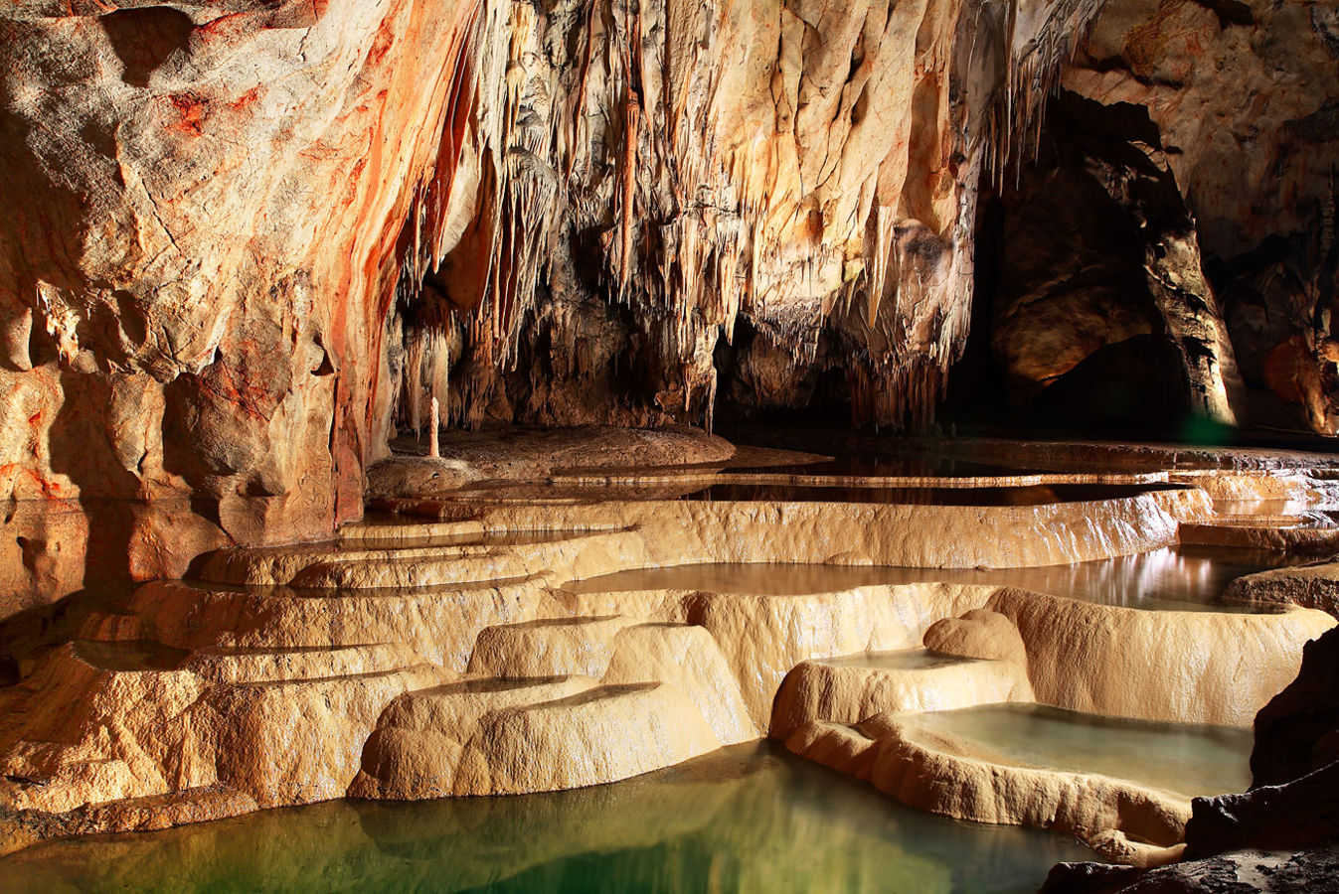
Cave - Demänovská ľadová jaskyňa
Cave - Domica
Grassalkovich Palace in Bratislava
Seat of the President of Slovakia

Slide 9
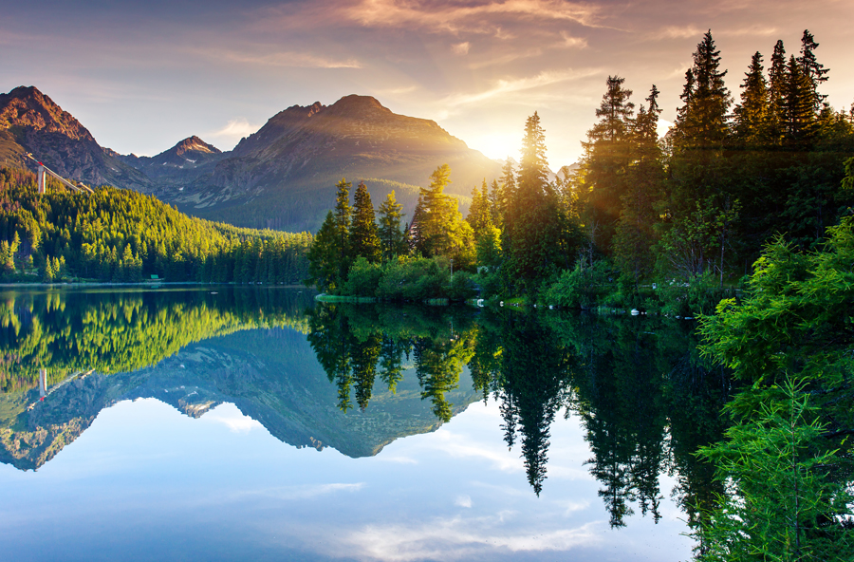
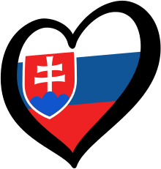
Thanks for watching!
Thanks for watching!

