Slide 1
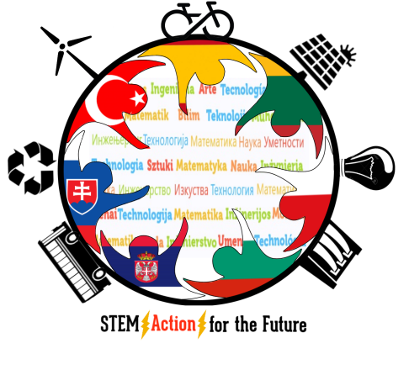
STEMAction for the Future
Slovakia

Slide 2
BIOMIMICRY
Biomimicry is the emulation of the models, systems, and elements of nature for the purpose of solving complex human problems.

Slide 3
How do we use biomimicry in life?
How do they help people?
What are the benefits of biomimicry?

Slide 4
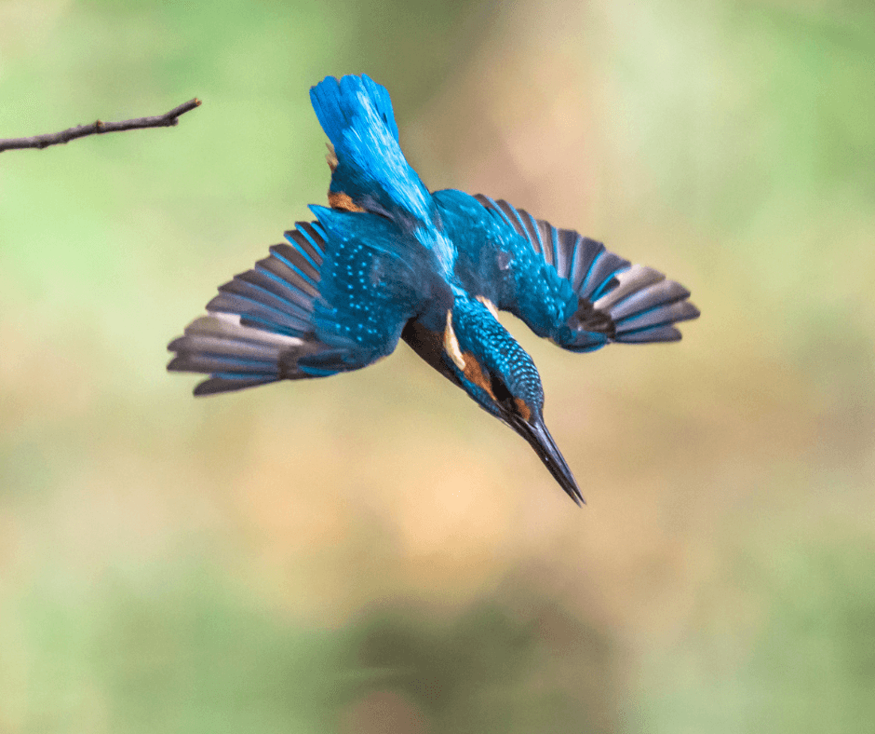
Examples of biomimicry
What does it remind you of?

Slide 6
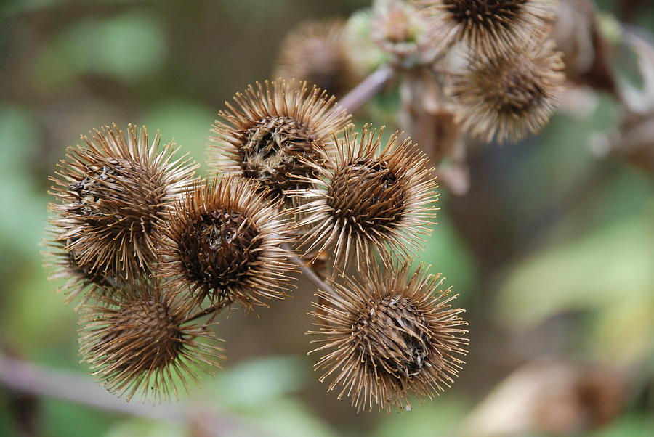

Slide 7
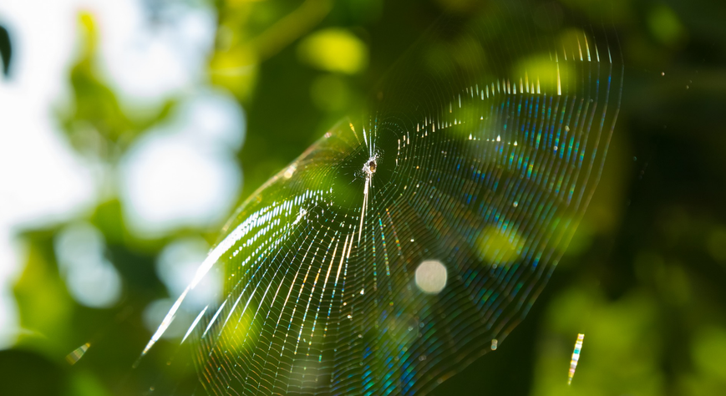

Slide 8
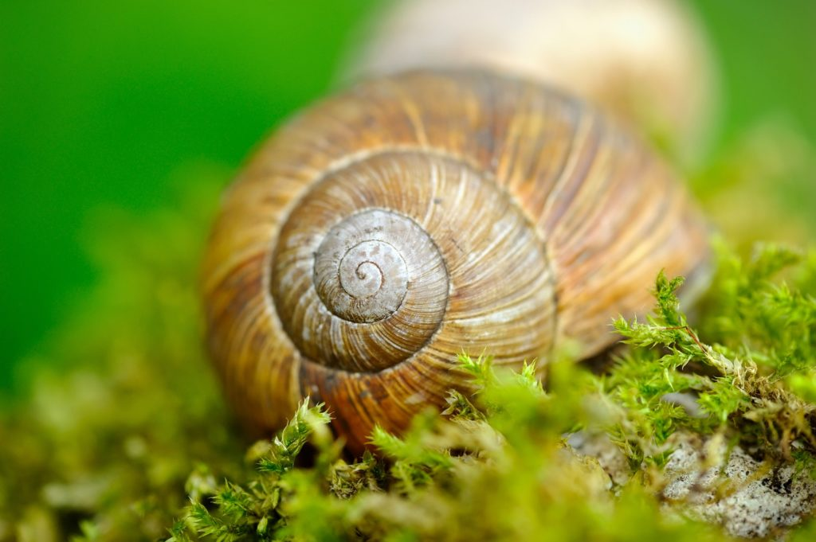

Slide 9
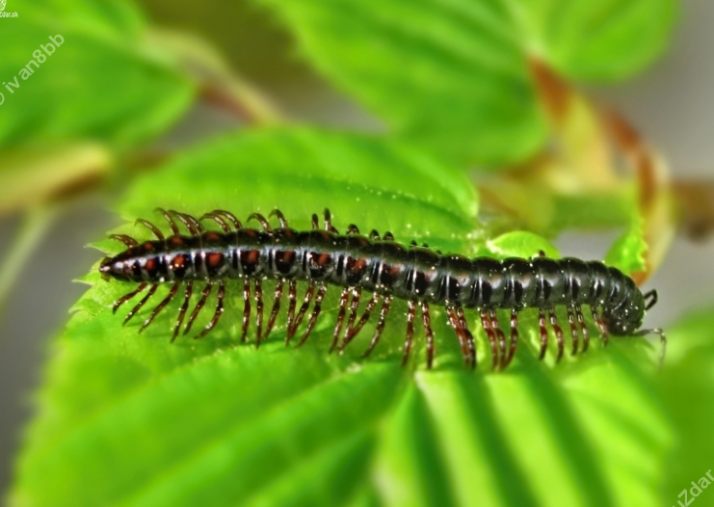

Slide 10
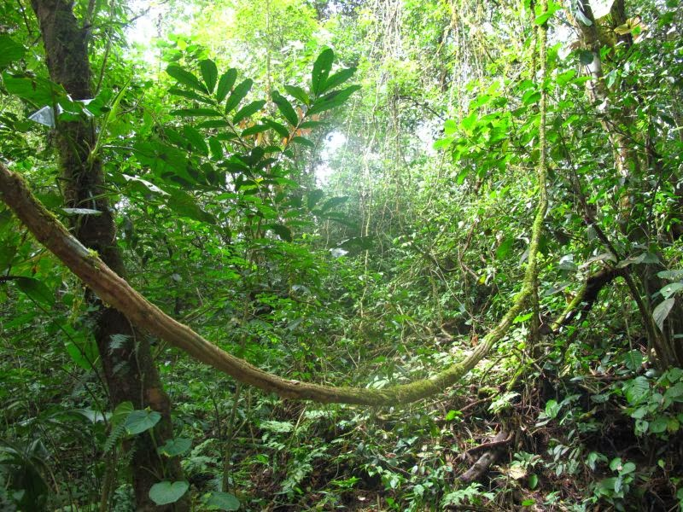

Slide 11
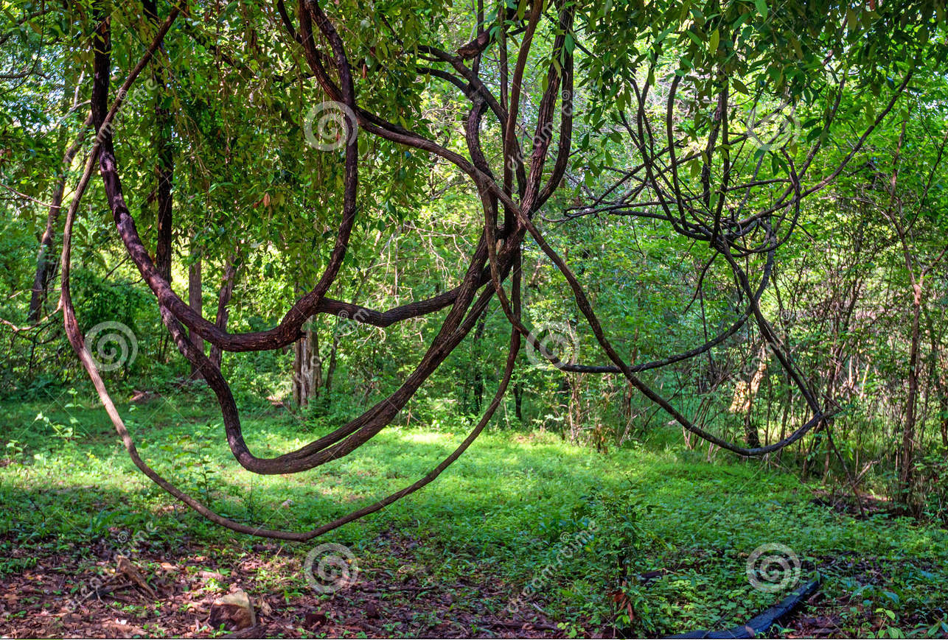

Slide 12
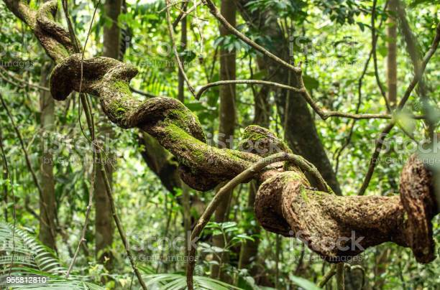

Slide 13
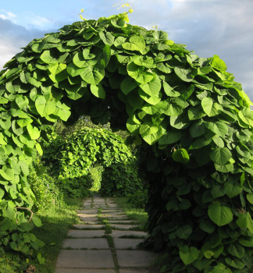

Slide 14
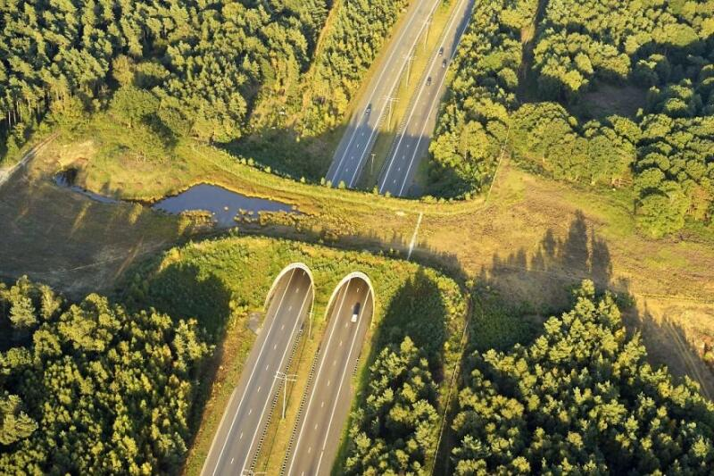
Ecoduct wildlife crossing in Belgium

Slide 15
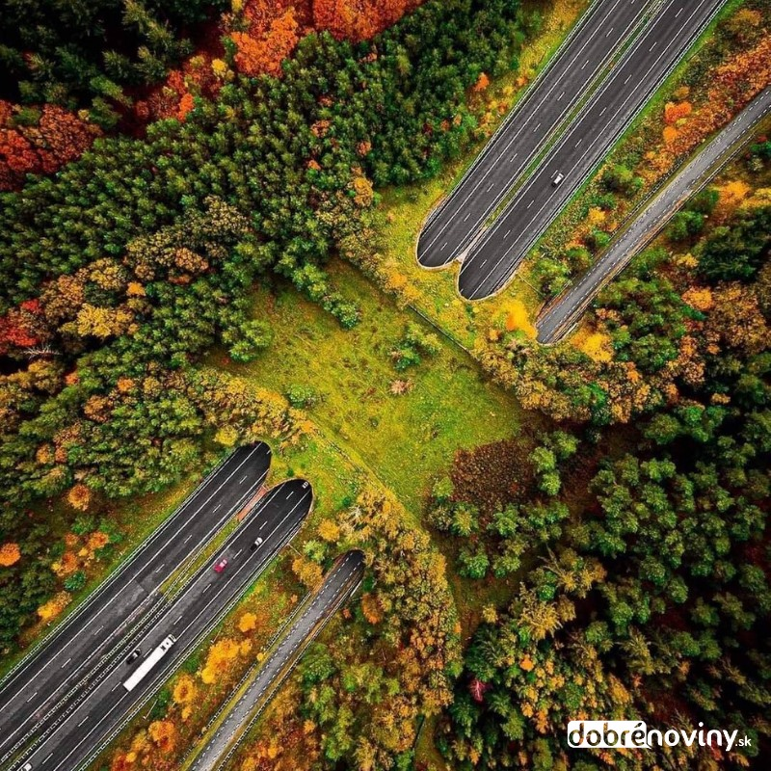
Ecoduct in Netherlands

Slide 16
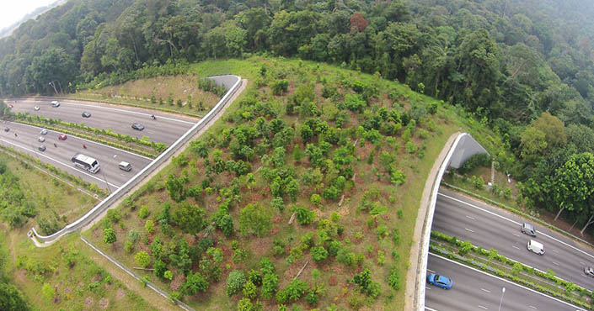

Slide 17
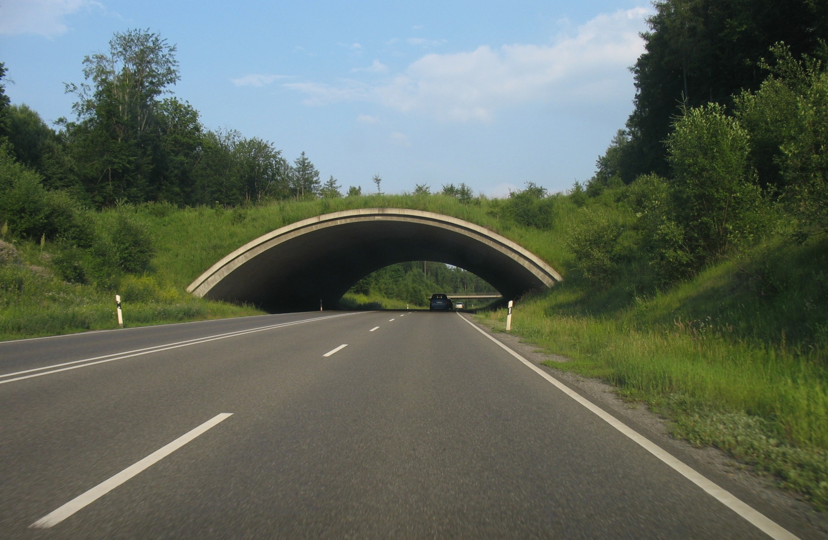

Slide 18
Why are ecoducts important?
What problem do they solve?
For what kind of animals are they build?
Do you know how many ecoducts are in your country?

Slide 19
Instructions:
Time: 90 minutes
Load capacity of bridge: 1 kg
Materials: wooden sticks
twine
moss
melt gun
cardboard
markers
kitchen scale
plasticise
protractor
Groups: 6 consisting of 5 students

Slide 20
Thank you for your attention!

