Slide 1
The School of Tolkkinen
The City of Porvoo, Finland

Slide 2
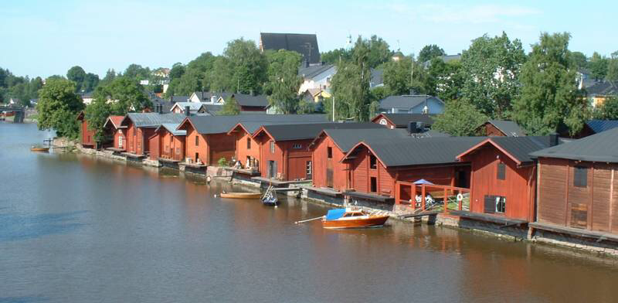
Welcome to Porvoo!

Slide 3
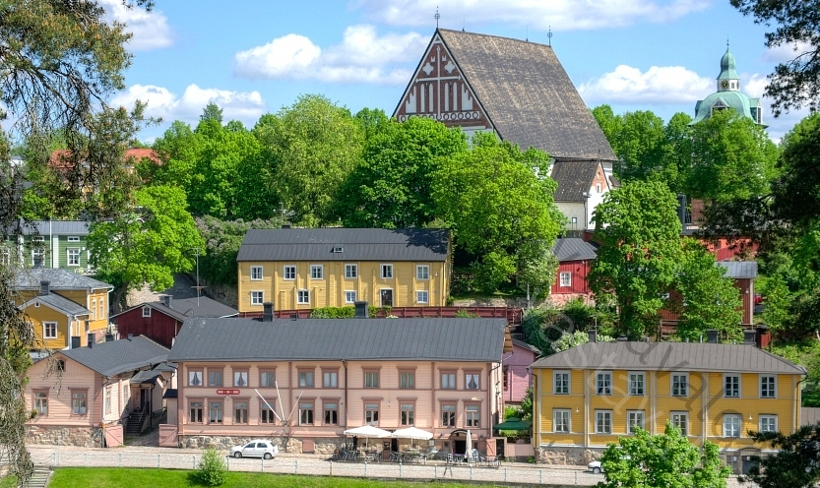
The city of Porvoo
About 50 kilometres from Helsinki to east, on the southern coast of Finland.
Established in 1380's.
Approximately 50 000
residents.
16 Finnish-speaking
schools,
14 Swedish-speaking
schools.

Slide 4
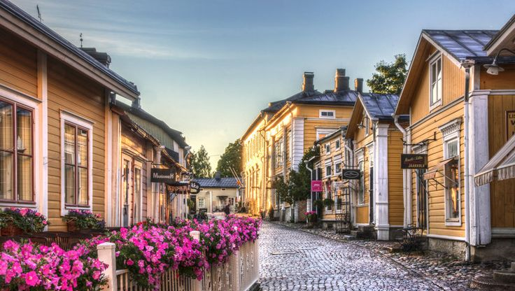
The city of Porvoo
Famous for the chocolate factory and delicates.
The old city brings in thousands of tourists through the year.

Slide 5
Our growing school

Slide 6
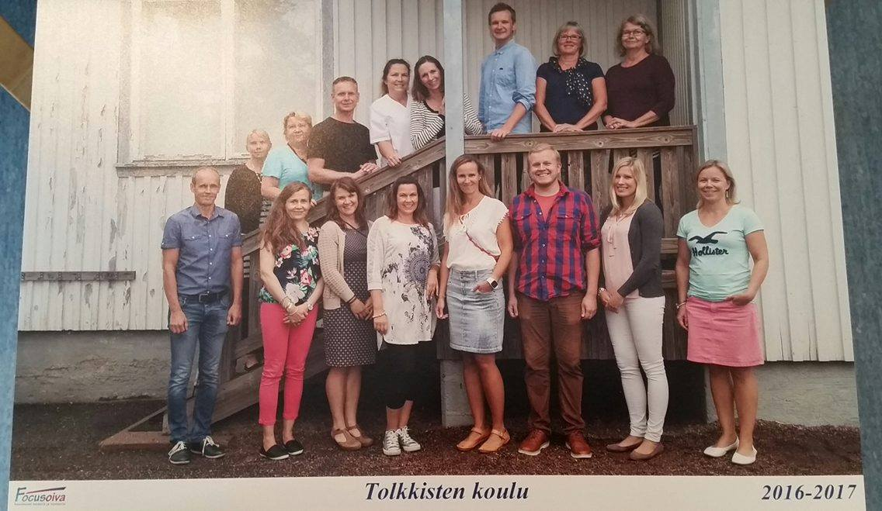
In our school works...
214 pupils, ages 7 to 12, grades 1 to 6.
Eleven classes, twelve next semester.
Thirteen teachers, three class assistants.
Other adults.

Slide 7
Our school and classes..
Every teachers teaches the same children approximately 2-3 grades.
Teachers also exchange lessons (music, English, handicraft, etc.)
In a couple of years there is going to be a new school building.
In Porvoo there are 16 Finnish speaking schools, and 14 Swedish speaking schools at the moment.

Slide 8
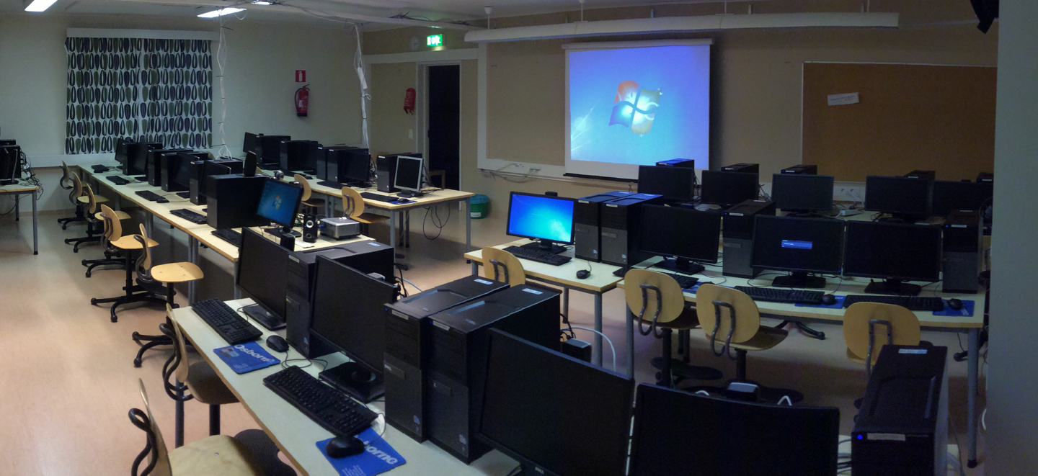
We have a projector and a whiteboard in each classroom and a couple of electronic schoolbook licences.
Our IT-lab considers 24 computers...
... Which are due to improve in year 2017.
Our IT-education is undergoing a great change in a couple of months.
Also the Finnish curriculum is under renovation.

