Slide 1
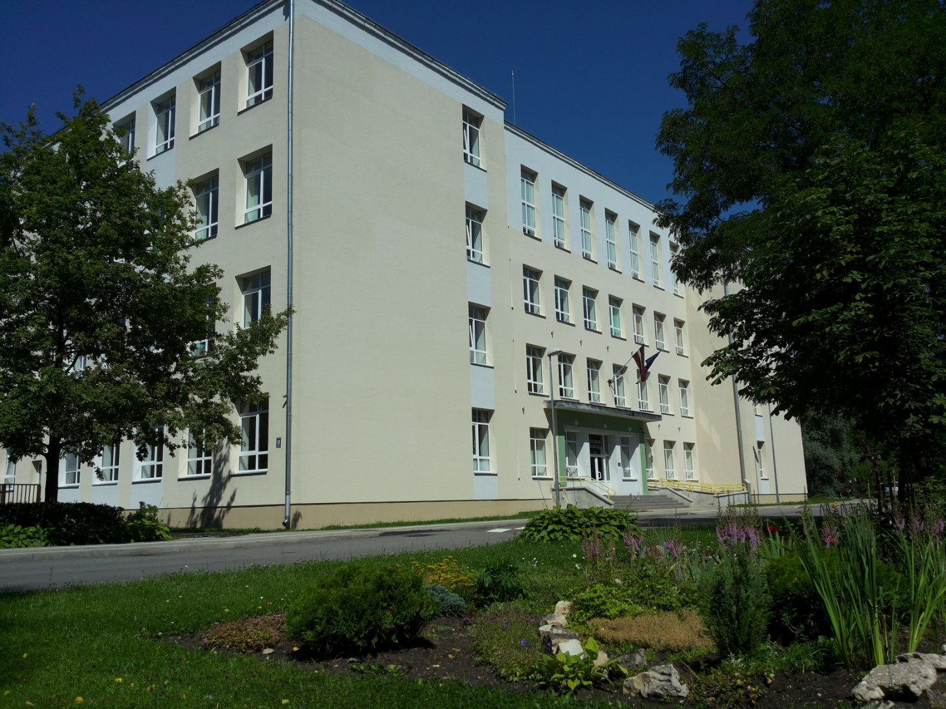
LATVIA
GULBENES
VIDUSSKOLA

Slide 2
About school
357 students
21 class sets
Teaching staff – 47
Technical staff – 20
In primary school clases pupils from 7 – 12 years.
In secondary school only 9th and 12th grades.
Uniforms – vests- since 2016 /2017

Slide 3
School year
Starts - 1st of September Finishes – end of May
1 lesson = 40 min
Marks – from 1 to 10
(10 maximum)
Holidays
Autumn holidays – 1 week in October
Winter holidays – 2 weeks (end of December – beginninf of January)
Spring holidays - 1 week in March
Summer holidays – 3 months (June, July, August)

Slide 4
How do we learn?
The school is open from 07:30 to 17:00.
After lessons 1st to 4th grade can visit extended day group lessons.
We are provided with free textbooks and necessary workbooks.

Slide 5
Our lunch
1st to 9th grade pupils once a day get free hot lunch.
School takes part in programs: “School fruit program” and
“School milk program” – we get free milk and fruits.

Slide 6
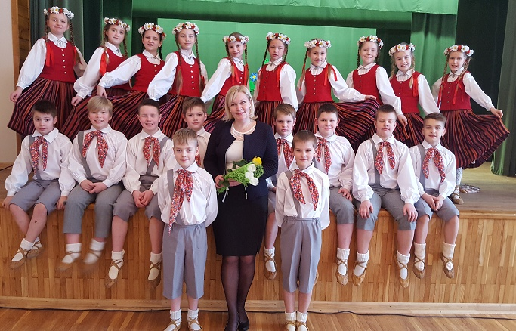
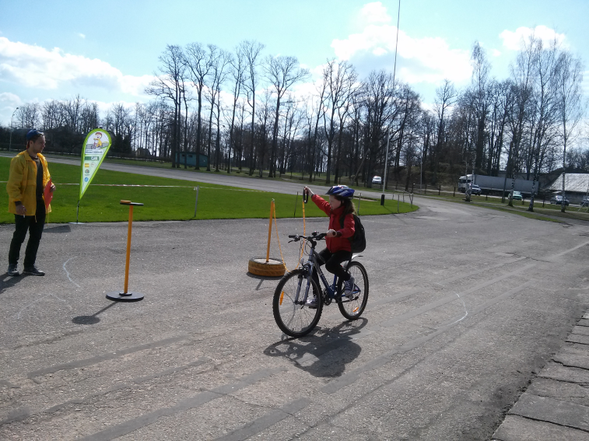
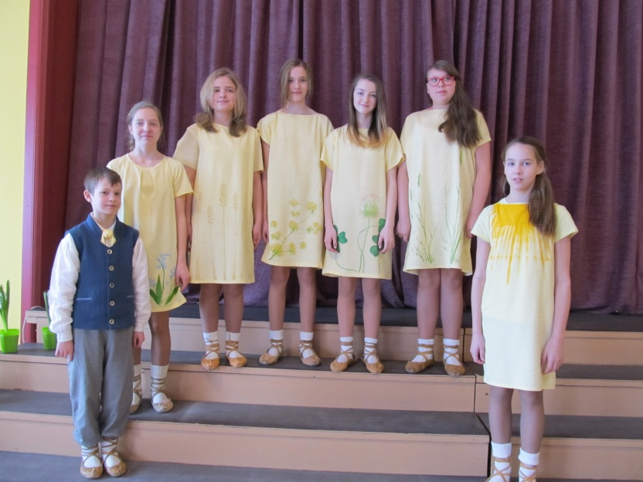
Clubs/interest groups in our school
Folk dancing
Choir
Ensemble
Contemporary dance
Ballroom dancing
Cycling club
Freestyle wrestling
General physical development group
Visual arts and plastic club
Environmental hobby group
Aircraft modeling club
Sand games

Slide 7
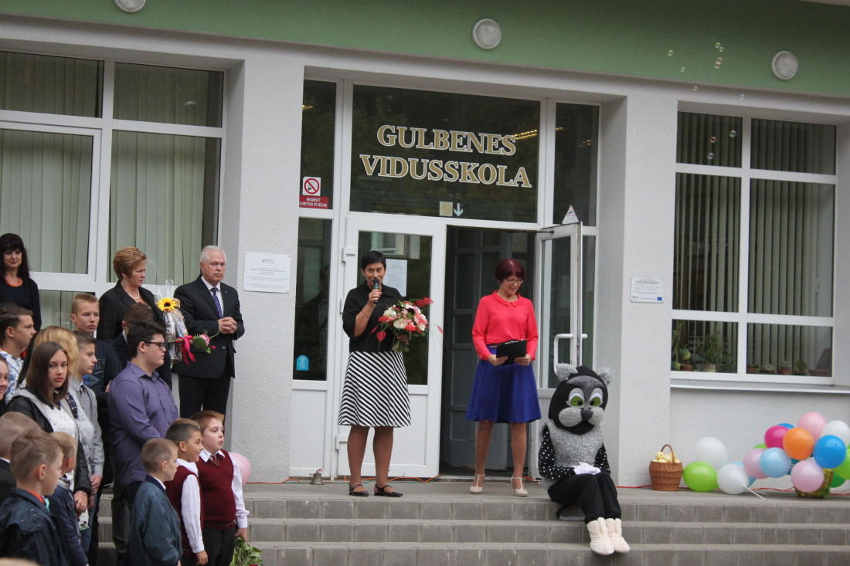
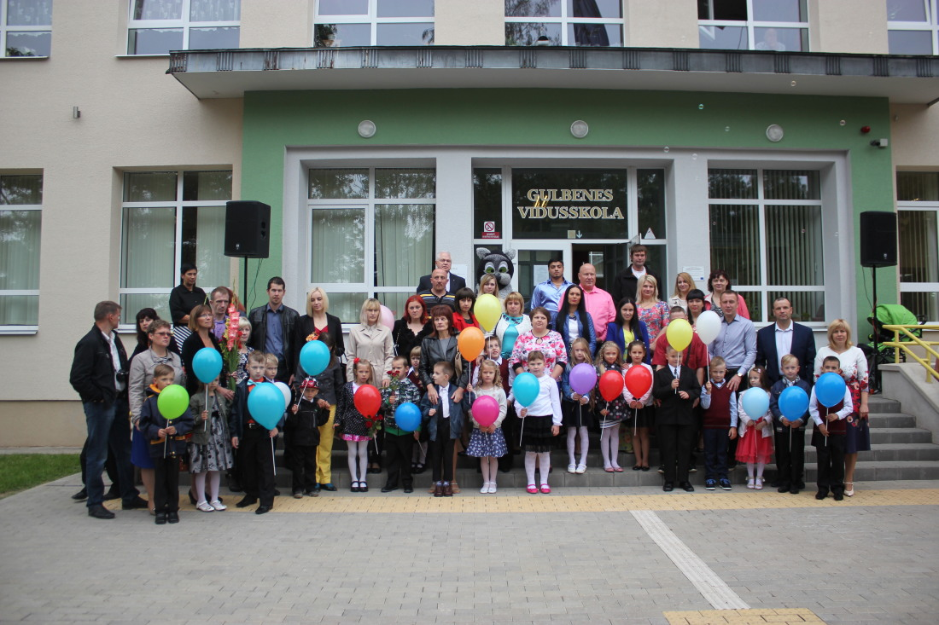
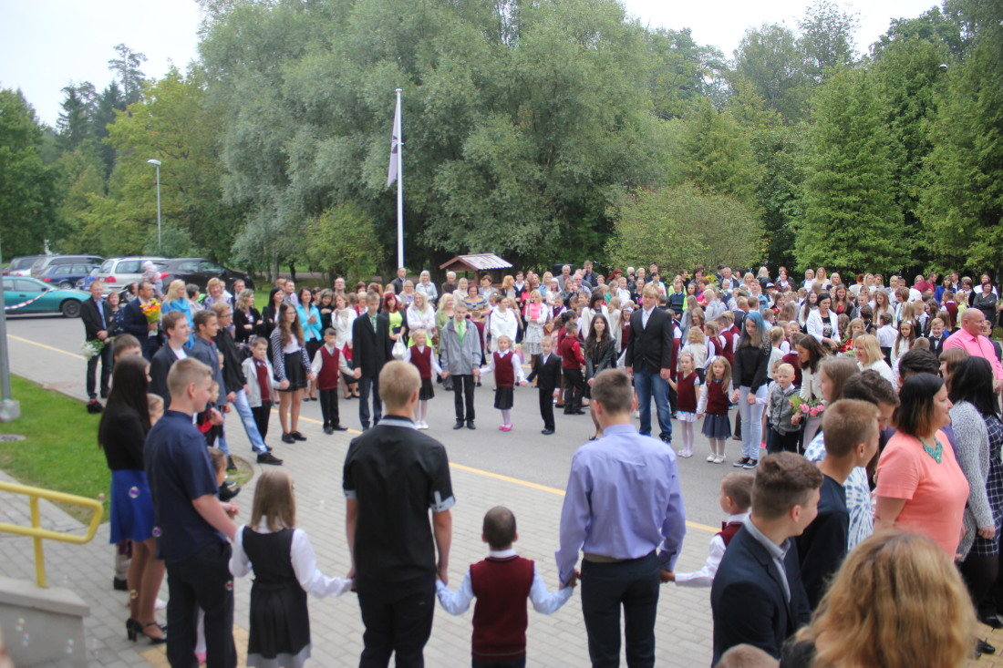
1st September

Slide 8
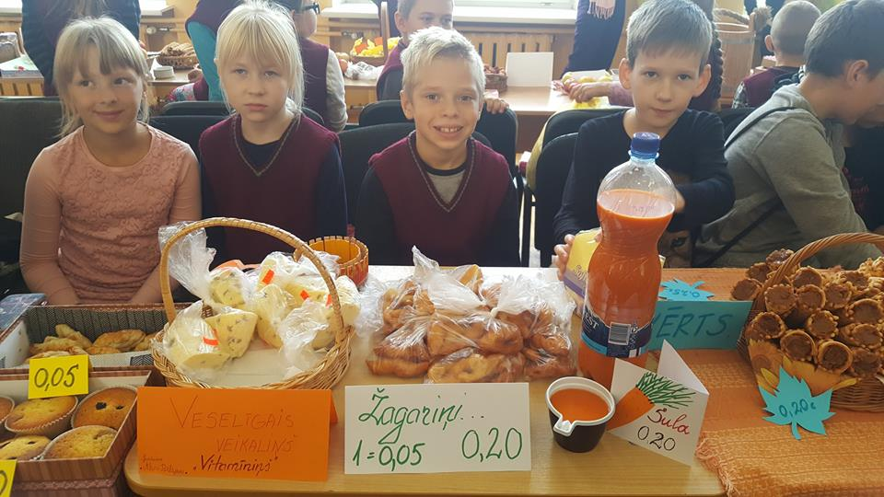
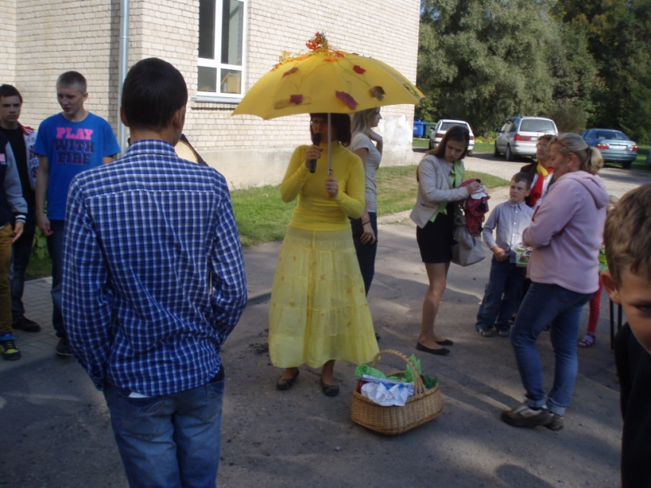
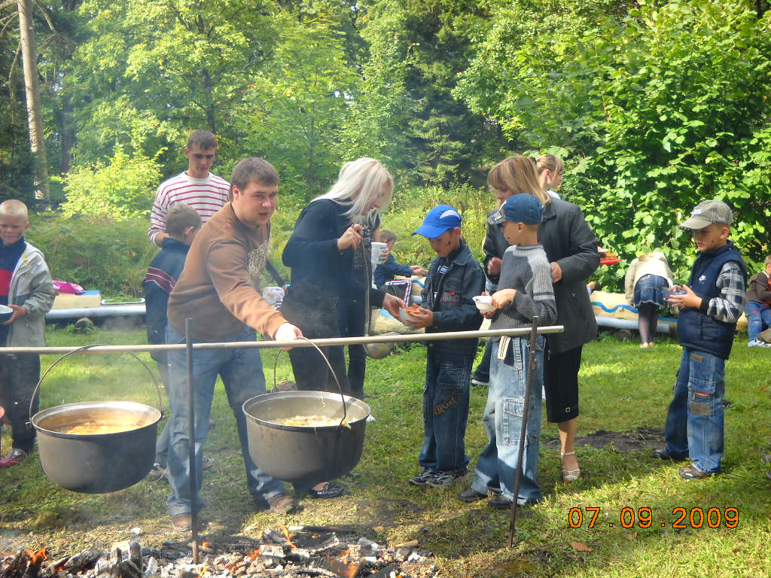
Autumn activities

Slide 9
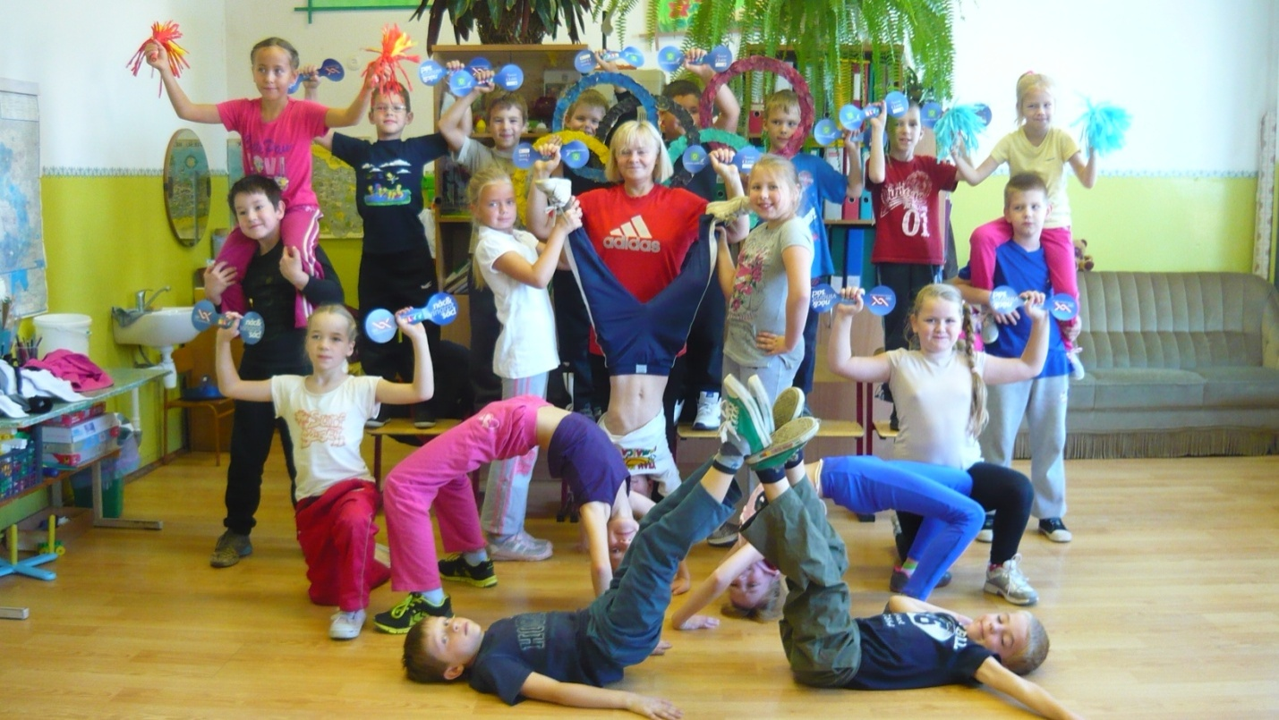
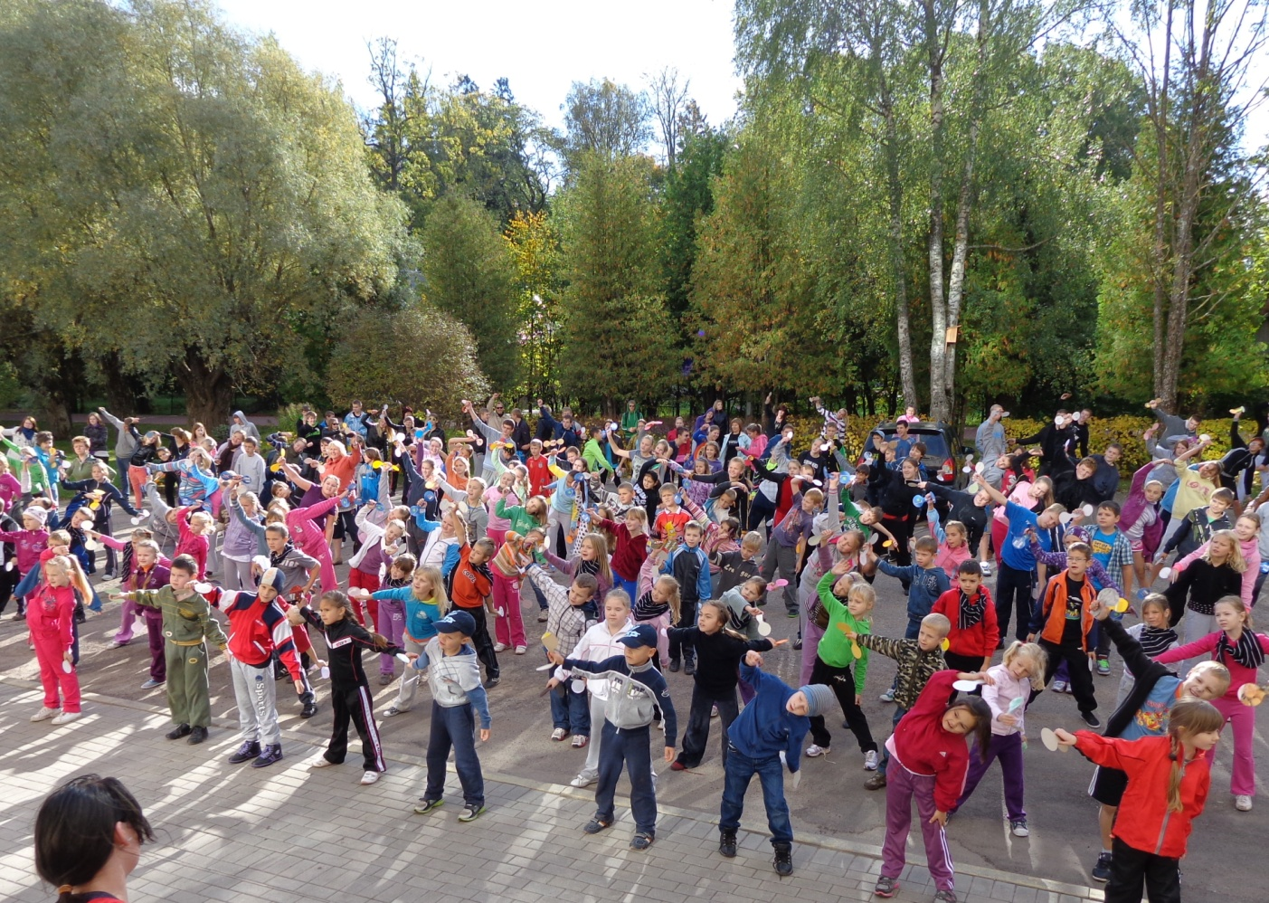
Olympic days

Slide 10
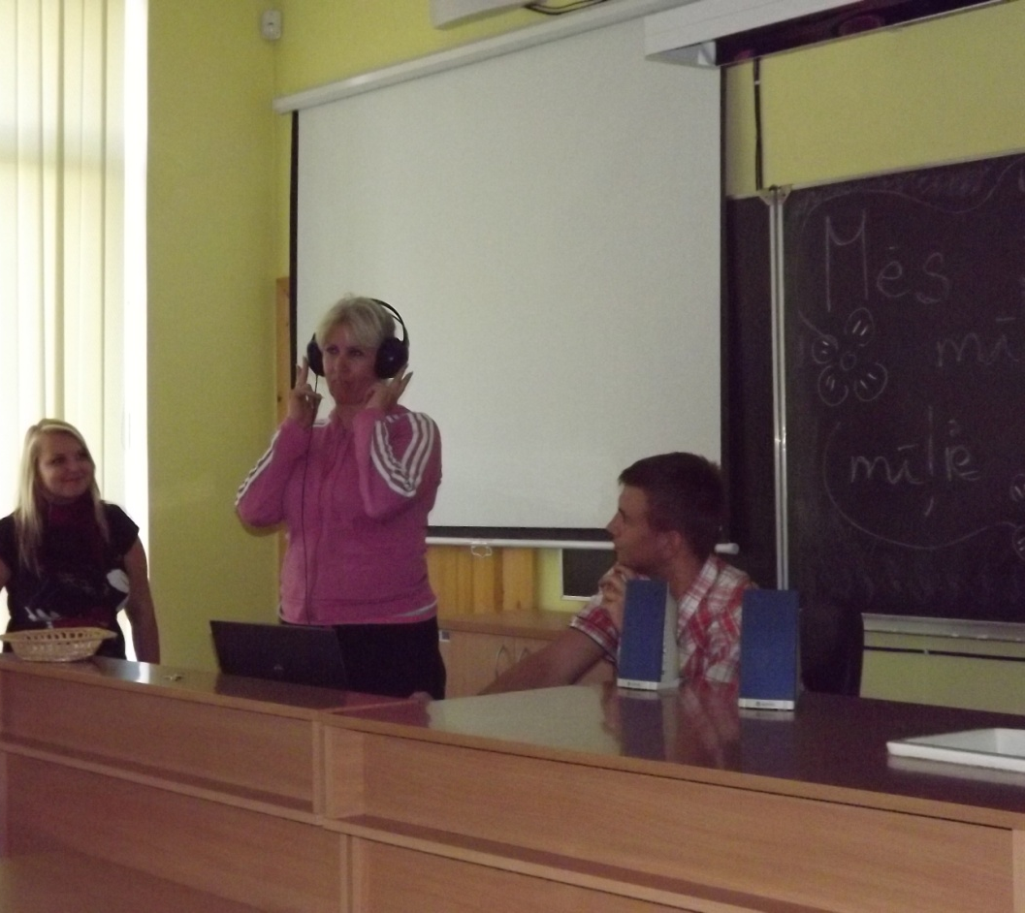
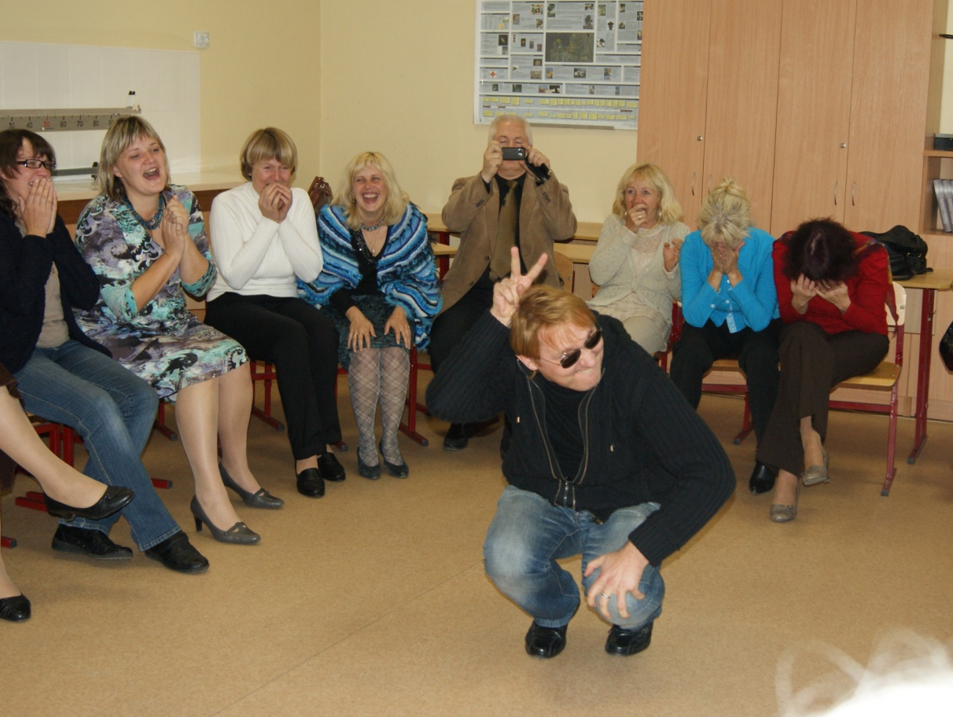
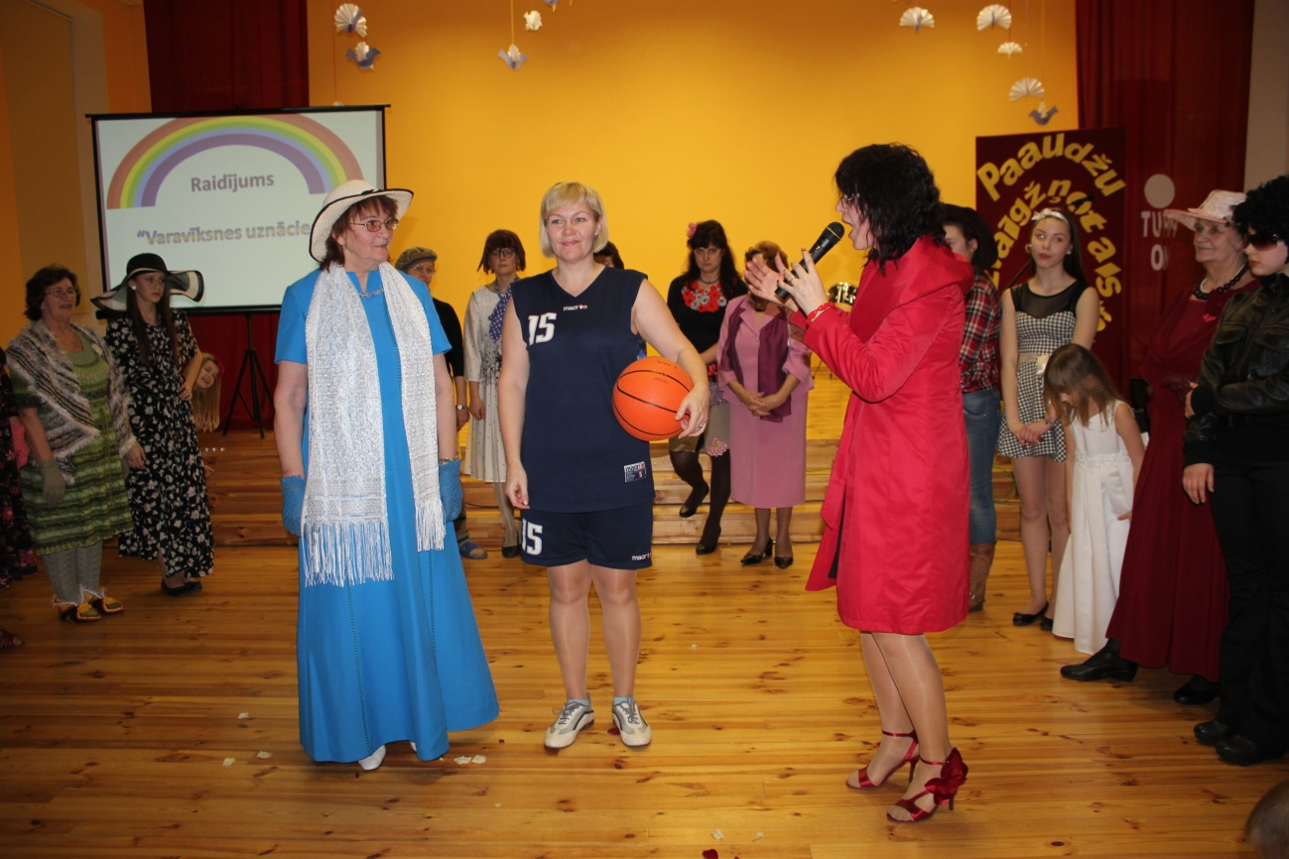
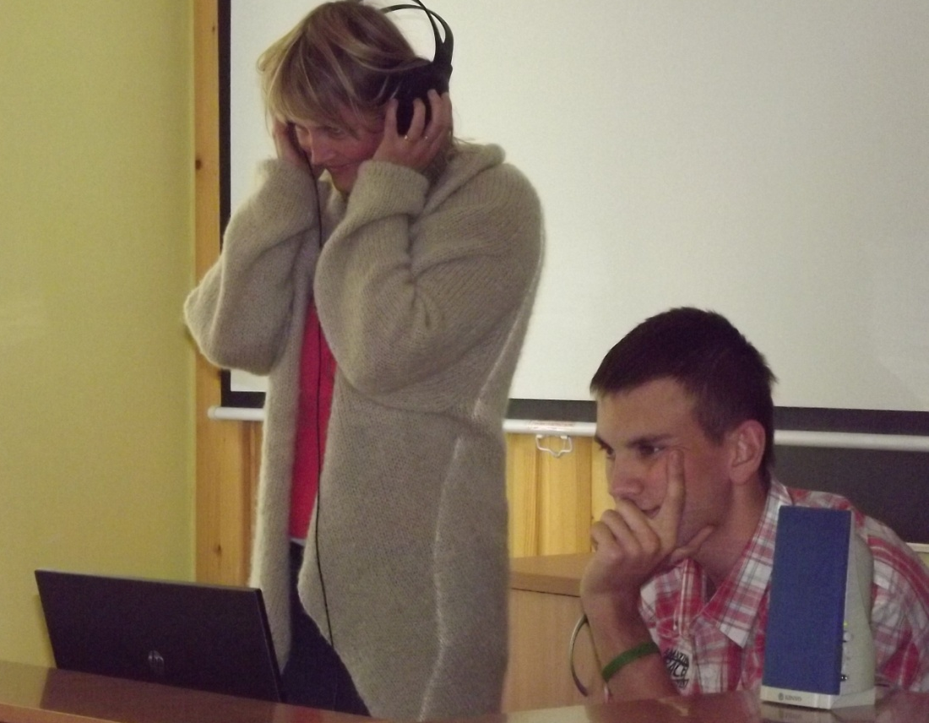
Teachers’ day

Slide 11
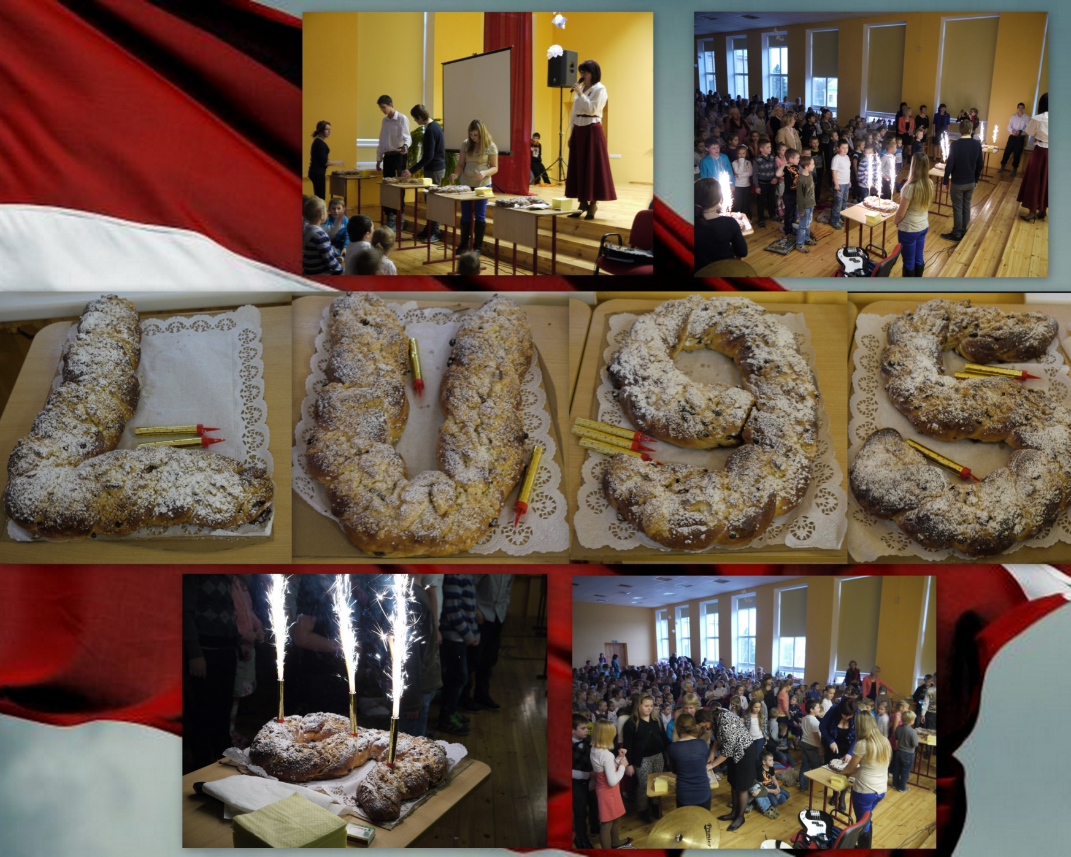
National Holidays

Slide 12
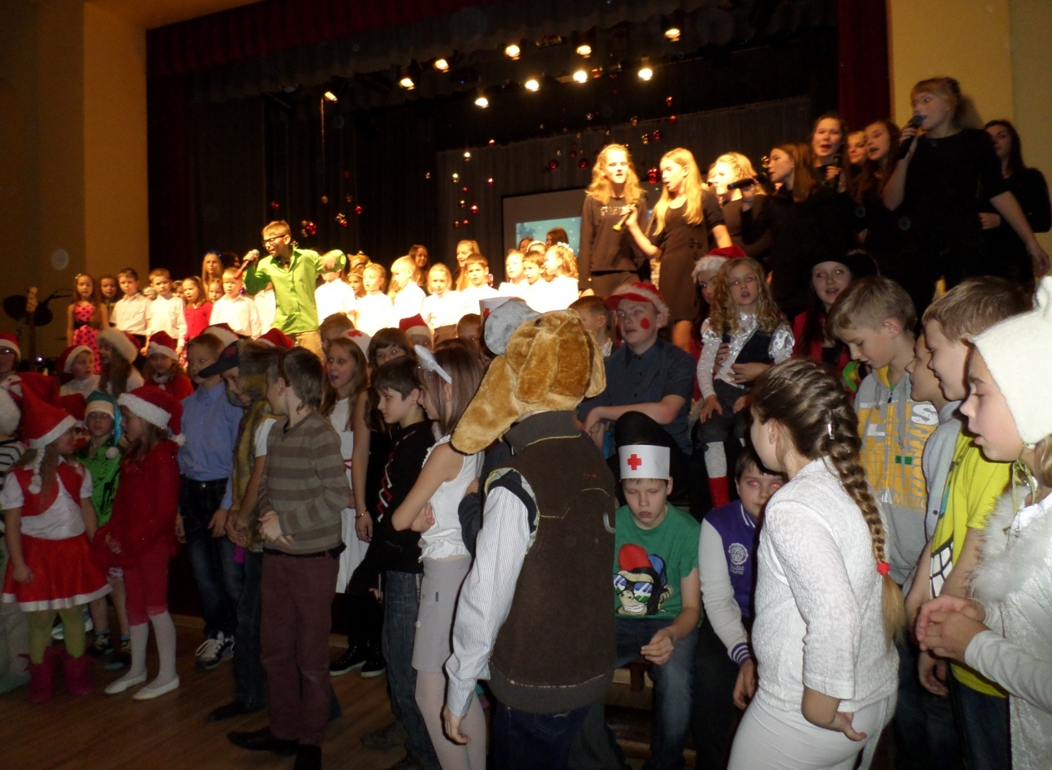
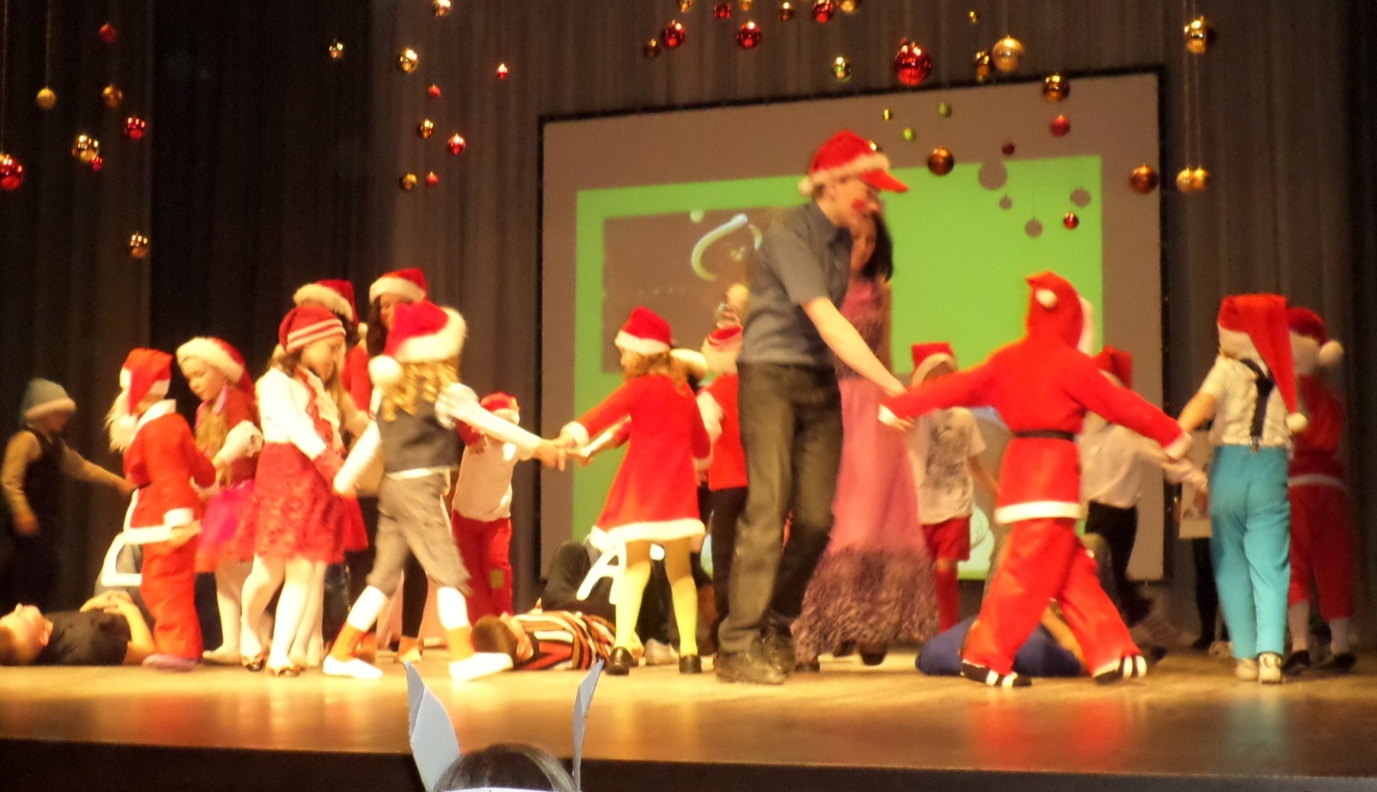
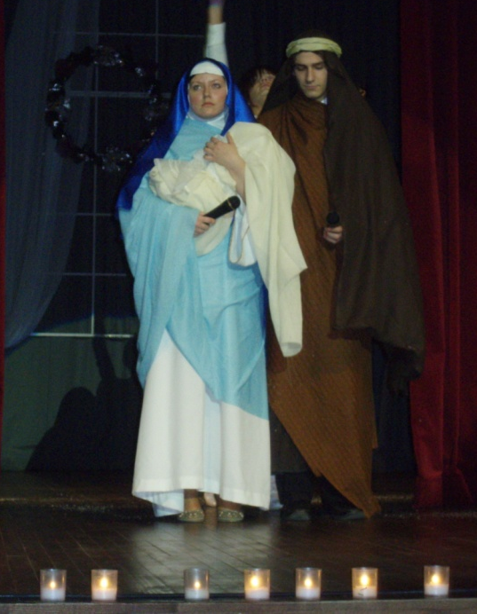
Christmas event

Slide 13
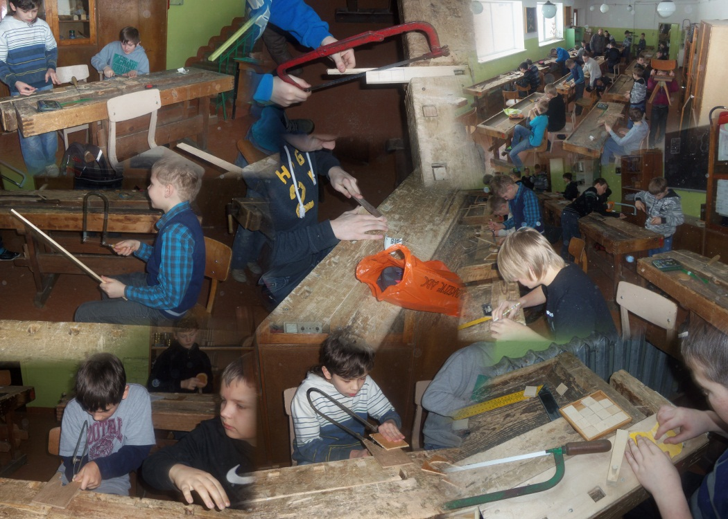
Project week

Slide 14
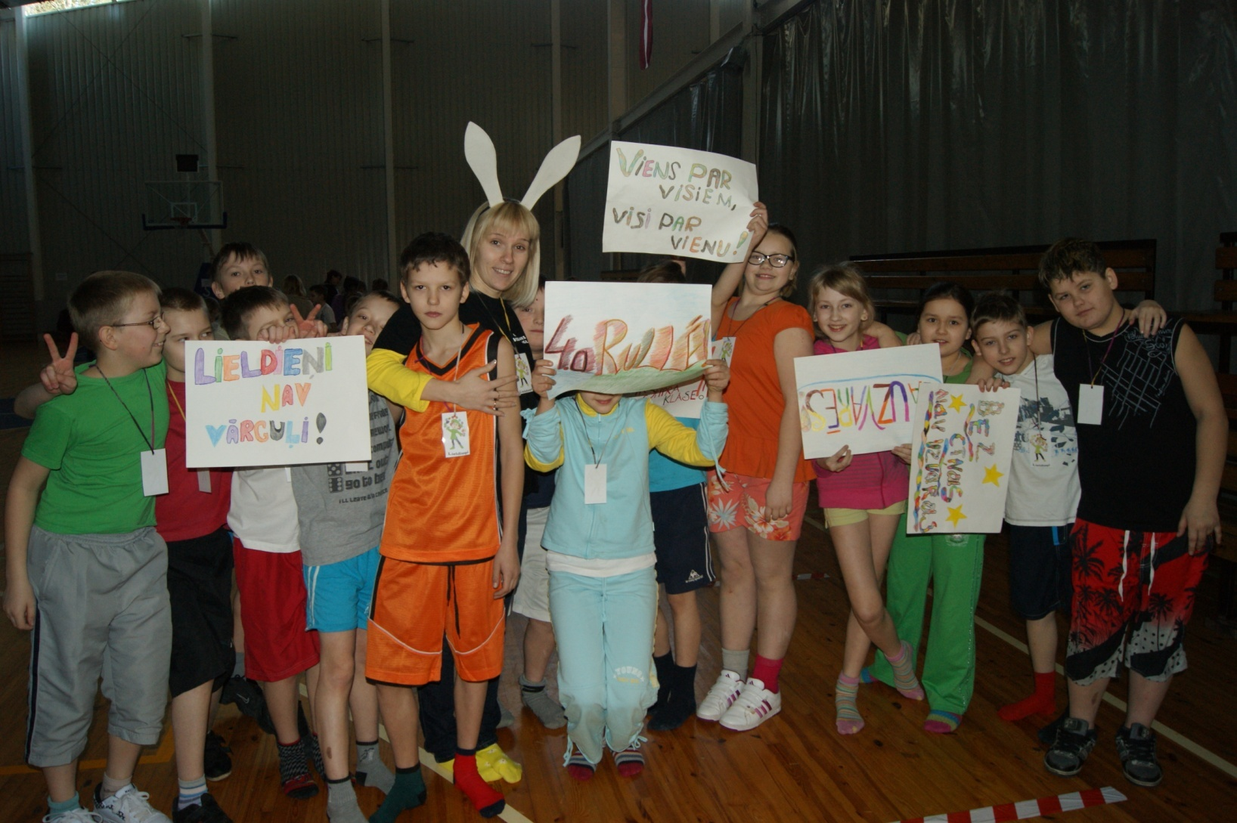
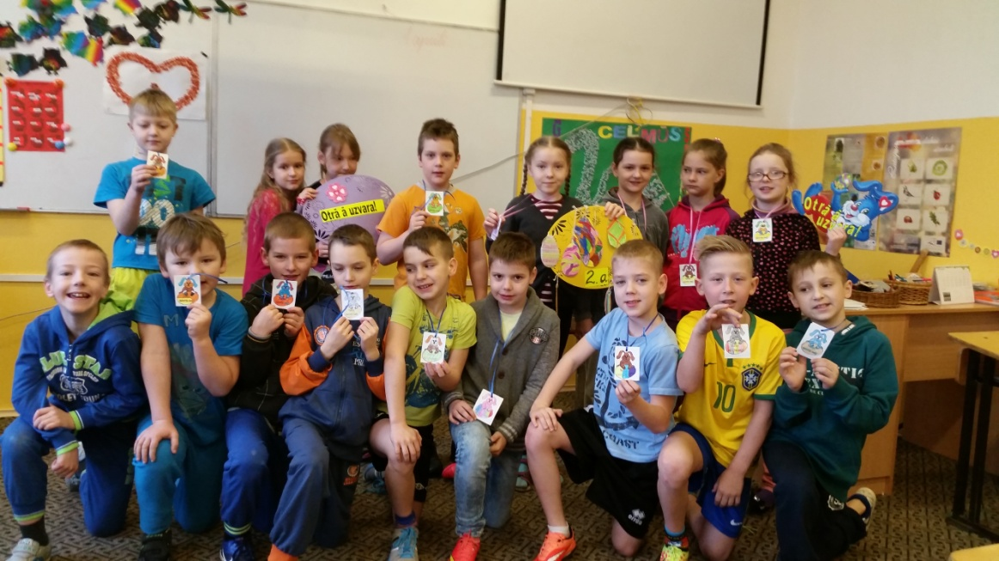
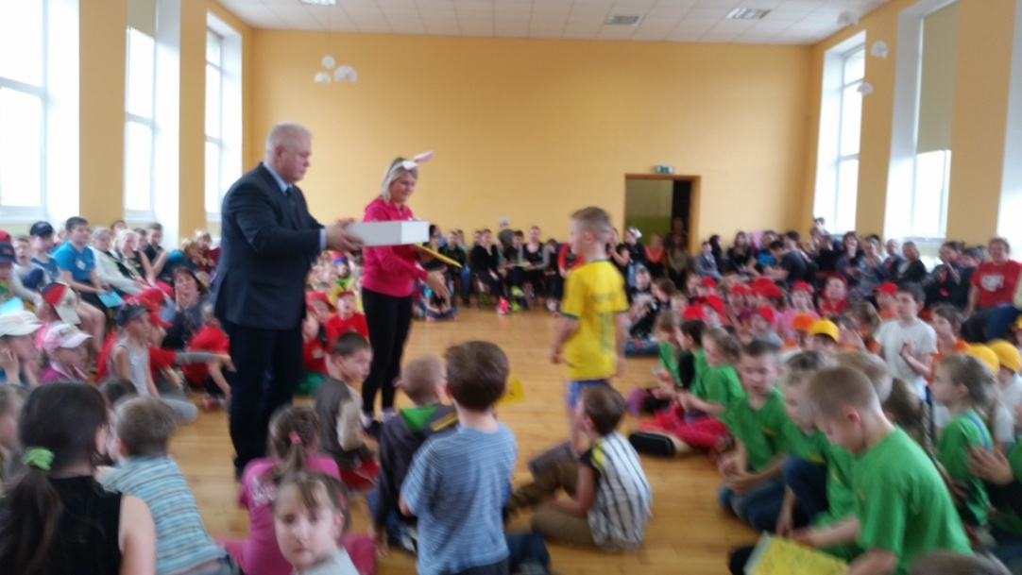
Easter

Slide 15
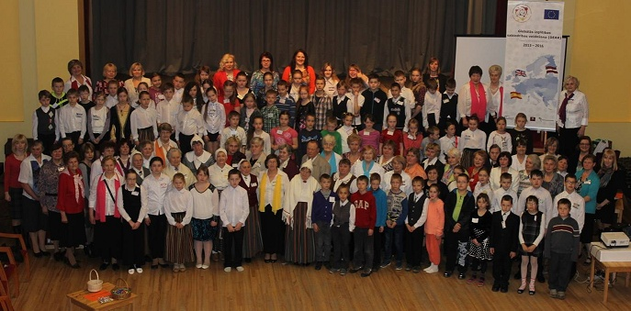
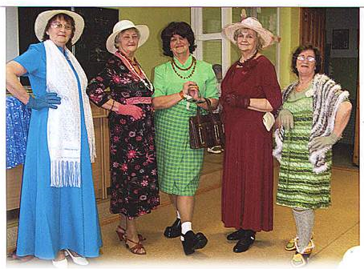
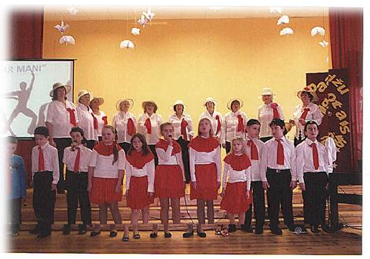
Intergenerational cooperation

Slide 16
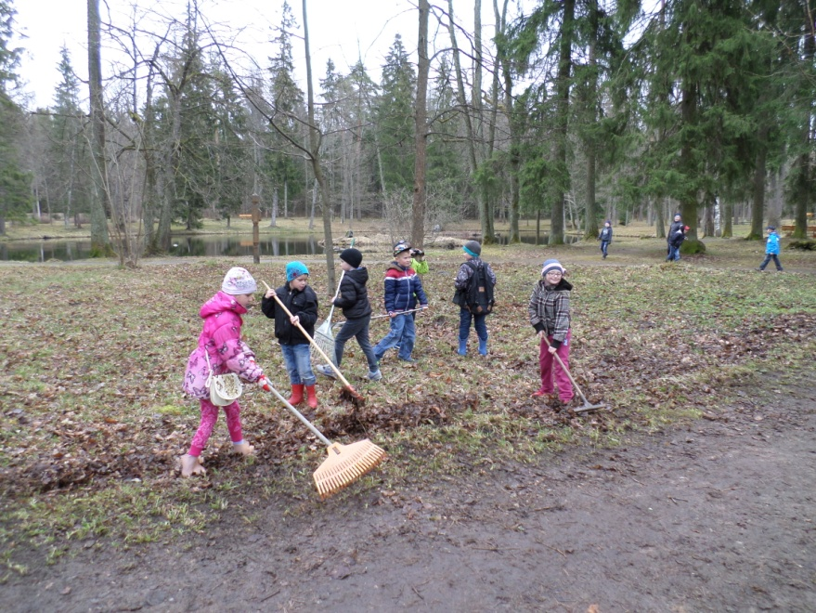
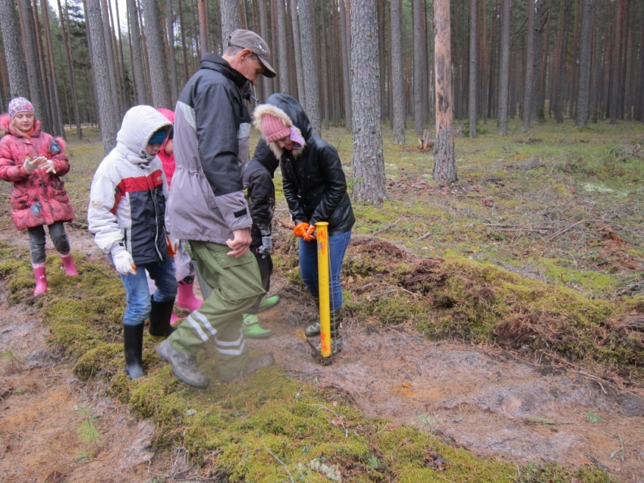
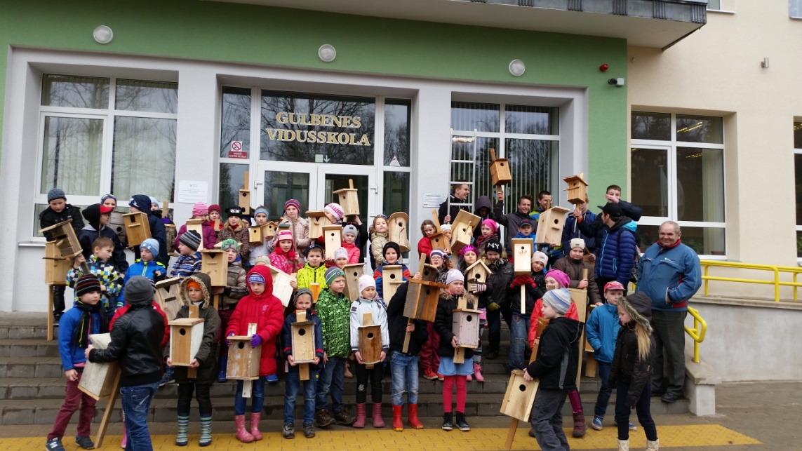
Mom Nature Embassy

Slide 17
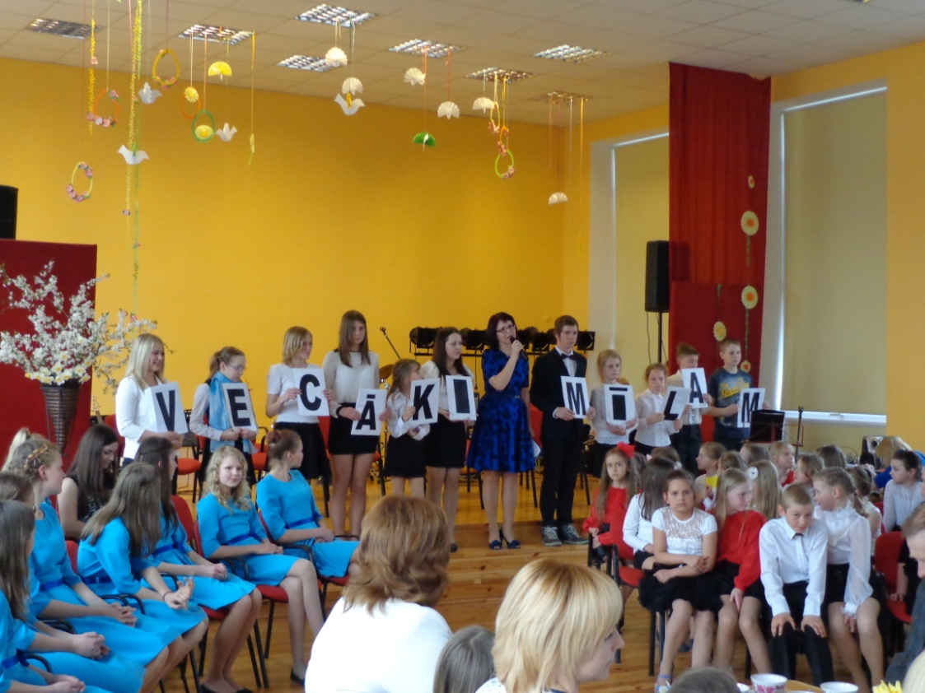
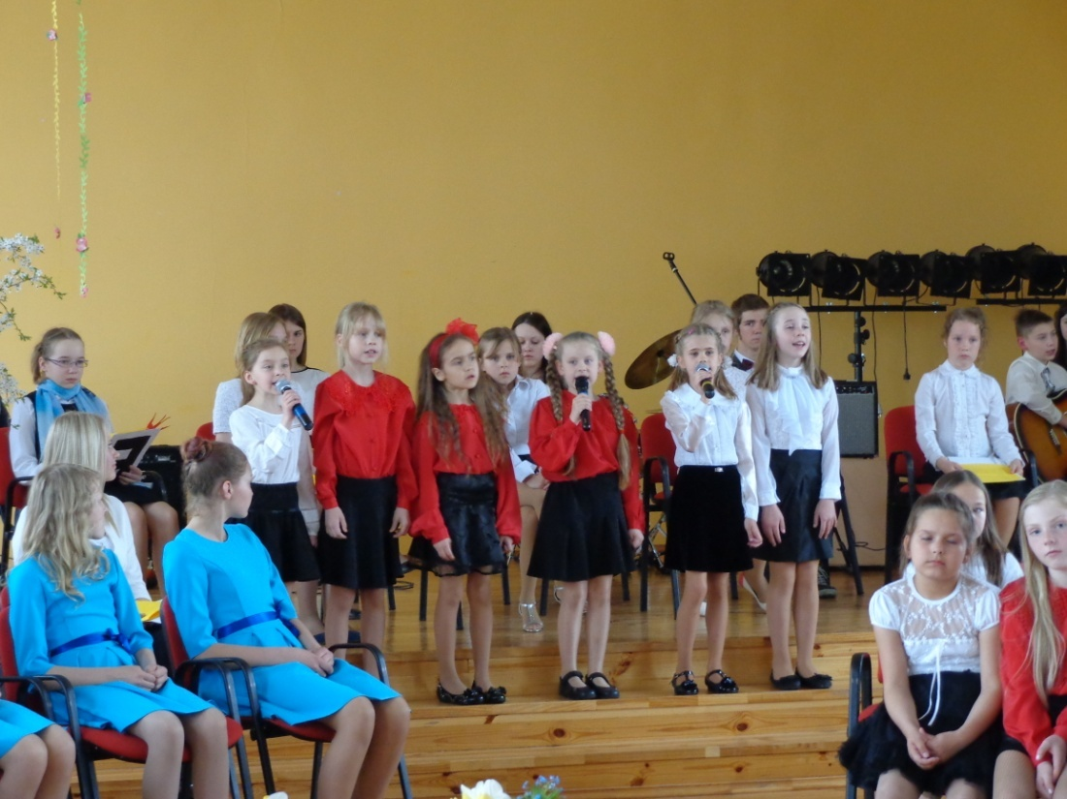
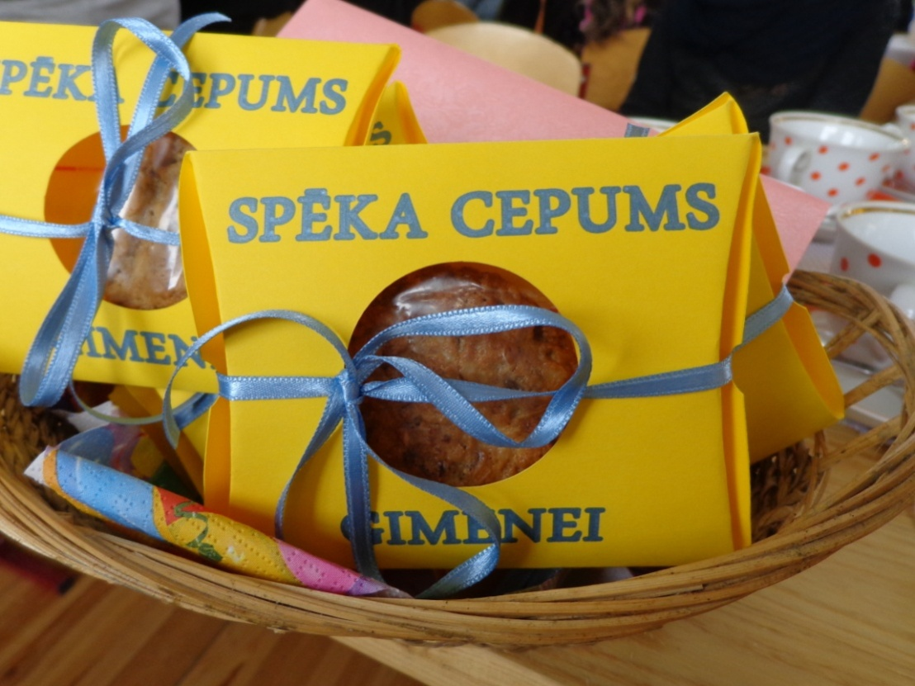
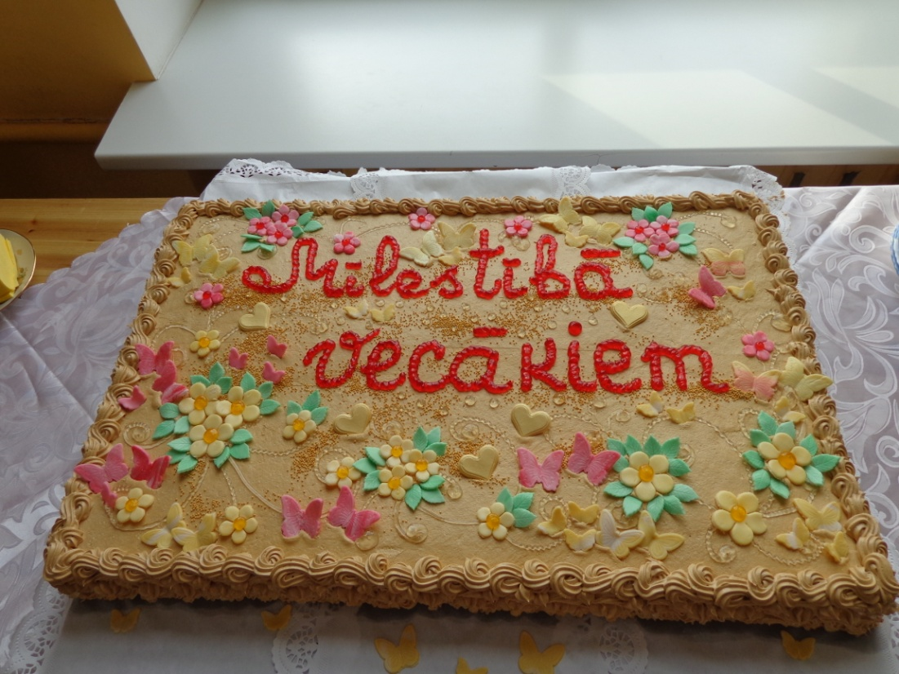
Family day

Slide 18
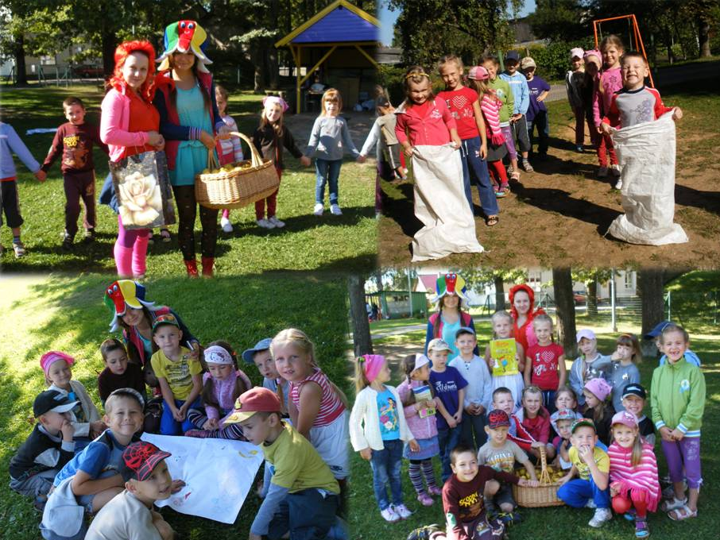
Students’ self-government

Slide 19
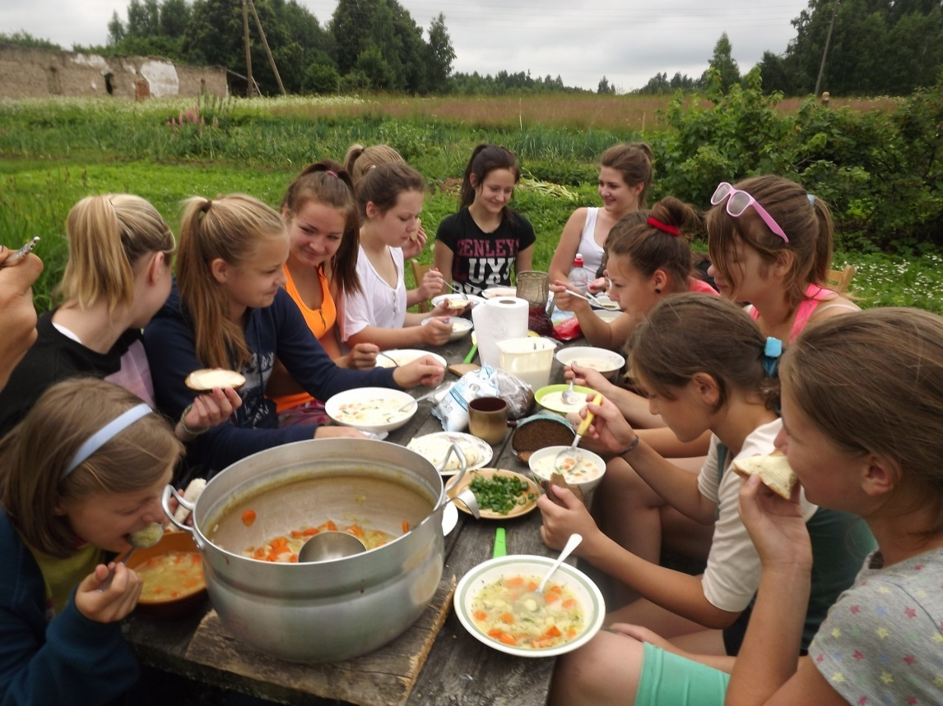
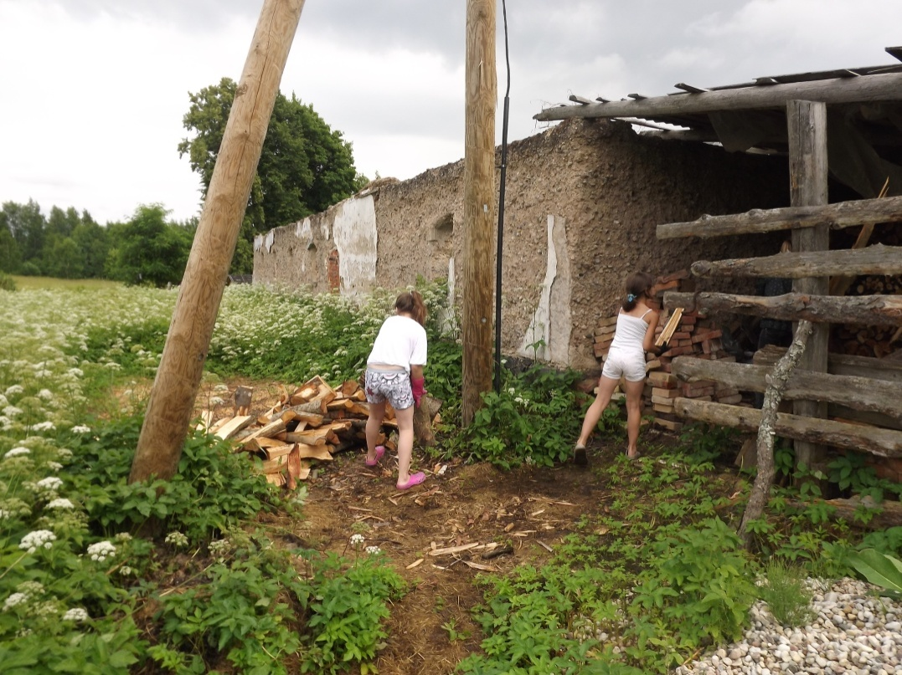
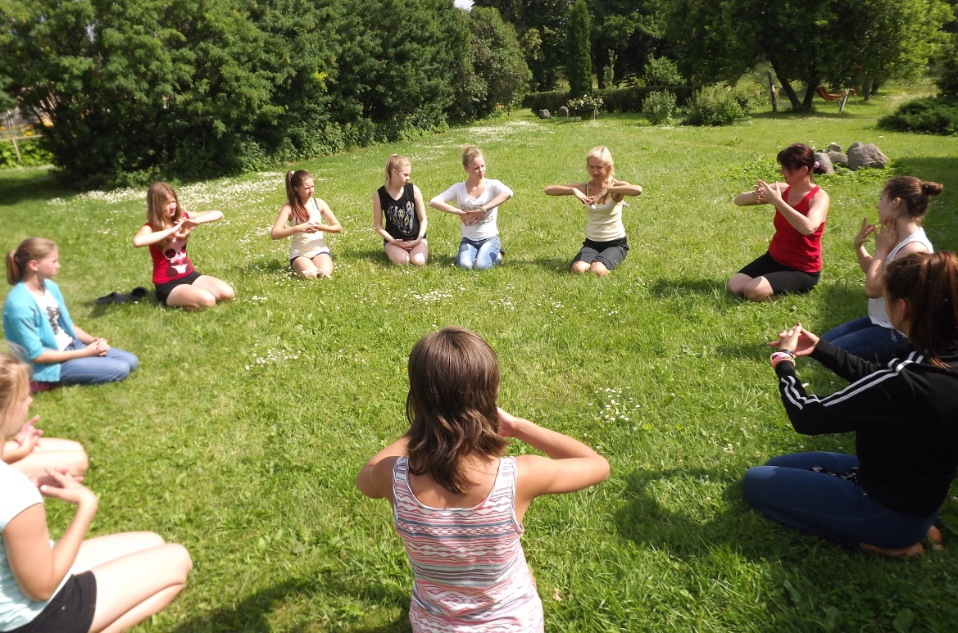
In the countryside

Slide 20
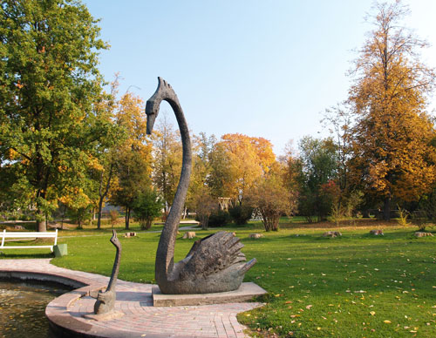
Our school is located in
town Gulbene
The symbol of Gulbene is swan.

Slide 21
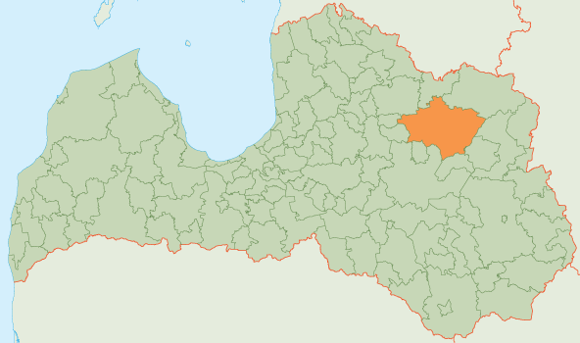
Gulbene town is located in Northeast Latvia – 186 km from capital city Riga.
Population: 8000
Gulbene town is the center of Gulbene district, which consist of 13 parishes.
Population of Gulbene district: 24 000

Slide 22
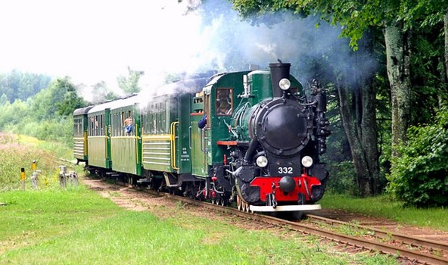
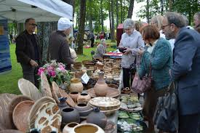
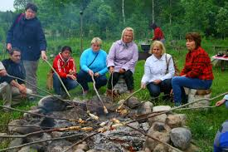

Slide 23
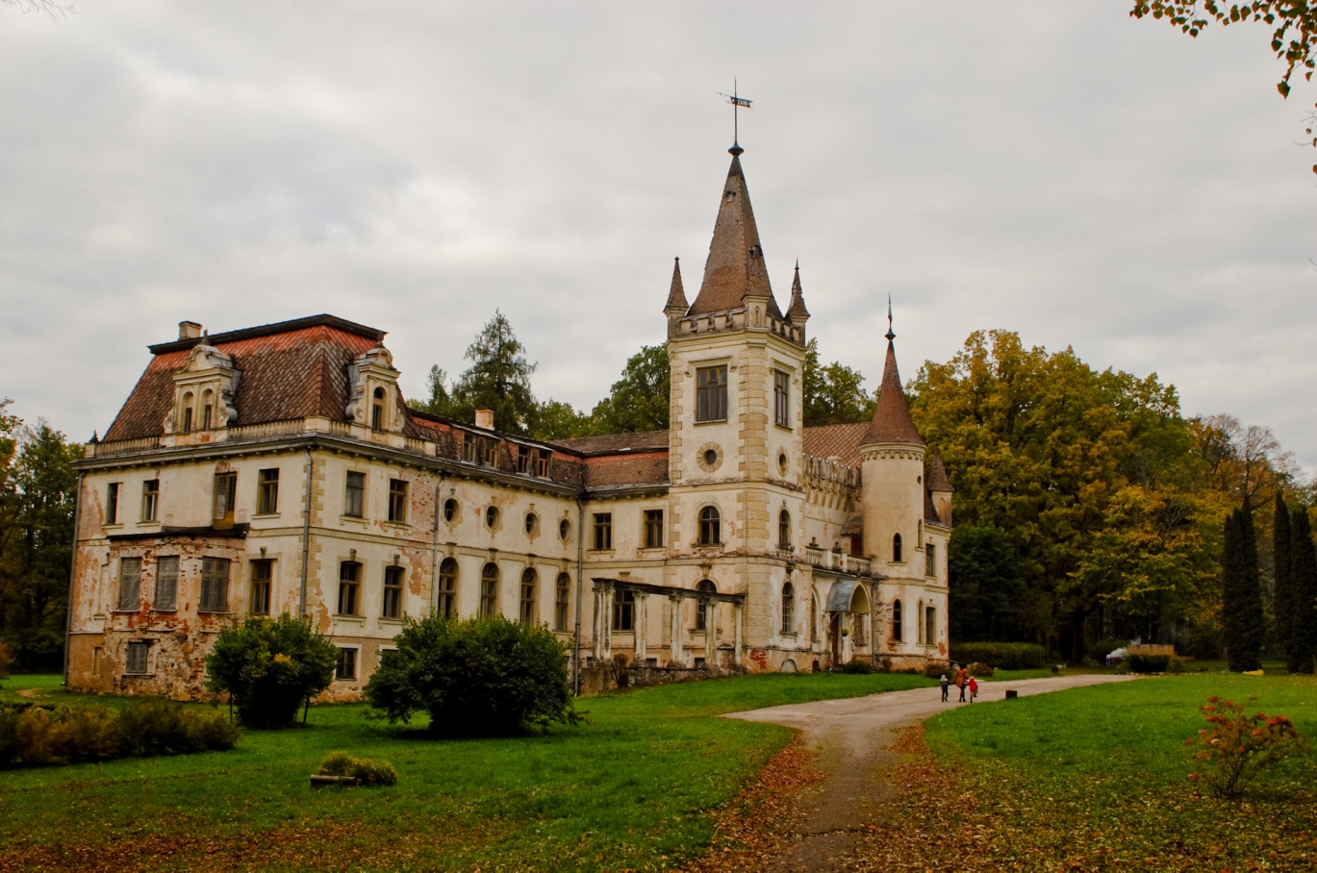
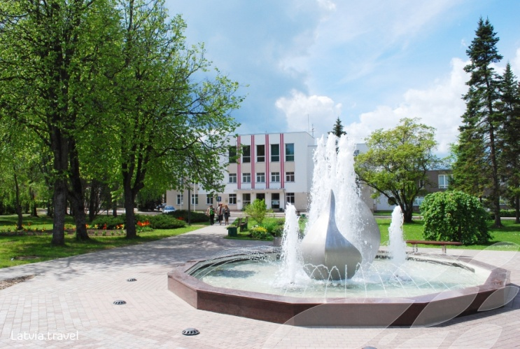
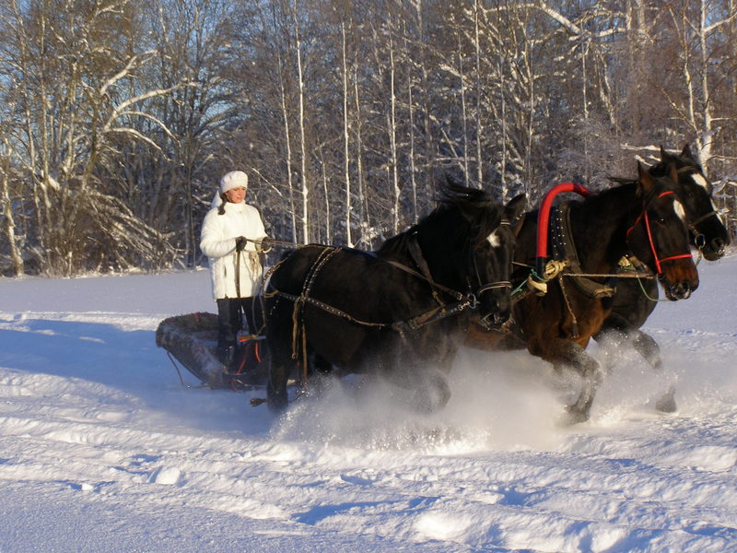
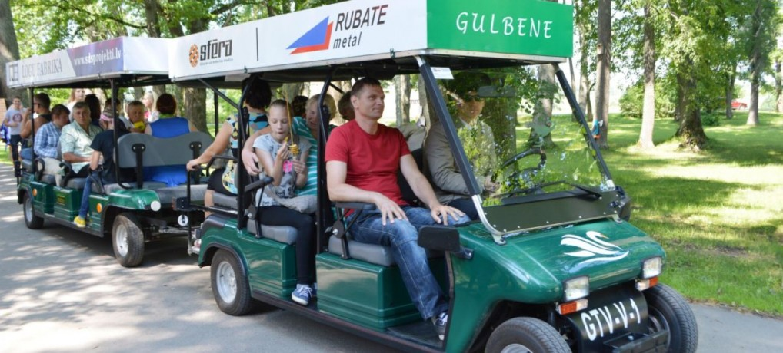

Slide 24
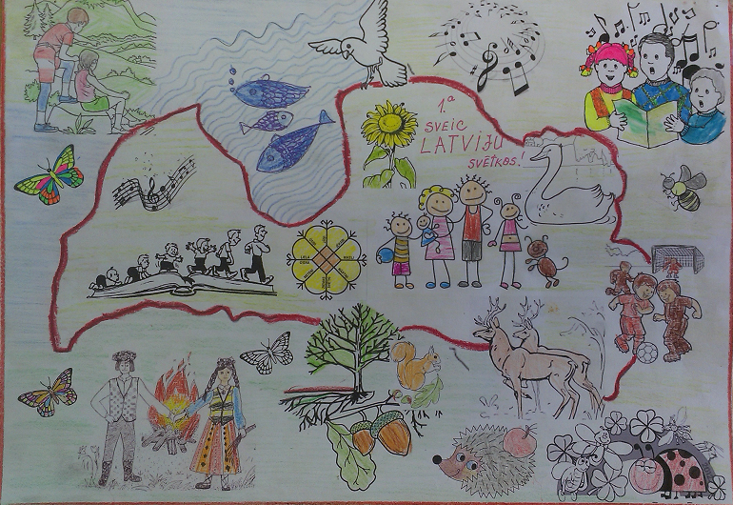
Our country is Latvia

Slide 25
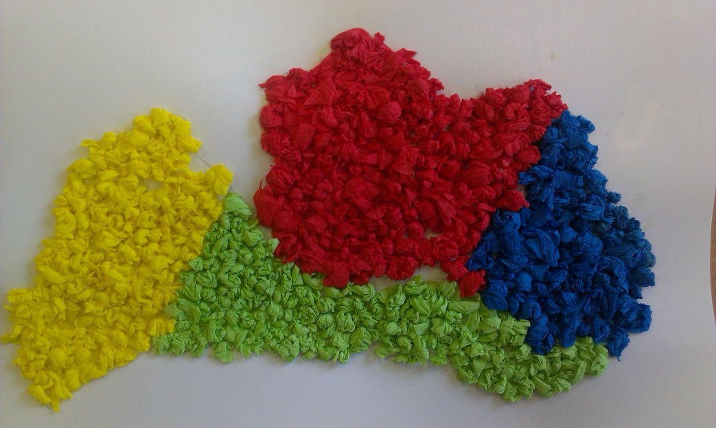
Welcome to Latvia!
To watch the video, please, click on the map of Latvia!

Slide 26
Thanks for watching!
See you! ☺

