Slide 1
Hands on clil
Slovakia, Spain, Portugal, Turkey

Slide 2
v
y

Slide 3
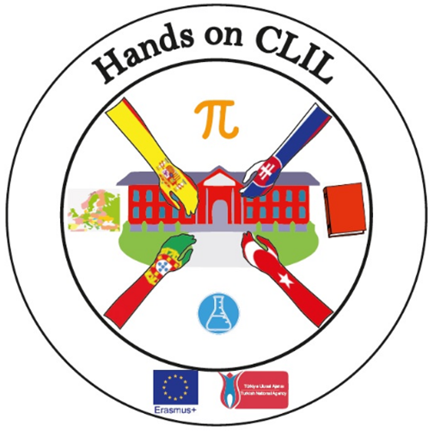
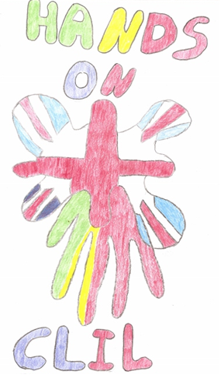
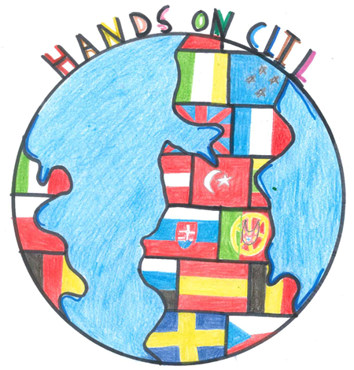
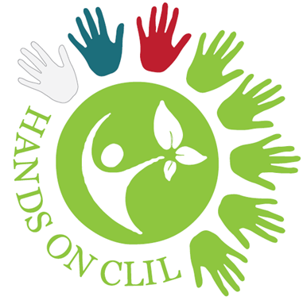
v
y

Slide 4
CLIL stands for Content and Language Integrated Learning and refers to teaching subjects such as science, history and geography to students through a foreign language. Learn more here.
The term CLIL was coined by David Marsh, University of Jyväskylä, Finland (1994):
However, CLIL teaching has been practised for many years, from the Babylonian era to the early sixties when bi-lingual education was introduced in many schools around the world. Even if you are unaware of the term CLIL, you may already have been using CLIL methodology for many years.

Slide 5
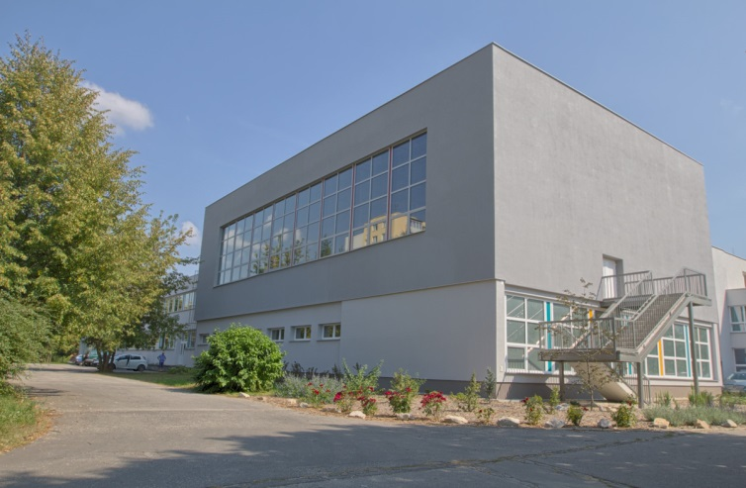
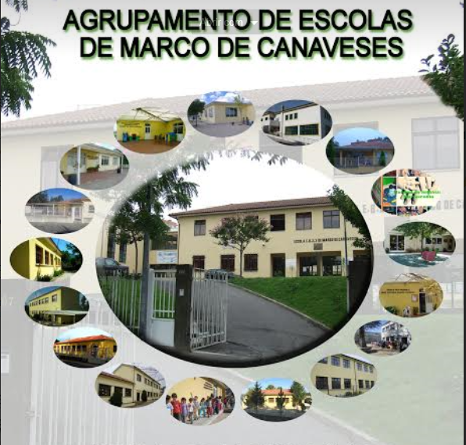
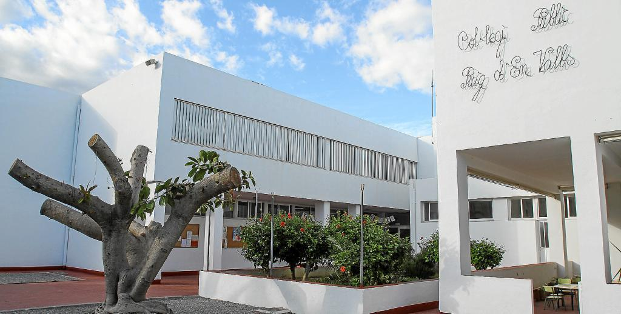

Slide 6
